Slide 1

Understanding
James 2:14-26
Part 1
Notes:
Part 1: James 2:14-17
Part 2 James 2:18-26

Slide 2
James 2
¹⁴ What does it profit, my brethren, if someone says he has faith but does not have works? Can faith save him? ¹⁵ If a brother or sister is naked and destitute of daily food, ¹⁶ and one of you says to them, “Depart in peace, be warmed and filled,” but you do not give them the things which are needed for the body, what does it profit? ¹⁷ Thus also faith by itself, if it does not have works, is dead.
Notes:
James 2:14-26
¹⁴ What does it profit, my brethren, if someone says he has faith but does not have works? Can faith save him? ¹⁵ If a brother or sister is naked and destitute of daily food, ¹⁶ and one of you says to them, “Depart in peace, be warmed and filled,” but you do not give them the things which are needed for the body, what does it profit? ¹⁷ Thus also faith by itself, if it does not have works, is dead.

Slide 3
James 2
¹⁸ But someone will say, “You have faith, and I have works.” Show me your faith without your works, and I will show you my faith by my works. ¹⁹ You believe that there is one God. You do well. Even the demons believe–and tremble! ²⁰ But do you want to know, O foolish man, that faith without works is dead? ²¹ Was not Abraham our father justified by works when he offered Isaac his son on the altar? ²² Do you see that faith was working together with his works, and by works faith was made perfect?
Notes:
¹⁸ But someone will say, “You have faith, and I have works.” Show me your faith without your works, and I will show you my faith by my works. ¹⁹ You believe that there is one God. You do well. Even the demons believe–and tremble! ²⁰ But do you want to know, O foolish man, that faith without works is dead? ²¹ Was not Abraham our father justified by works when he offered Isaac his son on the altar? ²² Do you see that faith was working together with his works, and by works faith was made perfect?

Slide 4
James 2
²³ And the Scripture was fulfilled which says, “Abraham believed God, and it was accounted to him for righteousness.” And he was called the friend of God. ²⁴ You see then that a man is justified by works, and not by faith only. ²⁵ Likewise, was not Rahab the harlot also justified by works when she received the messengers and sent them out another way? ²⁶ For as the body without the spirit is dead, so faith without works is dead also.
Notes:
²³ And the Scripture was fulfilled which says, “Abraham believed God, and it was accounted to him for righteousness.” And he was called the friend of God. ²⁴ You see then that a man is justified by works, and not by faith only. ²⁵ Likewise, was not Rahab the harlot also justified by works when she received the messengers and sent them out another way? ²⁶ For as the body without the spirit is dead, so faith without works is dead also.

Slide 5
Introduction
Roman Catholics claim that:
The Epistle of James is the Achilles Heel of the Reformation.
James is proof that faith plus good works results in salvation.
Notes:
James 2:14-26 is one of the most misunderstood texts in the Bible.
Roman Catholics do not understand the book of James. They claim that:
The Epistle of James is the Achilles Heel of the Reformation.
James is proof that faith plus good works results in salvation.
If these claims are true, then James contradicts the Apostle Paul who clearly taught that eternal salvation is by faith alone in Christ alone.

Slide 6
Introduction
Martin Luther:
Questioned the canonicity of James.
Felt that James contradicted Paul.
Called James “an epistle of straw and destitute of evangelic character.”
Notes:
Martin Luther did not understand the book of James.
He questioned the canonicity of James.
He felt that James contradicted Paul’s teaching on salvation by grace.
He said that it was “an epistle of straw and destitute of evangelic character.”

Slide 7
Introduction
Reformed Theology:
Uses James to add works to salvation by grace.
Claims that an absence of good works is proof of an unsaved condition.
Insists that “intellectual” faith is not a “saving faith.”
Notes:
Reformed theologians and Lordship Salvation teachers do not understand the book of James.
They use James to add works to salvation by grace.
They claim that an absence of good works is proof of an unsaved condition.
They insist that “intellectual” faith is not a “saving faith.”
Note: Even within non-Reformed circles today, this interpretation is popular.

Slide 8
Introduction
Three Protestant Views:
1) Refers to a person who was a believer but has lost his salvation.
Notes:
Three Views of James held by Protestants:
1) This section refers to a person who was a believer but has lost his salvation. (Arminian view)

Slide 9
Introduction
Three Protestant Views:
2) Refers to an unbeliever who professes to be a Christian but has never really had saving faith in Christ.
Notes:
Three Views of James held by Protestants:
2) This section refers to an unbeliever who professes to be a Christian but has never really had saving faith in Christ. (Calvinistic view)

Slide 10
Introduction
Three Protestant Views:
3) Refers to a believer who is not living by faith. He is not behaving consistently with what he believes.
Notes:
Three Views of James held by Protestants:
3) This section refers to a believer who is not living by faith. He is not behaving consistently with what he believes.

Slide 11
The Purpose
1) That the faith spoken of in James 2:14 is the faith of a Christian.
  a. It is not the “initial” faith of the unsaved in response to the Gospel.
  b. It is not simply an “intellectual” faith which does not save.
Notes:
The Purpose
We will show from the text and context:
1) That the faith spoken of in James 2:14 is the faith of a Christian.
a. It is not the “initial” faith of an unsaved sinner in response to the Gospel.
b. It is not simply an “intellectual” type of faith which theologians claim does not save.

Slide 12
The Purpose
2) That James is not addressing the eternal destiny of his readers.
He is addressing their profitability and productivity in this life.
Notes:
The Purpose
We will show:
2) James is not addressing the eternal destiny of his readers. Instead, he is addressing their profitability and productivity in this life.

Slide 13
The Purpose
3) That the intention of James is to encourage believers to practice their faith through good works.
Notes:
The Purpose
We will show:
3) That the intention of James is to encourage believers to practice their faith through good works.

Slide 14
The Purpose
4) That believers should not minimize good works, nor make them irrelevant.
Notes:
The Purpose
We will show:
4) That believers should not minimize good works, nor make them irrelevant.

Slide 15
The Purpose
5) That James and Paul agree:
  a. Justification before God is through faith alone by means of grace.
  b. Justification before men is through works produced by the Holy Spirit.
Notes:
The Purpose
We will show:
5) That James and Paul are in complete agreement:
a. Justification before God is through faith alone by means of God’s unmerited grace.
b. Justification before men is through works produced by means of the Holy Spirit.

Slide 16
The Problem
Incorrect assumptions:
  James is speaking about salvation from hell.
  James is addressing the eternal destiny of man.
Notes:
The Problem:
Theologians make incorrect assumptions:
They think that James is speaking about salvation from hell.
They assume that he is addressing the eternal destiny of man.

Slide 17
The Problem
Incorrect assumptions:
  James is dealing with justification in the forensic sense.
    Forensic Justification: God declares believers righteous based on their faith in the finished work of Christ.”
Notes:
The Problem:
Theologians make incorrect assumptions:
They presuppose that James is dealing with justification in the forensic sense in which God declares believers righteous based on their faith in the finished work of Christ.

Slide 18


The Problem
Theologians misrepresent the teaching of James because they ignore the context of the passage.
Notes:
The Problem:
Theologians misrepresent the teaching of James because they ignore the context of the passage.

Slide 19
The Problem
Theologians force the text to harmonize with Paul’s view of justification when in reality James is speaking of a different kind of justification.
Justification according to
Paul
Justification according to
James
Notes:
The Problem:
They force the text to harmonize with Paul’s view of justification when in reality James is speaking of a different kind of justification.

Slide 20

The Problem
Theologians attempt to pound their square peg of theological presuppositions into the round hole of God’s Word.
Notes:
The Problem:
They attempt to pound their square peg of theological presuppositions into the round hole of God’s Word.

Slide 21
The Scope of Salvation
Three tenses of salvation:
  1) Past Tense—Justification:
      Deliverance from the penalty of sin which is eternal separation from God.
Notes:
In Feb 2023, I did a message on the 3 tenses of salvation.
1) Past Tense (Justification): Deliverance from the penalty of sin which is eternal separation from God.

Slide 22
The Scope of Salvation
Three tenses of salvation:
  2) Present Tense—Sanctification:
      Deliverance from the power of sin in the present life.
Notes:
2) Present Tense—Sanctification: Deliverance from the power of sin in the present life.

Slide 23
The Scope of Salvation
Three tenses of salvation:
  3) Future Tense—Glorification:
      Deliverance from the presence of sin in the future glorified state.
Notes:
3) Future Tense—Glorification: Deliverance from the presence of sin in the future glorified state.

Slide 24
The Scope of Salvation
Failure to distinguish the 3 tenses of salvation results in confusion.
Past
Tense
Salvation
(Justification)
Present
Tense
Salvation
(Sanctification)
Future
Tense
Salvation
(Glorification)
Notes:
Confusion results when we do not distinguish between these three aspects of salvation. When we read “saved” or “salvation” in scripture we typically think that it means “salvation from hell.” But that is only one aspect of salvation. In fact, a reader of the Bible in the first century would NOT automatically jump to that conclusion.

Slide 25

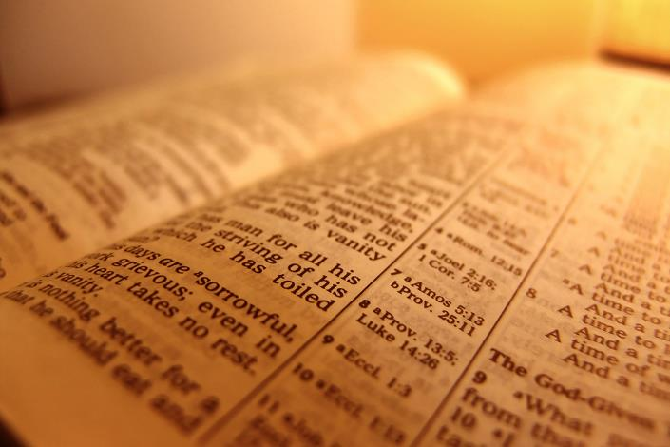
What does it mean to be saved?
Notes:
What does it mean to be saved?
As we consider what the Bible has to say about salvation, we need to ask a basic question: What does it mean to be saved? There are different types of salvation mentioned in the Bible. If we do not understand that truth, we will end up totally confused.

Slide 26

Context Determines Meaning
“Are you save?”
“Saved from what?”
  A drowning man is saved when he is rescued from the water and his physical life is spared.
Notes:
If you were asked, “Are you saved?” a good question would be: “Saved from what?” In other words, “What kind of salvation are you referring to?”
• If a drowning man is “saved,” he might be rescued from the water and his physical life is spared.

Slide 27

Context Determines Meaning
“Are you save?”
“Saved from what?”
  A man facing bankruptcy is saved when he is delivered from financial ruin.
Notes:
• If a man is “saved” from financial ruin, he might be delivered from bankruptcy.

Slide 28

Context Determines Meaning
“Are you save?”
“Saved from what?”
  A couple’s marriage is saved when they decide not to get divorced.
Notes:
• If a couple’s marriage is saved, they are spared the heartbreak of divorce.

Slide 29
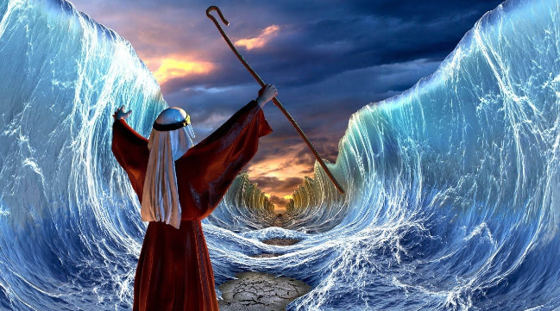
Context Determines Meaning
Ask: “Salvation from what?”
And Moses said to the people, “Do not be afraid. Stand still, and see the salvation of the LORD.” –Ex. 14:13
Notes:
As we read about salvation in the Bible, it is a good idea to ask, “salvation from what?” The context determines what type of salvation is being referred to in each passage. Recognizing the context of a verse is crucial to its proper interpretation.
And Moses said to the people, “Do not be afraid. Stand still, and see the salvation of the LORD.” –Ex. 14:13

Slide 30

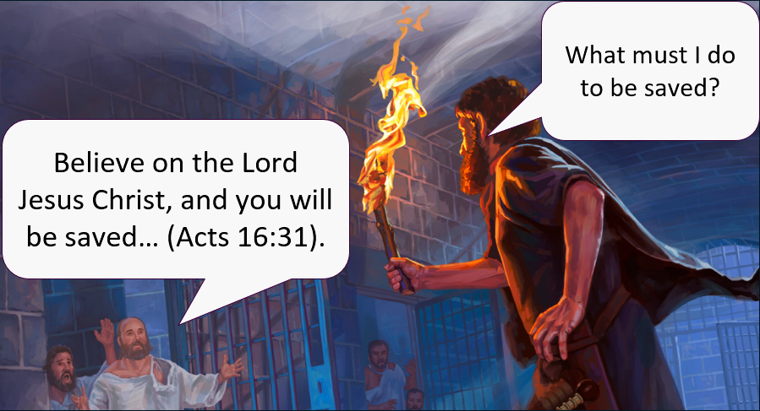
Physical vs Spiritual Salvation
And Moses said to the people, “Do not be afraid. Stand still, and see the salvation of the LORD.”
–Ex. 14:13
Spiritual Salvation
Physical Salvation
Notes:
Moses was not talking about how to be saved from hell! In contrast, Paul and Silas told the Philippian jailer how he could be saved from the penalty of his sins.
Depending on the context, salvation may refer to either 1) physical salvation or 2) spiritual salvation. There is a distinction between physical and spiritual salvation in God’s Word.

Slide 31
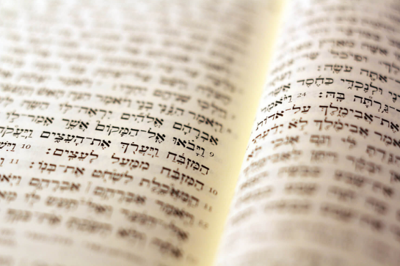
Physical vs Spiritual Salvation
Old Testament
Deliverance from physical enemies:
O LORD my God, in You I put my trust; Save me from all those who persecute me; And deliver me. –Ps. 7:1
Notes:
In the Old Testament, salvation primarily refers to deliverance from physical danger. For example:
Deliverance from physical enemies:
Ps. 7:1 O LORD my God, in You I put my trust; Save me from all those who persecute me; And deliver me.

Slide 32
Physical vs Spiritual Salvation
Old Testament
Deliverance from physical troubles:
Though I walk in the midst of trouble … Your right hand will save me. –Ps. 138:7
Notes:
Deliverance from physical troubles:
Ps. 138:7 Though I walk in the midst of trouble … Your right hand will save me.

Slide 33
Physical vs Spiritual Salvation
Old Testament
Deliverance from physical death:
… And Michal, David’s wife, told him, saying, “If you do not save your life tonight, tomorrow you will be killed.”
–1 Sam. 19:11
Notes:
Deliverance from physical death:
1 Sam. 19:11 Saul also sent messengers to David’s house to watch him and to kill him in the morning. And Michal, David’s wife, told him, saying, “If you do not save your life tonight, tomorrow you will be killed.”
In the Old Testament, salvation rarely, means spiritual salvation.

Slide 34
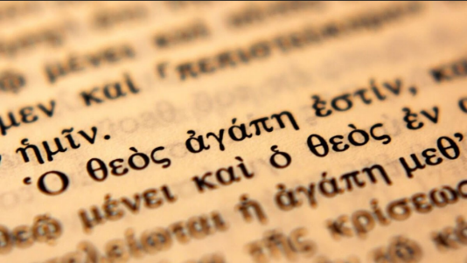
Physical vs Spiritual Salvation
New Testament
Notes:
In the New Testament, some passages of scripture are debatable as to whether the author is referring to physical salvation or spiritual salvation. But even if we conceded that all of those debatable passages referred to spiritual salvation, at least 55% of the time salvation refers to deliverance from a temporal difficulty such as death, disease, or a meaningless life (See Joseph Dillow; A Defense of Free Grace Theology).

Slide 35
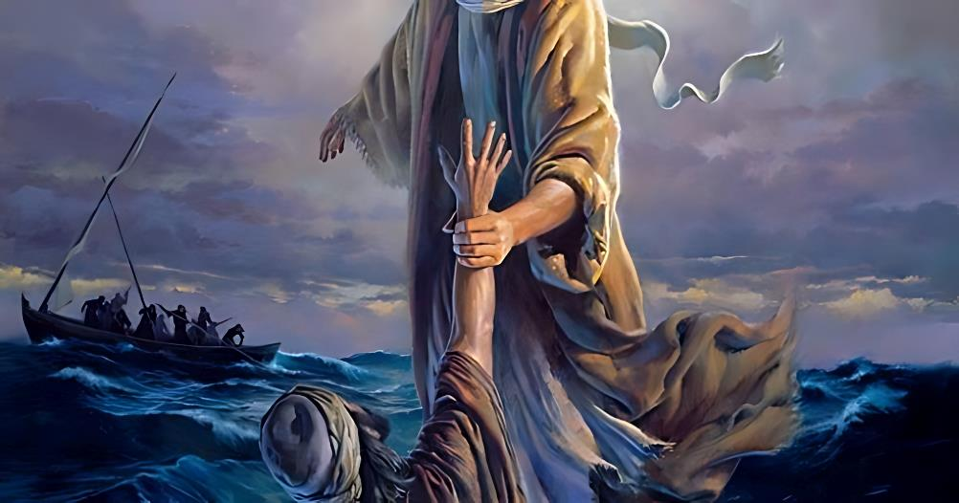
Physical vs Spiritual Salvation
Beginning to sink he cried out, saying, “Lord, save me!”
Notes:
The shortest prayer in the Bible was spoken by Peter.
Mt. 14:29-30 And when Peter had come down out of the boat, he walked on the water to go to Jesus. But when he saw that the wind was boisterous, he was afraid; and beginning to sink he cried out, saying, “Lord, save me!”
What happened here? Peter recognized that he was a lost sinner on his way to hell. So, he asked the Lord Jesus to save him from the penalty of his sins. Right?
Not at all! Peter recognized that he was about to die. So, he asked the Lord Jesus to save him from physically drowning.
Much confusion can be avoided by understanding that many times in the New Testament the authors are not speaking of spiritual salvation, but rather physical salvation. This is especially true regarding James chapter 2.

Slide 36
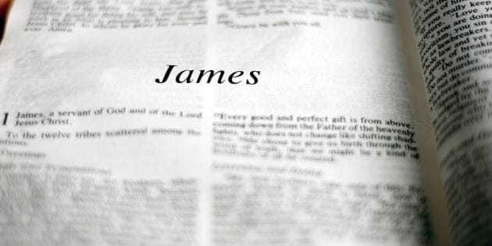
Examining the Biblical Text
Notes:
Transition: With this background, we can begin to examine the text to see what James actually means.

Slide 37
James 2:14
What does it profit, my brethren, if someone says he has faith but does not have works? Can faith save him? (2:14)
Question: Save from what?
Notes:
What does it profit, my brethren, if someone says he has faith but does not have works? Can faith save him? (2:14)
We need to ask: “save from what?”
The word save is used five times in James. Unless 2:14 is an exception, James never used the word save in reference to salvation from eternal damnation.
James 1:21, 2:14, 4:12, 5:15, 5:20

Slide 38
James 2:14 — The Text & Its Context
What does it profit, my brethren, if someone says he has faith but does not have works? Can faith save him? (2:14)
Question: Who is James addressing?
Notes:
What does it profit, my brethren, if someone says he has faith but does not have works? Can faith save him? (2:14)
Question #1a: Who is James addressing in the immediate context of 2:14?

Slide 39
James 2:14 — The Text & Its Context
What does it profit, my brethren, if someone says he has faith but does not have works? Can faith save him? (2:14)
Question: Who is James addressing?
Notes:
Answer: He is addressing “my brethren.”

Slide 40
James 2:14 — The Text & Its Context
What does it profit, my brethren, if someone says he has faith but does not have works? Can faith save him? (2:14)
Question: Who are “my brethren”?
Notes:
Question: Who are “my brethren”?

Slide 41
James 2:14 — The Text & Its Context
James is addressing:
  Fellow Christians who are saved.
  Fellow Jews who may or may not be saved.
Notes:
Two options:
James is addressing “fellow Christians” or
James is addressing fellow Jews who may or may not be saved.
The first rule of Bible interpretation is to examine the context. We begin by looking at the immediate context. In this case, we are left with 2 options. So, what are we to do? The next step is to examine the broader context. We need to ask…

Slide 42
James 2:14 — The Text & Its Context
Question: Who is James addressing elsewhere?
    James 1:2-3 My brethren, count it all joy when you fall into various trials, knowing that the testing of your faith produces patience.
Notes:
Question #1b: Who is James addressing in the broader context of his letter?
James 1:2-3 My brethren, count it all joy when you fall into various trials, knowing that the testing of your faith produces patience.
Observation: These people had faith. It does not seem likely that James would be telling unsaved Jews that the testing of their faith would produce patience.

Slide 43
James 2:14 — The Text & Its Context
Question: Who is James addressing elsewhere?
    James 1:18 Of His own will He brought us forth by the word of truth, that we might be a kind of firstfruits of His creatures.
Notes:
James 1:18 Of His own will He brought us forth by the word of truth, that we might be a kind of firstfruits of His creatures.
Observation: James includes himself in those he is writing to.

Slide 44
James 2:14 — The Text & Its Context
Question: Who is James addressing elsewhere?
    James 2:1 My brethren, do not hold the faith of our Lord Jesus Christ, the Lord of glory, with partiality.
Notes:
James 2:1 My brethren, do not hold the faith of our Lord Jesus Christ, the Lord of glory, with partiality.
Observation: Clearly James is writing to Christian and not a mixed audience of the saved and unsaved.

Slide 45
James 2:14 — The Text & Its Context
Question: What is James asking his readers to do?
    James 1:12 Blessed is the man who endures temptation; for when he has been approved, he will receive the crown of life which the Lord has promised to those who love Him.
Notes:
Question #1c: In the broad context of his letter, what is James asking his readers to do?
James 1:12 Blessed is the man who endures temptation; for when he has been approved, he will receive the crown of life which the Lord has promised to those who love Him.

Slide 46
James 2:14 — The Text & Its Context
Question: What is James asking his readers to do?
    James 1:21 Therefore lay aside all filthiness and overflow of wickedness, and receive with meekness the implanted word, which is able to save your souls.
Notes:
James 1:21 Therefore lay aside all filthiness and overflow of wickedness, and receive with meekness the implanted word, which is able to save your souls (NKJV).
Observations:
James is asking his readers to follow a life-style that only Christians have the ability through the Holy Spirit to follow.
The expression “save your souls” cannot be talking about salvation from hell.

Slide 47
James 2:14 — The Text & Its Context
Question: What is James asking his readers to do?
    James 1:21 Therefore lay aside all filthiness and overflow of wickedness, and receive with meekness the implanted word, which is able to save your souls (ψυχή—psuchē; life).
Notes:
James 1:21 (NKJV) save your souls (ψυχή—psuchē; life).

Slide 48
James 2:14 — The Text & Its Context
Dr. Constable:
  Some interpreters have understood the phrase “which is able to save your souls” to imply that the souls of James’ readers still needed to experience salvation from eternal damnation. Yet the words James used and the context make clear that this is not what he meant.
Notes:
Dr. Constable:
Some interpreters have understood the phrase “which is able to save your souls” to imply that the souls of James’ readers still needed to experience salvation from eternal damnation. Yet the words James used and the context make clear that this is not what he meant.

Slide 49
James 2:14 — The Text & Its Context
Dr. Constable:
  “Save your lives” or “save your selves” is a better translation. I counted 40 instances in the New Testament where the translators of the AV rendered the Greek word psyche “life” rather than “soul.” By obeying God’s Word the believer can save his life, himself, from the consequences of sin.
Notes:
“Save your lives” or “save your selves” is a better translation. I counted 40 instances in the New Testament where the translators of the AV rendered the Greek word psyche “life” rather than “soul.” By obeying God’s Word the believer can save his life, himself, from the consequences of sin.

Slide 50
James 2:14 — The Text & Its Context
Observations:
  James is addressing believers.
  James is challenging them in their walk with the Lord.
  James is dealing with issues of sanctification and not justification.
Notes:
Observations:
Up to this point in his letter, James is addressing believers.
He is challenging them in their walk with the Lord.
He is dealing with issues of sanctification and not justification. In other words, James is addressing the 2nd tense of salvation and not the 1st tense of salvation.

Slide 51
James 2:14 — The Text & Its Context
Observations:
  These issues have nothing to do with unbelievers.
  These issues have everything to do with believers.
Notes:
Observations:
These issues have nothing to do with unbelievers.
These issues have everything to do with believers.

Slide 52
James 2:14 — The Text & Its Context
What does it profit, my brethren, if someone says he has faith but does not have works? Can faith save him? (James 2:14)
Question: In what sense can a believer be saved?
Notes:
What does it profit, my brethren, if someone says he has faith but does not have works? Can faith save him? (2:14)
Question #2: Since James is addressing Christians then in what sense can a believer be saved?

Slide 53
James 2:14 — The Text & Its Context
What does it profit, my brethren, if someone says he has faith but does not have works? Can faith save him? (James 2:14)
Therefore lay aside all filthiness and overflow of wickedness, and receive with meekness the implanted word, which is able to save your souls. (James 1:21)
Notes:
Compare this with:
James 1:21 Therefore lay aside all filthiness and overflow of wickedness, and receive with meekness the implanted word, which is able to save your souls (ψυχή—psuchē; life).
Note: Believers can be saved from temporal judgement. Believers can also be saved from an unproductive life.

Slide 54
James 2:14 — The Text & Its Context
Question:
Does a person have to have a special kind of faith in order to be saved?
Head Knowledge
Heart Knowledge
Mental Assent
Genuine Faith
Notes:
Question #3: Does James mean that a person must have a special kind of faith in order to be saved?
Some preachers say that some people will miss heaven by 18 inches—the distance between their head and their heart. They say that there is a difference between head-knowledge and heart-knowledge. In other words, one type of faith is mere mental assent which cannot save. Another type of faith is believing with the heart which results in salvation.

Slide 55
James 2:14 — The Text & Its Context
Question:
Does a person have to have a special kind of faith in order to be saved?
Saving Faith Equals Salvation
Spurious Faith Equals Damnation
Notes:
Some theologians speak of “saving faith.” They say that there is a type of faith which results in salvation and another type of faith which cannot save.
Is this what James is teaching?

Slide 56

James 2:14 — The Text & Its Context
Question:
Does the quality of a person’s faith determine their salvation?
Saving
Faith
By
Dave Breese
The Heresy
Is in the Adjectives
By
Dave Breese
Notes:
Question #4: Does the quality of a person’s faith determine their salvation?
Dave Breese addressed that issue in two articles that he wrote: Saving Faith & The Heresy Is in the Adjectives

Slide 57
James 2:14 — The Text & Its Context
Dave Breese:
  Incipient heresy may many times reside in the adjectival modifications to some good Christian words.
Notes:
Dave Breese:
Incipient heresy may many times reside in the adjectival modifications to some good Christian words.

Slide 58
James 2:14 — The Text & Its Context
Dave Breese:
  The expression “saving faith” should … concern us. There is, strictly speaking, no such thing as saving faith. This implies that the faith which saves us has some kind of a deeper quality than ordinary faith.
Notes:
The expression “saving faith” should … concern us. There is, strictly speaking, no such thing as saving faith. This implies that the faith which saves us has some kind of a deeper quality than ordinary faith.

Slide 59
James 2:14 — The Text & Its Context
Dave Breese:
  The adjective “saving” is now used by its proponents to teach that there is some special quality, depth or sincerity of faith which makes it “saving” faith. It is presented as faith that is “genuinely sincere,” “real” and the like.
Notes:
The adjective “saving” is now used by its proponents to teach that there is some special quality, depth or sincerity of faith which makes it “saving” faith. It is presented as faith that is “genuinely sincere,” “real” and the like.

Slide 60
James 2:14 — The Text & Its Context
Dave Breese:
  It is frequently defined as being “heart faith” rather than mere “head faith.” The implication is that the first will save and the second will not.
Notes:
It is frequently defined as being “heart faith” rather than mere “head faith.” The implication is that the first will save and the second will not.

Slide 61
James 2:14 — The Text & Its Context
Dave Breese:
  The fallacy is that faith is made real not by its “quality” but rather by its object.
Notes:
The fallacy is that faith is made real not by its “quality” but rather by its object.

Slide 62
James 2:14 — The Text & Its Context
Dave Breese:
  Faith is “real” or saving only, yes only, because it has the proper object. A “deep,” “genuine,” “high-quality” faith in a rotting rope ladder is worthless by comparison to a simple faith in a strong, solid staircase.
Notes:
Faith is “real” or saving only, yes only, because it has the proper object. A “deep,” “genuine,” “high-quality” faith in a rotting rope ladder is worthless by comparison to a simple faith in a strong, solid staircase.

Slide 63
James 2:14 — The Text & Its Context
Dave Breese:
  Yes, a flicker of faith (which may not be thought of as faith at all by its possessor) in a marble staircase is infinitely more valuable than a long, strong faith in aged hemp which has been eaten away by time.
Notes:
Yes, a flicker of faith (which may not be thought of as faith at all by its possessor) in a marble staircase is infinitely more valuable than a long, strong faith in aged hemp which has been eaten away by time.

Slide 64
James 2:14 — The Text & Its Context
Dave Breese:
  The “assumption” that the staircase will support your weight is better than the passionate, tear-stained, profound conviction that the rotting rope will hold you.
Notes:
The “assumption” that the staircase will support your weight is better than the passionate, tear-stained, profound conviction that the rotting rope will hold you.

Slide 65
James 2:14 — The Text & Its Context
How are we to understand the word “faith” as used in James 2:14?
Isn’t James is speaking about different “kinds” of faith?
Notes:
But you might ask, “how are we to understand the word “faith” as used in James 2:14? James is clearly speaking about different “kinds” of faith, isn’t he?
That is a valid question.

Slide 66
James 2:14 — The Text & Its Context
NASB & ESV: Can that faith save him?
NCV: Can faith like that save them?
NIV: Can such faith save him?
NET: Can this kind of faith save him?
EMTV: Is that kind of faith able to save him?
Notes:
Many translations of the Bible would lead us to believe that James is indeed describing different kinds of faith.
NASB & ESV: Can that faith save him?
NCV: Can faith like that save them?
NIV: Can such faith save him?
NET: Can this kind of faith save him?
EMTV: Is that kind of faith able to save him?
Note: Those words in italics are added by the translators.

Slide 67
James 2:14 — The Text & Its Context
KJV: Can faith save him?
NKJV: Can faith save him?
Literal NT Greek: Can faith save him?
Notes:
In Greek, it is literally “can faith save him?”
KJV & NKJV: Can faith save him?

Slide 68
James 2:14 — The Text & Its Context
Misleading:
  Can that kind of faith save him?
  Can such faith save him?
Notes:
To translate verse 14 as, “Can that kind of faith save him,” or, “Can such faith save him,” is extremely misleading and does harm to the text.

Slide 69
James 2:14 — The Text & Its Context
James 1:2-4:
  My brethren, count it all joy when you fall into various trials, knowing that the testing of your faith produces patience.
  My brethren, count it all joy when you fall into various trials, knowing that the testing of your kind of faith produces patience.
Notes:
The same construction exists in James 1:2-4. If we translate this verse by adding “kind” or “such” we end up confusing the reader.
My brethren, count it all joy when you fall into various trials, knowing that the testing of your faith produces patience.
<click>
My brethren, count it all joy when you fall into various trials, knowing that the testing of your kind of faith produces patience.

Slide 70
James 2:14 — The Text & Its Context
Correct:
  Can faith save him?
Misleading:
  Can that kind of faith save him?
  Can such faith save him?
Notes:
Unfortunately, translators of the Bible have inserted words into James 2:14 which are not in the Greek text. They thought that they were helping out their readers by making the text more understandable. However, they actually confused their readers by distorting what James was really intending to say. No doubt those translators had good intentions. But horrific roads have been paved with good intentions.
To translate verse 14 as, “Can that kind of faith save him,” or, “Can such faith save him,” is extremely misleading and does harm to the text.

Slide 71

James 2:14 — The Text & Its Context
What did James mean?
Was he teaching salvation by works?
Paul
James
Notes:
According to James 2:14, faith without works cannot save a person. But what did James actually mean when he wrote that? Was he teaching salvation by works? If James were dealing with the issue of “salvation from hell” then he was contradicting Paul.

Slide 72
James 2:14 — The Text & Its Context
  Past Tense: We were delivered from the penalty of sin.
  Present Tense: We are being delivered from the power of sin .
  Future Tense: We will be delivered from the presence of sin.
Notes:
But remember that there are three tenses of salvation:
1) Past Tense: We were delivered from the penalty of sin (eternal separation from God).
2) Present Tense: We are being delivered from the power of sin (in the present life).
3) Future Tense: We will be delivered from the presence of sin (in the future glorified state).

Slide 73
James 2:14 — The Text & Its Context
  Past Tense: We were delivered from the penalty of sin.
  Present Tense: We are being delivered from the power of sin.
  Future Tense: We will be delivered from the presence of sin.
Notes:
James was not dealing with the Past Tense aspect of salvation—deliverance from the penalty of sin.

Slide 74
James 2:14 — The Text & Its Context
  Past Tense: We were delivered from the penalty of sin.
  Present Tense: We are being delivered from the power of sin.
  Future Tense: We will be delivered from the presence of sin.
Notes:
James was not dealing with the Future Tense aspect of salvation—deliverance from the presence of sin.

Slide 75
James 2:14 — The Text & Its Context
  Past Tense: We were delivered from the penalty of sin.
  Present Tense: We are being delivered from the power of sin.
  Future Tense: We will be delivered from the presence of sin.
Notes:
Instead, James was actually dealing with the Present Tense aspect of salvation—deliverance from the power of sin.

Slide 76

James 2:14 — The Text & Its Context
Works are never a condition for the Past Tense aspect of salvation.
Notes:
Works are never a condition for the Past Tense aspect of salvation.

Slide 77

James 2:14 — The Text & Its Context
Works are a condition for the Present Tense aspect of salvation.
Believers need to be delivered from things that might damage the soul or life (James 1:21).
Notes:
Works are a condition for the Present Tense aspect of salvation. As believers, we need to be delivered from things that might damage our soul or life (James 1:21).

Slide 78

James 2:14 — The Text & Its Context
Faith
Works
Plus
Equals Christian Growth
Notes:
Faith needs to be couple with works in order to grow in this Christian life.

Slide 79

James 2:14 — The Text & Its Context
Christianity is not simply about talking the talk.
It includes walking the walk.
Notes:
Christianity is not simply about talking the talk. It includes walking the walk.

Slide 80

James 2:14 — The Text & Its Context
Faith without works cannot protect the Christian from sin’s deadly consequences.
Notes:
Faith without works cannot protect the Christian from sin’s deadly consequences in this life.

Slide 81
James 2:14 — The Text & Its Context
For the Lord disciplines the one he loves and chastises every son he accepts.
-Hebrews 12:6
Notes:
Faith, by itself, cannot save a Christian from God’s discipline of him as a believer.
For the Lord disciplines the one he loves and chastises every son he accepts. -Hebrews 12:6

Slide 82

Faith
Works
Plus
Notes:
Good works in addition to faith are necessary for the Present Tense aspect of salvation—deliverance from the power of sin.

Slide 83
James 2:15-16 — Illustration of Barrenness
If a brother or sister is naked and destitute of daily food, and one of you says to them, “Depart in peace, be warmed and filled,” but you do not give them the things which are needed for the body, what does it profit?
James 2:15-16
Notes:
James 2:15-16 — Illustration of Barrenness
If a brother or sister is naked and destitute of daily food, and one of you says to them, “Depart in peace, be warmed and filled,” but you do not give them the things which are needed for the body, what does it profit? (2:15-16)
James is addressing believers and their good works or lack thereof.
He raises the issue of brothers and sisters in Christ who have unmet needs for the vital essentials of life.
James asks, “What profit (benefit/gain) is there in a faith that ignores the needs of others?”
In other words, how can the needy benefit from your faith which does not meet their needs?

Slide 84
James 2:15-16 — Illustration of Barrenness
Dr. Constable:
A benediction cannot save a starving man from death; only bread can do that.
Notes:
Dr. Constable: A benediction cannot save a starving man from death; only bread can do that.

Slide 85
James 2:17 — Dead Faith
Thus also faith by itself, if it does not have works, is dead.
James 2:17
Notes:
James 2:17 — Dead Faith
Thus also faith by itself, if it does not have works, is dead. (2:17)

Slide 86
James 2:17 — Dead Faith
What is “dead” faith?
And the LORD God commanded the man, saying, “Of every tree of the garden you may freely eat; but of the tree of the knowledge of good and evil you shall not eat, for in the day that you eat of it you shall surely die.”
Gen 2:16-17
Notes:
Question: What is “dead” faith?
Gen 2:16-17 And the LORD God commanded the man, saying, “Of every tree of the garden you may freely eat; but of the tree of the knowledge of good and evil you shall not eat, for in the day that you eat of it you shall surely die.”
Question: Did Adam die the day he ate the forbidden fruit?
The word “dead” means separation. It does not mean annihilation or lack of existence.
Physical death is separation of the soul-spirit from the physical body, not annihilation nor non-existence.
Question: What did God mean when He said that Adam would die the day he ate the forbidden fruit?

Slide 87
James 2:17 — Dead Faith
What is “dead” faith?
  The person has no faith therefore they must be unsaved.
  The person has inactive/unproductive faith but that does not mean they are unsaved.
Notes:
Question: What is dead faith?
Option #1: The person has no faith therefore they must be unsaved.
Option #2: The person has inactive/unproductive faith but that does not mean they are unsaved.
Some interpret this verse as though it says: “Failure to do good works proves that a person does not have saving faith and therefore they do not have eternal life.”
James is not saying faith does not exist. James is saying that “dead or useless faith” is separated from God’s purposes.
Dead faith is profitless or useless. It has no benefit to mankind.

Slide 88
James 2:17 — Dead Faith
Eph 2:8-10 For by grace you have been saved through faith, and that not of yourselves; it is the gift of God, not of works, lest anyone should boast. For we are His workmanship, created in Christ Jesus for good works, which God prepared beforehand that we should walk in them.
Notes:
James is agreeing with Paul.
Eph 2:8-10 For by grace you have been saved through faith, and that not of yourselves; it is the gift of God, not of works, lest anyone should boast. For we are His workmanship, created in Christ Jesus for good works, which God prepared beforehand that we should walk in them.

Slide 89
James 2:17 — Dead Faith
Not by works of righteousness which we have done, but according to His mercy He saved us, through the washing of regeneration and renewing of the Holy Spirit … those who have believed in God should be careful to maintain good works. These things are good and profitable to men.
Titus 3:5, 8
Notes:
Titus 3:5, 8 Not by works of righteousness which we have done, but according to His mercy He saved us, through the washing of regeneration and renewing of the Holy Spirit … those who have believed in God should be careful to maintain good works. These things are good and profitable to men.
The purpose of God in saving men by grace through faith is that good works might result.

Slide 90
Summary of James 2:14-17
James is addressing “brethren” or fellow believers.
James is concerned with sanctification and not justification.
Notes:
Summary of James 2:14-17
James is addressing “brethren” or fellow believers.
James is concerned with sanctification and not justification.

Slide 91
Summary of James 2:14-17
James is asking: “Can dead (non-productive) faith benefit the needy Brother or Sister in Christ?”
Notes:
Summary of James 2:14-17
James is asking: “Can dead (non-productive) faith benefit the needy Brother or Sister in Christ?”

Slide 92
Summary of James 2:14-17
James concludes: “If a Christian’s faith is separated from God’s purpose for him of good works then there is no profit of benefit man-ward (toward the brethren).”
Notes:
Summary of James 2:14-17
James concludes: “If a Christian’s faith is separated from God’s purpose for him of good works then there is no profit of benefit man-ward (toward the brethren).”

Slide 93


Conclusion
Part 1—James 2:14-17
Part 2—James 2:18-26
Notes:
Conclusion
This morning we covered 4 verses (14-17). Next week we will look at the rest of the chapter.
Next Sunday you will need to fasten your seat belts.

