Slide 1

Understanding
James 2:14-26
Part 2
Notes:
Part 1: James 2:14-17
Part 2 James 2:18-26

Slide 2
James 2
¹⁴ What does it profit, my brethren, if someone says he has faith but does not have works? Can faith save him? ¹⁵ If a brother or sister is naked and destitute of daily food, ¹⁶ and one of you says to them, “Depart in peace, be warmed and filled,” but you do not give them the things which are needed for the body, what does it profit? ¹⁷ Thus also faith by itself, if it does not have works, is dead.
Notes:
James 2:14-26
¹⁴ What does it profit, my brethren, if someone says he has faith but does not have works? Can faith save him? ¹⁵ If a brother or sister is naked and destitute of daily food, ¹⁶ and one of you says to them, “Depart in peace, be warmed and filled,” but you do not give them the things which are needed for the body, what does it profit? ¹⁷ Thus also faith by itself, if it does not have works, is dead.

Slide 3
James 2
¹⁸ But someone will say, “You have faith, and I have works.” Show me your faith without your works, and I will show you my faith by my works. ¹⁹ You believe that there is one God. You do well. Even the demons believe–and tremble! ²⁰ But do you want to know, O foolish man, that faith without works is dead? ²¹ Was not Abraham our father justified by works when he offered Isaac his son on the altar? ²² Do you see that faith was working together with his works, and by works faith was made perfect?
Notes:
¹⁸ But someone will say, “You have faith, and I have works.” Show me your faith without your works, and I will show you my faith by my works. ¹⁹ You believe that there is one God. You do well. Even the demons believe–and tremble! ²⁰ But do you want to know, O foolish man, that faith without works is dead? ²¹ Was not Abraham our father justified by works when he offered Isaac his son on the altar? ²² Do you see that faith was working together with his works, and by works faith was made perfect?

Slide 4
James 2
²³ And the Scripture was fulfilled which says, “Abraham believed God, and it was accounted to him for righteousness.” And he was called the friend of God. ²⁴ You see then that a man is justified by works, and not by faith only. ²⁵ Likewise, was not Rahab the harlot also justified by works when she received the messengers and sent them out another way? ²⁶ For as the body without the spirit is dead, so faith without works is dead also.
Notes:
²³ And the Scripture was fulfilled which says, “Abraham believed God, and it was accounted to him for righteousness.” And he was called the friend of God. ²⁴ You see then that a man is justified by works, and not by faith only. ²⁵ Likewise, was not Rahab the harlot also justified by works when she received the messengers and sent them out another way? ²⁶ For as the body without the spirit is dead, so faith without works is dead also.

Slide 5
The Purpose
1) That the faith spoken of in James 2:14 is the faith of a Christian.
  a. It is not the “initial” faith of the unsaved in response to the Gospel.
  b. It is not simply an “intellectual” faith which does not save.
Notes:
The Purpose
We will show from the text and context:
1) That the faith spoken of in James 2:14 is the faith of a Christian.
a. It is not the “initial” faith of an unsaved sinner in response to the Gospel.
b. It is not simply an “intellectual” type of faith which theologians claim does not save.

Slide 6
The Purpose
2) That James is not addressing the eternal destiny of his readers.
He is addressing their profitability and productivity in this life.
Notes:
The Purpose
We will show from the text and context:
2) That in reference to this faith, James is not addressing the eternal destiny of his readers, rather their profitability and productivity in this life.

Slide 7
The Purpose
3) That the intention of James is to encourage believers to practice their faith through good works.
Notes:
The Purpose
We will show from the text and context:
3) That the intention of James is to encourage believers to practice their faith through good works.

Slide 8
The Purpose
4) That believers should not minimize good works, nor make them irrelevant.
Notes:
The Purpose
We will show from the text and context:
4) That believers should not minimize good works, nor make them irrelevant.

Slide 9
The Purpose
5) That James and Paul agree:
  a. Justification before God is through faith alone by means of grace.
  b. Justification before men is through works produced by the Holy Spirit.
Notes:
The Purpose
We will show from the text and context:
5) That James and Paul are in complete agreement:
a. Justification before God is through faith alone by means of God’s unmerited grace.
b. Justification before men is through works produced by means of the Holy Spirit.

Slide 10
Summary of James 2:14-17
James is addressing “brethren” or fellow believers.
James is concerned with sanctification and not justification.
Notes:
Summary of James 2:14-17
James is addressing “brethren” or fellow believers.
James is concerned with sanctification and not justification.

Slide 11
Summary of James 2:14-17
James is asking: “Can dead (non-productive) faith benefit the needy Brother or Sister in Christ?”
Notes:
Summary of James 2:14-17
James is asking: “Can dead (non-productive) faith benefit the needy Brother or Sister in Christ?”

Slide 12
Summary of James 2:14-17
James concludes: “If a Christian’s faith is separated from God’s purpose for him of good works then there is no profit or benefit man-ward (toward the brethren).”
Notes:
Summary of James 2:14-17
James concludes: “If a Christian’s faith is separated from God’s purpose for him of good works then there is no profit or benefit man-ward (toward the brethren).”

Slide 13
James 2:18 — A Hypothetical Objector
But someone will say, “You have faith, and I have works.” Show me your faith without your works, and I will show you my faith by my works. (2:18)
Notes:
The Objector: James introduces a hypothetical objector. This literary device of objection and response was a common one that Paul also used (Rom. 9:19-20; 1 Cor. 15:35-36). It is called a diatribe.
But someone will say, “You have faith, and I have works.” Show me your faith without your works, and I will show you my faith by my works. (2:18)

Slide 14
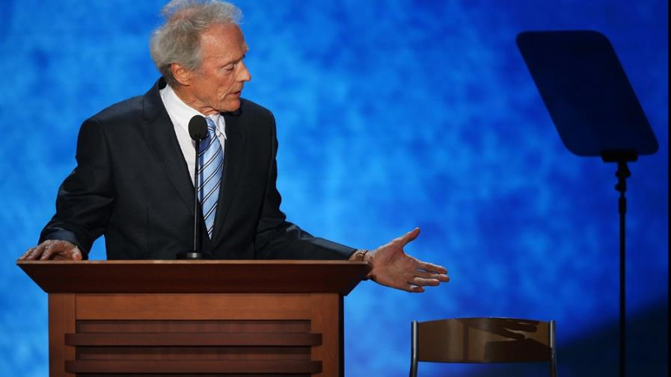
James 2:18 — A Hypothetical Objector
Clint Eastwood @ 2012 Republican National Convention
Notes:
An Illustration: On August 2012, Clint Eastwood gave a speech at the Republican National Convention. In his speech he addressed an empty chair that represented President Barack Obama. Eastwood’s conversation with an empty chair is similar to the dialogue that James has with this hypothetical objector.

Slide 15
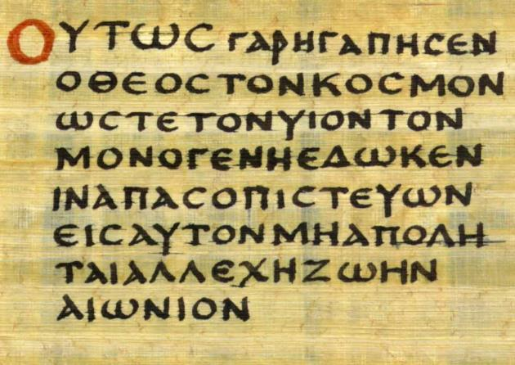
James 2:18 — A Hypothetical Objector
NKJV:
  But someone will say, “You have faith, and I have works.” Show me your faith without your works, and I will show you my faith by my works.
English uses punctuation marks.
NT Greek had no punctuation marks.
Notes:
Question: How do we know when the hypothetical objector begins to speak and when he stops speaking? In English, we use quotation marks and a comma. But James wrote using Greek, not English.
English translations use punctuation to tell us where the words of the hypothetical objector end and the reply of James begins. But the original Greek did not have any punctuation so it is simply the guess of the translator.

Slide 16
James 2:18 — A Hypothetical Objector
NKJV:
  But someone will say, “You have faith, and I have works.” Show me your faith without your works, and I will show you my faith by my works.
NASB:
But someone may well say, “You have faith and I have works; show me your faith without the works, and I will show you my faith by my works.”
James is speaking.
The Objector is speaking.
Notes:
If you compare the NKJV and the NASB, you will notice a difference in punctuation.
Why is this important? It makes a huge difference in how we understand this verse.

Slide 17
James 2:18 — A Hypothetical Objector
NKJV:
  But someone will say, “You have faith, and I have works.” Show me your faith without your works, and I will show you my faith by my works.
NASB:
But someone may well say, “You have faith and I have works; show me your faith without the works, and I will show you my faith by my works.”
James is speaking.
The Objector is speaking.
Notes:
If the NKJV is correct, then James is saying that works are a necessary sign of faith.
If the NASB is correct, then the objector is saying that works are a necessary sign of faith.

Slide 18


James 2:18 — A Hypothetical Objector
Lordship Salvation
How much is enough?
You can never be sure!
Notes:
Here is the problem: Many who hold to Lordship Salvation insist that good works (or fruit) are a necessary sign of faith. You can only have assurance of salvation, if you have enough good works or fruit in your life. But how much is enough?! You can never be sure!

Slide 19
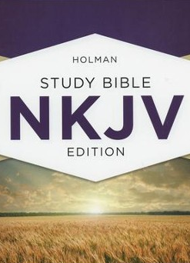
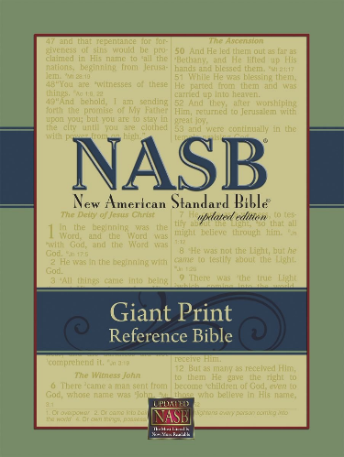

James 2:18 — A Hypothetical Objector
Which is correct?
Works = Assurance
Works ≠ Assurance
Notes:
If the NASB is correct, then the hypothetical objector is saying that works are a necessary sign of faith. Therefore James is presenting an argument against that teaching.
How can we tell which translation is correct?

Slide 20

James 2:18 — A Hypothetical Objector
Which translation is correct?
Clue #1:
  The Grammar of NT Greek.
Clue #2:
  The Harmony of Revelation.
Notes:
Which translation is correct?
Since there were no punctuation marks in the Greek text, we have to use other clues to help us determine which translation is more probable.
What clues do we have that can help us?
Both the grammar of the Greek New Testament and the harmony of revelation

Slide 21
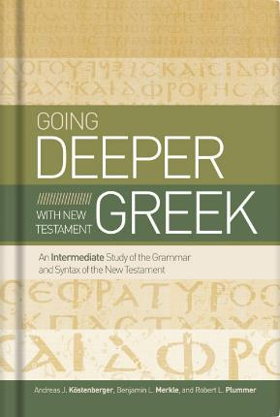
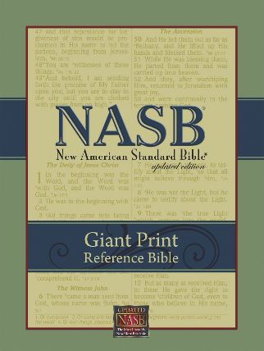

James 2:18 — A Hypothetical Objector
Clue #1: The Grammar of NT Greek.
Notes:
Clue #1: The Grammar of NT Greek.
In verse 18, James is using literary device called a diatribe. He introduces a hypothetical objector and then he presents his response to the hypothetical objections. This style of argumentation was common in Koine Greek. Paul also used it in Rom. 9:19-20; 1 Cor. 15:35-36.
<click>
When you compare the Greek grammar of Paul and James on a discourse level, the NASB seems to be a better rendering of this verse.

Slide 22
James 2:18 — A Hypothetical Objector
Clue #2: The Harmony of Revelation.
Scripture cannot conflict with itself.
No verse is to be studied by itself.
Notes:
Clue #2: The Harmony of Revelation.
No Scripture is to be interpreted so as to conflict with any other. No verse is to be studied as a unit by itself. The context of the verse must be noted. We need to ask, “What does the Bible says on the same subject in other portions of Scripture?
A key principle of interpretation is that the obscure passage must yield to the clear passage.

Slide 23
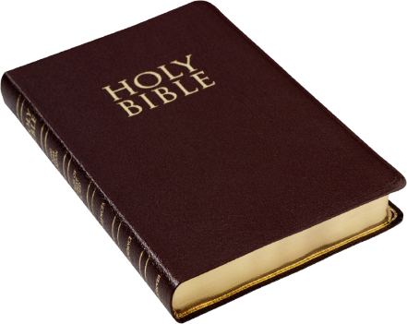

James 2:18 — A Hypothetical Objector
Clue #2: The Harmony of Revelation.
-or-
Where do we get assurance of salvation?
Notes:
Clue #2: The Harmony of Revelation.
When we compare scripture with scripture, what does God’s Word say? Does assurance of salvation comes through our good works? Or does assurance come through simply believing God’s Word?
If assurance of salvation comes through trusting in God’s Word, then the NASB seems to be a better rendering of this verse.

Slide 24
What is the role of good works?
Good works should not be a test of genuine faith.
Good works should be a normal part of Christian growth.
Notes:
What is the role of good works in the life of a Christian?
Good works should not be used as a measuring rod to test if one’s faith is genuine.
Good works should be present in the life of a growing believer.

Slide 25
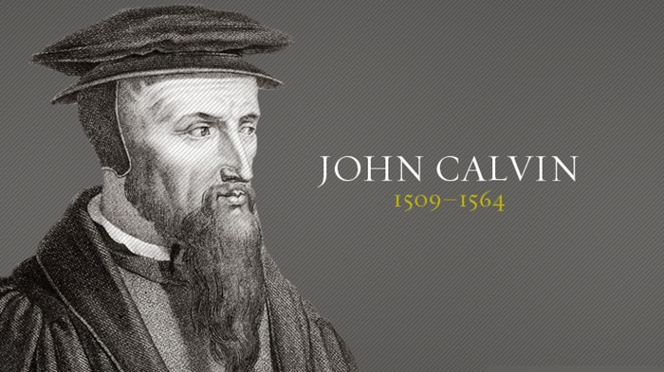
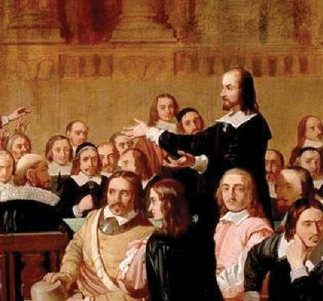
What is the role of good works?
Not a test of genuine faith.
Second Generation Reformers
Notes:
The idea using good works as a basis for having full assurance of salvation, became popular among Reformed teachers after the time of John Calvin. This idea is neither scriptural nor did John Calvin teach it.

Slide 26
What is the role of good works?
Not a test of genuine faith.
Look to Christ as the objective basis for assurance of salvation!
Looking to yourself produces doubt!
Notes:
John Calvin unequivocally warned against looking to ourselves for assurance of salvation. He taught that we should look to Christ as the objective basis for assurance. To look to ourselves produces doubt and detracts from the saving work of Christ. Calvin rejected the idea of self-examination to gain assurance as a dangerous doctrine.

Slide 27
What is the role of good works?
Not a test of genuine faith.
Good works are extremely subjective!
How many good works are enough?
Notes:
Here’s the problem: Good works are extremely subjective. How much is enough? Whose list of fruit is correct?

Slide 28
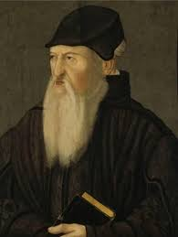
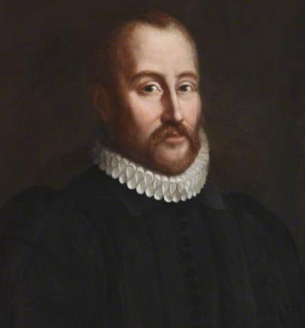
What is the role of good works?
Not a test of genuine faith.
Theodore Beza
William Perkins
Notes:
Theodore Beza in Geneva and William Perkins in England were Calvinists who came on the scene after the time of John Calvin. They led the way in departing from the teaching of John Calvin concerning faith and assurance of salvation.

Slide 29

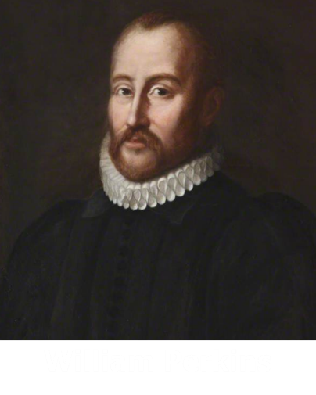
What is the role of good works?
Not a test of genuine faith.
Assurance of Salvation
Notes:
William Perkins (an early Puritan) wrote 2500 pages on the subject of assurance of salvation. His teaching on assurance had the opposite effect. Perkins created more doubts about salvation in the minds of believers than were resolved. Perkins died without a clear assurance of his own salvation.

Slide 30
What is the role of good works?
You can tell that you are a true believer if…
You feel bitterness of heart for every sin!
Notes:
William Perkins told his congregation that they could tell if they were true believers only if they 1) felt bitterness of heart for their every sin.

Slide 31
What is the role of good works?
You can tell that you are a true believer if…
You are striving against your sinful nature, and grieving over the ungodly desires of your heart!
Notes:
2) If they were striving against their sinful nature, and grieving over the ungodly desires of their heart.

Slide 32
What is the role of good works?
You can tell that you are a true believer if…
You count the gospel as the most precious jewel!
Notes:
3) If they counted the gospel as the most precious jewel.

Slide 33
What is the role of good works?
You can tell that you are a true believer if…
You love the
minister of God!
Notes:
4) If they loved the minister of God.

Slide 34
What is the role of good works?
You can tell that you are a true believer if…
You call on God earnestly and with tears!
Notes:
5) If they called on God earnestly and with tears.

Slide 35
What is the role of good works?
You can tell that you are a true believer if…
You flee all occasions
of sin!
Notes:
6) If they fled all occasions of sin.

Slide 36

What is the role of good works?
The basis of assurance
The Promises of God’s Word
Notes:
The basis of our assurance of salvation rests on the foundation of the promises of God in Scripture. The basis of our assurance is not the presence of good works (fruit) in our lives.

Slide 37

What is the role of good works?
A normal part of Christian growth.
Notes:
Good works should be present in the life of a growing believer.

Slide 38
What is the role of good works?
Dr. Ryrie:
  Every Christian will bear spiritual fruit. Somewhere, sometime, somehow. Otherwise that person is not a believer. Every born-again individual will be fruitful. Not to be fruitful is to be faithless, without faith, and therefore without salvation.
Notes:
Ryrie:
Every Christian will bear spiritual fruit. Somewhere, sometime, somehow. Otherwise that person is not a believer. Every born-again individual will be fruitful. Not to be fruitful is to be faithless, without faith, and therefore without salvation.

Slide 39
What is the role of good works?
Dr. Ryrie:
  Three Caveats
  1) This does not mean that a believer will always be fruitful.
Notes:
Three Caveats:
One, this does not mean that a believer will always be fruitful.

Slide 40
What is the role of good works?
Dr. Ryrie:
  Three Caveats
  2) This does not mean that a certain person’s fruit will necessarily be outwardly evident.
Notes:
Three Caveats:
Two, this does not mean that a certain person’s fruit will necessarily be outwardly evident.

Slide 41
What is the role of good works?
Dr. Ryrie:
  Three Caveats
  3) My understanding of what fruit is … may be faulty and/or incomplete. God likely has a much more accurate and longer list than most of us do.
Notes:
Three Caveats:
Three, my understanding of what fruit is and therefore what I expect others to bear may be faulty and/or incomplete. God likely has a much more accurate and longer list than most of us do.

Slide 42
James 2:19 — Quality of Faith vs Object of Faith
You believe that there is one God. You do well. Even the demons believe–and tremble!
James 2:19
Notes:
James 2:19 — Quality of Faith versus Object of Faith
You believe that there is one God. You do well. Even the demons believe–and tremble! (2:19)

Slide 43
James 2:19 — Quality of Faith vs Object of Faith
Typical Interpretation:
  A person says they believe in Jesus Christ as Savior, but do not have good works. Therefore they are not really saved. They are like the demons who believe in God but are not saved because they have not submitted to God or obeyed Him.
Notes:
The typical interpretation of verse 19 goes something like this: “A person says they believe in Jesus Christ as Savior, but do not have good works. Therefore they are not really saved. They are like the demons who believe in God but are not saved because they have not submitted to God or obeyed Him.”
But is that what James really means?
Theologians use this verse about the faith of demons to argue that it is important to have the right kind of faith. You must have “saving faith”. They say that the demons only had a head-knowledge about God rather than a genuine heart-knowledge. They claim that people can miss heaven by 18 inches – the distance between their head and their heart.

Slide 44
James 2:19 — Quality of Faith vs Object of Faith
Can demons be saved?
  And suddenly they cried out, saying, “What have we to do with You, Jesus, You Son of God? Have You come here to torment us before the time?”
  Mt. 8:29
Notes:
Question #1: Can demons be saved?
In other words, are they lost because they do not have the right kind of faith. If so, then these theologians have a valid argument. If not, then their argument topples like a house of cards.
The fact is, the fate of demons is already sealed. They can’t be saved. The reason is not because they don’t have the right kind of faith. The reason is that they made there choice a long time ago and their destiny is sealed. Demons do not miss heaven by 18 inches.
Mt. 8:29 And suddenly they cried out, saying, “What have we to do with You, Jesus, You Son of God? Have You come here to torment us before the time?”

Slide 45
James 2:19 — Quality of Faith vs Object of Faith
Can demons be saved?
  Then He will also say to those on the left hand, “Depart from Me, you cursed, into the everlasting fire prepared for the devil and his angels.”
  Mt. 25:41
Notes:
Question #1: Can demons be saved?
Mt. 25:41 Then He will also say to those on the left hand, “Depart from Me, you cursed, into the everlasting fire prepared for the devil and his angels.”

Slide 46
James 2:19 — Quality of Faith vs Object of Faith
Can demons be saved?
  And the angels who did not keep their proper domain, but left their own abode, He has reserved in everlasting chains under darkness for the judgment of the great day.
  Jude 6
Notes:
Question #1: Can demons be saved?
Jude 6 And the angels who did not keep their proper domain, but left their own abode, He has reserved in everlasting chains under darkness for the judgment of the great day.

Slide 47
James 2:19 — Quality of Faith vs Object of Faith
Can demons be saved?
  The fate and condemnation of the demons is sealed.
  This verse says nothing about eternal salvation.
Notes:
The fate and condemnation of the demons is sealed. That is why they tremble when they think about God.
This verse is not about eternal salvation.

Slide 48
James 2:19 — Quality of Faith vs Object of Faith
What fact about God is James dealing with?
  You believe that there is one God. You do well. Even the demons believe–and tremble!
James 2:19
Monotheism:
There is only one God!
Notes:
Question #2: What fact about God is James dealing with?
You believe that there is one God. You do well. Even the demons believe–and tremble! (2:19)
<click>
Answer: Monotheism—there is 1 God.

Slide 49

James 2:19 — Quality of Faith vs Object of Faith
Can monotheism save anyone?
Notes:
Question 2a: Can monotheism (belief that there is only one God) save people?
No one is saved by belief in monotheism.
Question 2b: Does this verse explicitly say or imply that the demons were trusting in Jesus death on the cross?
It does not say that the demons believe in Jesus Christ as their Savior.
Jesus Christ did not die and rise from death to save demons.
Again this verse is not eternal salvation.

Slide 50
James 2:19 — Quality of Faith vs Object of Faith
Summary:
  It is not the quality of faith that is being questioning. The reality of the demons’ faith is not doubted.
  This verse should not teach that works are needed to prove saving faith.
Notes:
Summary of James 2:19:
It is not the quality of faith that is being questioning. The reality of the demons’ faith is not doubted. They honestly believe that there is one God and that is why they tremble in fear of their judgment.
James 2:19 should not be used to argue that works are needed to prove saving faith.

Slide 51
James 2:19 — Quality of Faith vs Object of Faith
Summary:
  Good works are God’s purpose for Christians.
  Good works are useful to the body of Christ.
Notes:
Summary of James 2:19:
Good works are God’s purpose for Christians.
Good works are useful to the body of Christ.

Slide 52
James 2:19 — Quality of Faith vs Object of Faith
Summary:
  Good works result in a good evaluation at the Judgment Seat of Christ.
  Good works cannot prove or disprove the reality of a person’s salvation.
Notes:
Summary of James 2:19:
Good works result in a good evaluation at the Judgment Seat of Christ.
Good works cannot prove or disprove the reality of a person’s salvation.

Slide 53
James 2:19 — Quality of Faith vs Object of Faith
Summary:
  Eternal salvation is by grace alone through faith alone—apart from any works at any time.
Notes:
Summary of James 2:19:
Eternal salvation is by grace alone through faith alone—apart from any works at any time.

Slide 54
James 2:20-25 — Works Vindicates Words
²⁰ But do you want to know, O foolish man, that faith without works is dead? ²¹ Was not Abraham our father justified by works when he offered Isaac his son on the altar? ²² Do you see that faith was working together with his works, and by works faith was made perfect?
Notes:
²⁰ But do you want to know, O foolish man, that faith without works is dead? ²¹ Was not Abraham our father justified by works when he offered Isaac his son on the altar? ²² Do you see that faith was working together with his works, and by works faith was made perfect?

Slide 55
James 2:20-25 — Works Vindicates Words
²³ And the Scripture was fulfilled which says, “Abraham believed God, and it was accounted to him for righteousness.” And he was called the friend of God. ²⁴ You see then that a man is justified by works, and not by faith only.
Notes:
²³ And the Scripture was fulfilled which says, “Abraham believed God, and it was accounted to him for righteousness.” And he was called the friend of God. ²⁴ You see then that a man is justified by works, and not by faith only.

Slide 56
James 2:20-25 — Works Vindicates Words
²⁵ Likewise, was not Rahab the harlot also justified by works when she received the messengers and sent them out another way?
Notes:
²⁵ Likewise, was not Rahab the harlot also justified by works when she received the messengers and sent them out another way?

Slide 57
James 2:20-25 — Works Vindicates Words
Two examples:
  Abraham — the upright Jew
  Rahab — the immoral Gentile.
All the rest of humanity falls between the two extremes!
Notes:
Two examples of the principle that faith is vindicated by works are given:
Abraham— the upright Jew
Rahab— the immoral Gentile.
All the rest of humanity falls between the two extremes!

Slide 58
James 2:20-25 — Works Vindicates Words
Example #1: Abraham
  Was not Abraham our father justified by works when he offered Isaac his son on the altar?
  –James 2:21
Notes:
The first OT illustration is Abraham the Jew.
James says in verse 21 that Abraham was justified by works in offering up Isaac his son on the altar.
Was not Abraham our father justified by works when he offered Isaac his son on the altar? (v. 21)
This event occurred in Genesis chapter 22.

Slide 59
James 2:20-25 — Works Vindicates Words
Example #1: Abraham
  And he [Abraham] believed in the LORD, and He accounted it to him for righteousness.
  –Gen. 15:6
Notes:
Genesis 15 tells us that Abraham was justified by faith.
And he [Abraham] believed in the LORD, and He accounted it to him for righteousness. (Gen. 15:6)

Slide 60
James 2:20-25 — Works Vindicates Words
Example #1: Abraham
  What then shall we say that Abraham our father has found according to the flesh? For if Abraham was justified by works, he has something to boast about, but not before God. For what does the Scripture say? “Abraham believed God, and it was accounted to him for righteousness.” –Rom. 4:1-3
Notes:
Paul referred to the account in Genesis 15 to prove that Abraham was justified by faith.
Rom. 4:1-3 What then shall we say that Abraham our father has found according to the flesh? For if Abraham was justified by works, he has something to boast about, but not before God. For what does the Scripture say? “Abraham believed God, and it was accounted to him for righteousness.”

Slide 61
James 2:20-25 — Works Vindicates Words
The Problem:
  Genesis 15 says Abraham was justified by faith.
  Paul says Abraham was justified by faith in Genesis 15.
  James says that Abraham was justified by works in Genesis 22.
Notes:
We have a problem!!!
Genesis 15 says that Abraham was justified by faith when he believed God.
Paul agrees with the book of Genesis. He wrote that Abraham was justified by faith in Genesis 15.
However, James says that Abraham was justified by works in Genesis 22 when he offered Isaac his son on the altar. James clearly contradicts Paul. Also, Genesis 22 says nothing about Abraham being justified by works.
Who is correct, Paul or James? How can we reconcile this apparent contradiction made by James?

Slide 62
James 2:20-25 — Works Vindicates Words
The Solution:
  Paul and James used the word “justified” differently.
Notes:
Paul and James used the word “justified” differently.

Slide 63
James 2:20-25 — Works Vindicates Words
The Solution:
  Paul used the word “justified” to mean “declared righteous before God.”
  Paul was dealing with the 1st tense of salvation – justification.
Notes:
Paul used the word “justified” to mean “declared righteous before God.” Paul was dealing with the 1st tense of salvation known as justification.

Slide 64
James 2:20-25 — Works Vindicates Words
The Solution:
  James used the word “justified” to mean “vindicated before men.”
  James was dealing with the 2nd tense of salvation – sanctification.
Notes:
James used the word “justified” to mean “vindicated before men.” James was dealing with the 2nd tense of salvation known as progressive sanctification.
In other words, Abraham’s initial faith in God found in Genesis 15 was vindicated in Genesis 22.

Slide 65
James 2:20-25 — Works Vindicates Words
James 2:21:
  NKJV: Was not Abraham our father justified by works when he offered Isaac his son on the altar?
  Wuest: Was not our father Abraham vindicated by works [justified as to his claim to a living faith] in that he offered his son Isaac on the altar of sacrifice?
Notes:
NKJV: Was not Abraham our father justified by works when he offered Isaac his son on the altar?
<click>
Wuest: Was not our father Abraham vindicated by works [justified as to his claim to a living faith] in that he offered his son Isaac on the altar of sacrifice?

Slide 66
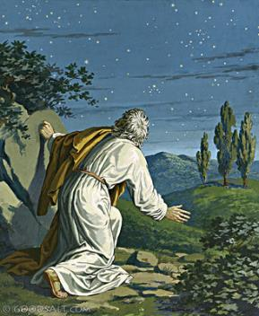
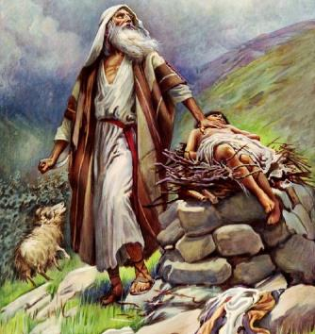
James 2:20-25 — Works Vindicates Words
The Solution:
Justified
by Faith
Vindicated
by Works
Gen. 15
Gen. 22
Notes:
In chapter 15 Abraham was justified before God by his faith.
As Abraham continued through life’s journey he professed his faith in God.
<click>
In chapter 22 his profession of faith was justified or vindicated before men.
Abraham demonstrated his faith by his willingness to offer up Isaac. His actions proved that his faith was not dead or useless.
Abraham’s faith in God was vindicated in the sight of men by works in Genesis 22. However it was Abraham’s faith that justified him in the sight of God in Genesis 15.

Slide 67
James 2:20-25 — Works Vindicates Words
The Solution:
  Abraham was justified by faith Godward when he believed (Gen. 15).
  Abraham was vindicated by works man-ward when he obeyed (Gen. 22).
Notes:
Abraham was justified by faith Godward when he believed (Gen. 15).
Abraham was vindicated by works man-ward when he obeyed (Gen. 22).

Slide 68
James 2:20-25 — Works Vindicates Words
Example #2: Rahab
  NKJV: Likewise, was not Rahab the harlot also justified by works when she received the messengers and sent them out another way?
  James 2:25
Notes:
NKJV: Likewise, was not Rahab the harlot also justified by works when she received the messengers and sent them out another way? (James 2:25)

Slide 69
James 2:20-25 — Works Vindicates Words
Example #2: Rahab
  Wuest: Now, similarly, was not Rahab the prostitute also vindicated [justified as to her possession of a living faith] in that she entertained as guests the messengers and thrust them forth by means of a different way [from that by which they entered the city]?
  James 2:25
Notes:
Wuest: Now, similarly, was not Rahab the prostitute also vindicated [justified as to her possession of a living faith] in that she entertained as guests the messengers and thrust them forth by means of a different way [from that by which they entered the city]? (James 2:25)

Slide 70
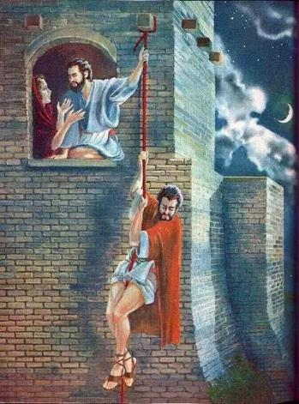
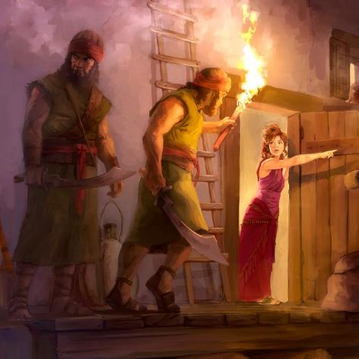
James 2:20-25 — Works Vindicates Words
Example #2: Rahab
Notes:
She certainly was not saved by good character — she was a prostitute!
But Rahab’s faith was vindicated by works because she received the spies and sent them out another way.
Rahab was a Canaanite, living in the city of Jericho. She heard reports that a victorious army was advancing toward the city, and that no opposition had been successful against this army. She concluded that the God of the Hebrews was the true God, and decided to identify herself with this God, whatever the cost might be.
When the spies entered the city, she befriended them. In doing so, she proved the genuineness of her faith in the true and living God. She was not saved by harboring the spies, but this act of hospitality proved that she was a genuine believer.

Slide 71
James 2:20-25 — Works Vindicates Words
William MacDonald:
Some people misuse this passage to teach that salvation is partly by good works. But what they mean by good works is giving to charity, paying your debts, telling the truth, and going to church. Were these the good works of Abraham and Rahab? Certainly not!
Notes:
William MacDonald: Some people misuse this passage to teach that salvation is partly by good works. But what they mean by good works is giving to charity, paying your debts, telling the truth, and going to church. Were these the good works of Abraham and Rahab? Certainly not!

Slide 72
James 2:20-25 — Works Vindicates Words
William MacDonald:
In Abraham’s case, it was willingness to kill his son! In Rahab’s case, it was treason! If you remove faith from these works, they would be evil rather than good. “Strip them of faith and they were not only immoral and unfeeling, but they would have been sinful.”
Notes:
In Abraham’s case, it was willingness to kill his son! In Rahab’s case, it was treason! If you remove faith from these works, they would be evil rather than good. “Strip them of faith and they were not only immoral and unfeeling, but they would have been sinful.”

Slide 73
James 2:20-25 — Works Vindicates Words
C. H. Mackintosh:
  This section refers to life-works, not law-works. If you abstract faith from Abraham’s and Rahab’s works, they were bad works. Look at them as the fruit of faith and they were life-works.
Notes:
C. H. Mackintosh: This section refers to life-works, not law-works. If you abstract faith from Abraham’s and Rahab’s works, they were bad works. Look at them as the fruit of faith and they were life-works.

Slide 74
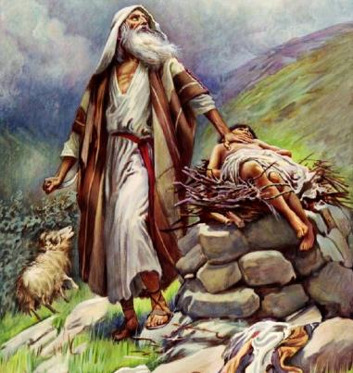

James 2:20-25 — Works Vindicates Words
Is James teaching salvation by works?
Salvation by murder!
Salvation by treason!
Notes:
This is a not a passage that can be used to teach salvation by good works. To do so would be teaching salvation by:
<click>
murder (Abraham sacrificing his son) and treason (Rabah betraying her people)

Slide 75
James 2:20-25 — Works Vindicates Words
When was Rahab saved?
  And when we heard [it,] our hearts melted and no courage remained in any man any longer because of you; for the Lord your God, He is God in heaven above and on earth beneath.
  Josh 2:11
Notes:
When was Rahab saved? Probably when she first heard about Jehovah.
Josh 2:11 And when we heard [it,] our hearts melted and no courage remained in any man any longer because of you; for the Lord your God, He is God in heaven above and on earth beneath.
Then she showed the character of her faith by what she did. That is why James refers to her work as an example of faith in action.

Slide 76
Conclusion
For as the body without the spirit is dead, so faith without works is dead also.
James 2:26
Notes:
James 2:26 ends the passage with the statement, “For as the body without the spirit is dead, so faith without works is dead also.”
<click>
Here the matter is summarized very beautifully. James compares faith to the human body. And he likens works to the human spirit.

Slide 77
Conclusion
The body without the spirit is:
lifeless
useless
valueless.
Notes:
The body without the spirit is lifeless, useless, valueless.

Slide 78
Conclusion
Faith
without
works is:
dead
ineffective
useless
Notes:
So also, faith without works is dead, ineffective, useless.

Slide 79
Conclusion
James is addressing “brethren” or fellow believers.
James is concerned with sanctification and not justification.
Notes:
Conclusion
James is addressing “brethren” or fellow believers.
James is concerned with sanctification and not justification.

Slide 80
Conclusion
James is asking: “Can dead (non-productive) faith benefit needy Brothers or Sisters in Christ?”
Notes:
Conclusion
James is asking: “Can dead (non-productive) faith benefit the needy Brother or Sister in Christ?”

Slide 81
Conclusion
James concludes: “If a Christian’s faith is separated from God’s purpose for him of good works then there is no profit of benefit man-ward (toward the brethren).”
Faith without works is dead, ineffective or useless.
Notes:
Conclusion
James concludes: “If a Christian’s faith is separated from God’s purpose for him of good works then there is no profit of benefit man-ward (toward the brethren).”
Faith without works is: dead, ineffective or useless.

