Slide 1
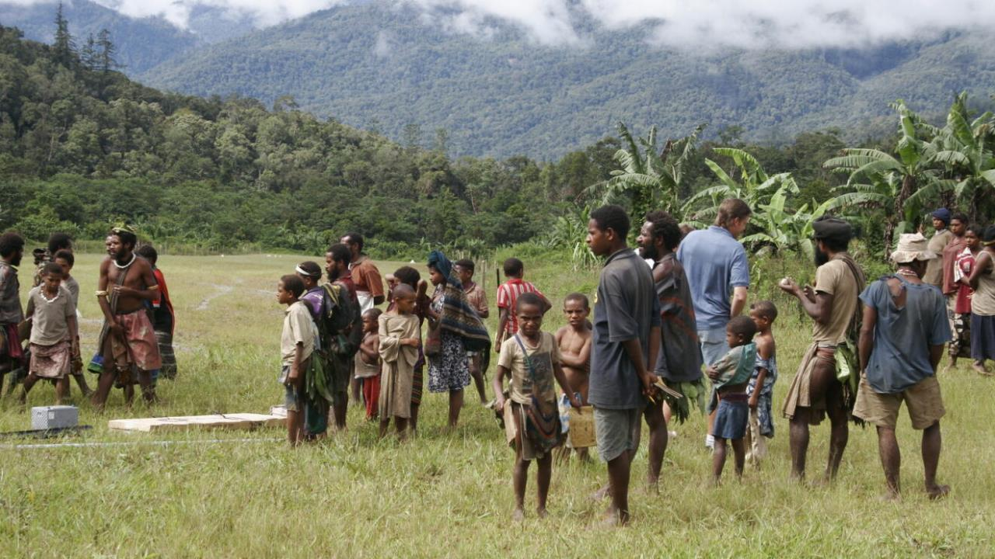
Misunderstanding the Culture
USA
USA
USA
USA
Notes:
Illustration: A missionary couple moved into a new tribal group to begin their language and culture study. They noticed that most husbands and wives would leave to go their separate ways as they did their daily chores. The women would work in the gardens while their husbands went off hunting or fishing. However, there was one couple who were the exception to this norm. This couple did everything together. The missionaries assumed that this couple had a deep affection for one another because they did everything together. They were surprised when the village elders called this couple together for marriage counseling. There was a reason that they did everything together. It was because they were jealous and suspicious of one another. They were afraid that if they left their mate for any length of time, then that would give their partner an opportunity to have an affair with someone else.
<click>
The problem was that the missionaries were viewing this people group through Western tinted glasses.

Slide 2
Erroneous conclusions result when we read God’s Word wearing tinted glasses.
bias
bias
Notes:
It is easy to come to erroneous conclusions about the Bible because of our preconceived ideas. It is easy to read God’s Word with tinted glasses on. We tend to read scripture through the lens of our own culture rather than the culture that existed at the time the Bible was written. There is also a tendency to read scripture through the lens of theology.

Slide 3
We need to remove our tinted glasses and allow the text to speak for itself.
Notes:
As we come to God’s Word, we need to put aside our cultural and theological preconceptions. We need to allow the text to speak for itself. We allow God’s word to speak for itself by using the consistent, literal, historical-grammatical method of interpretation. What is that?
We have a paper on the Sanford Bible Church website that is a must read!

Slide 4
Notes:
Click on Articles & Issues

Slide 5
Notes:
Click on Principles of Biblical Interpretation

Slide 6
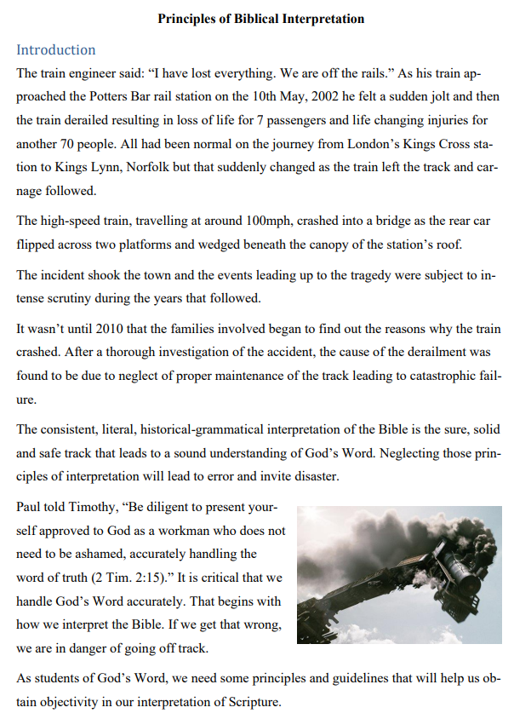
Notes:
The consistent, literal, historical-grammatical interpretation of the Bible is the sure, solid and safe track that leads to a sound understanding of God’s Word. Neglecting those principles of interpretation will lead to error and invite disaster.
Paul told Timothy, “Be diligent to present yourself approved to God as a workman who does not need to be ashamed, accurately handling the word of truth (2 Tim. 2:15).” It is critical that we handle God’s Word accurately.
<Click>
That begins with how we interpret the Bible. If we get that wrong, we are in danger of going off track.

Slide 7
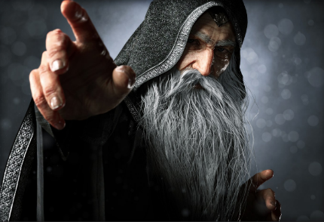
The Curious Case of Simon the Sorcerer
Acts 8:5-25
Notes:
The Curious Case of Simon the Sorcerer -- Acts 8:5-25
This morning we will be looking at a controversial section of scripture. Arminians will interpret it one way and Calvinists will interpret it another way. In my opinion, both groups read this section of scripture with their theological glasses on. This morning I would like to propose a better way of looking at this biblical text.

Slide 8
Acts 8:5–25
⁵ Then Philip went down to the city of Samaria and preached Christ to them. ⁶ And the multitudes with one accord heeded the things spoken by Philip, hearing and seeing the miracles which he did. ⁷ For unclean spirits, crying with a loud voice, came out of many who were possessed; and many who were paralyzed and lame were healed. ⁸ And there was great joy in that city. ⁹ But there was a certain man called Simon, who previously practiced sorcery in the city and astonished the people of Samaria, claiming that he was someone great, ¹⁰ to whom they all gave heed, from the least to the greatest, saying, “This man is the great power of God.”
Notes:
Acts 8:5–25 ⁵ Then Philip went down to the city of Samaria and preached Christ to them. ⁶ And the multitudes with one accord heeded the things spoken by Philip, hearing and seeing the miracles which he did. ⁷ For unclean spirits, crying with a loud voice, came out of many who were possessed; and many who were paralyzed and lame were healed. ⁸ And there was great joy in that city. ⁹ But there was a certain man called Simon, who previously practiced sorcery in the city and astonished the people of Samaria, claiming that he was someone great, ¹⁰ to whom they all gave heed, from the least to the greatest, saying, “This man is the great power of God.”

Slide 9
Acts 8:5–25
¹¹ And they heeded him because he had astonished them with his sorceries for a long time. ¹² But when they believed Philip as he preached the things concerning the kingdom of God and the name of Jesus Christ, both men and women were baptized. ¹³ Then Simon himself also believed; and when he was baptized he continued with Philip, and was amazed, seeing the miracles and signs which were done. ¹⁴ Now when the apostles who were at Jerusalem heard that Samaria had received the word of God, they sent Peter and John to them, ¹⁵ who, when they had come down, prayed for them that they might receive the Holy Spirit.
Notes:
¹¹ And they heeded him because he had astonished them with his sorceries for a long time. ¹² But when they believed Philip as he preached the things concerning the kingdom of God and the name of Jesus Christ, both men and women were baptized. ¹³ Then Simon himself also believed; and when he was baptized he continued with Philip, and was amazed, seeing the miracles and signs which were done. ¹⁴ Now when the apostles who were at Jerusalem heard that Samaria had received the word of God, they sent Peter and John to them, ¹⁵ who, when they had come down, prayed for them that they might receive the Holy Spirit.

Slide 10
Acts 8:5–25
¹⁶ For as yet He had fallen upon none of them. They had only been baptized in the name of the Lord Jesus. ¹⁷ Then they laid hands on them, and they received the Holy Spirit. ¹⁸ And when Simon saw that through the laying on of the apostles’ hands the Holy Spirit was given, he offered them money, ¹⁹ saying, “Give me this power also, that anyone on whom I lay hands may receive the Holy Spirit.” ²⁰ But Peter said to him, “Your money perish with you, because you thought that the gift of God could be purchased with money! ²¹ You have neither part nor portion in this matter, for your heart is not right in the sight of God.
Notes:
¹⁶ For as yet He had fallen upon none of them. They had only been baptized in the name of the Lord Jesus. ¹⁷ Then they laid hands on them, and they received the Holy Spirit. ¹⁸ And when Simon saw that through the laying on of the apostles’ hands the Holy Spirit was given, he offered them money, ¹⁹ saying, “Give me this power also, that anyone on whom I lay hands may receive the Holy Spirit.” ²⁰ But Peter said to him, “Your money perish with you, because you thought that the gift of God could be purchased with money! ²¹ You have neither part nor portion in this matter, for your heart is not right in the sight of God.

Slide 11
Acts 8:5–25
²² Repent therefore of this your wickedness, and pray God if perhaps the thought of your heart may be forgiven you. ²³ For I see that you are poisoned by bitterness and bound by iniquity.” ²⁴ Then Simon answered and said, “Pray to the Lord for me, that none of the things which you have spoken may come upon me.” ²⁵ So when they had testified and preached the word of the Lord, they returned to Jerusalem, preaching the gospel in many villages of the Samaritans.
Notes:
²² Repent therefore of this your wickedness, and pray God if perhaps the thought of your heart may be forgiven you. ²³ For I see that you are poisoned by bitterness and bound by iniquity.” ²⁴ Then Simon answered and said, “Pray to the Lord for me, that none of the things which you have spoken may come upon me.” ²⁵ So when they had testified and preached the word of the Lord, they returned to Jerusalem, preaching the gospel in many villages of the Samaritans.

Slide 12
The Context
Barna Group: 75% of young adults leave the church after high school!
Notes:
The Context
My Rant:
I do not like the term “Bible Stories.” It implies that the accounts in the Bible are on equal footing with Aesop’s Fables or Grimm’s Fairy Tales. What kind of impact does that have on our young people who are being taught “Bible Stories” that are no more factual than fables or fairy tales?
Studies conducted by the Barna Group found that nearly 75% of Christian young people fall away from the faith and leave the church after high school.
It is no wonder so many young people leave the church when they get out on their own.

Slide 13
The Context
Twenty-six million Americans stopped reading the Bible in 2022.
A Bible reader is described as one who reads his or her Bible three times per year.
Notes:
The American Bible Society released the results of a startling survey. Roughly fifty percent of American adults reported reading Scripture at least three times a year from 2011 to 2021. In 2022, that number declined to thirty-nine percent. That means twenty-six million Americans stopped reading the Bible in 2022. Even more alarming than this drop in Bible reading is the idea that a Bible reader is described as one who reads his or her Bible three times per year.

Slide 14
The Context
Do you agree with the following statement?
“The Bible contains helpful accounts of ancient myths but is not literally true.”
26% of evangelicals said “yes.”
Notes:
In 2022, LifeWay Research conducted a survey. They wanted to know how many evangelicals agreed with the following statement: “The Bible contains helpful accounts of ancient myths but is not literally true.”
In 2020, 15% of evangelicals agreed with that statement.
In 2022, 26% of evangelicals agreed with that statement.
We are in theological freefall, not just in America, but among so-called evangelicals as well.
Why is that? The problem does not stop with young adults leaving home. Even professors at conservative seminaries have been bitten by the “Bible Story” plague.

Slide 15
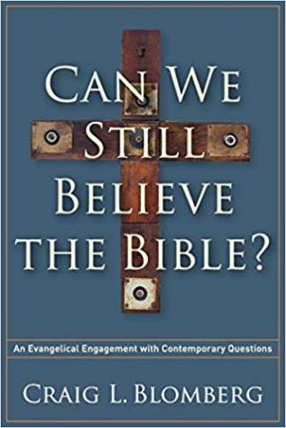
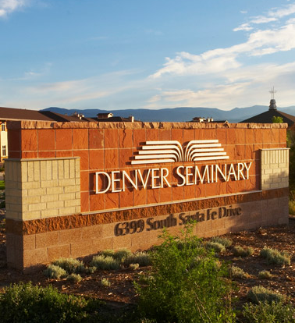
The Context
The Bible is still trustworthy if we learn to distinguish between inspired fiction and inspired history.
Notes:
Craig Blomberg of Denver Seminary: In his book Can We Still Believe the Bible, Professor Craig Blomberg of Denver Seminary says that the Bible is still trustworthy. He says we can still believe the Bible, but only if we learn to distinguish between inspired fiction and inspired history.

Slide 16
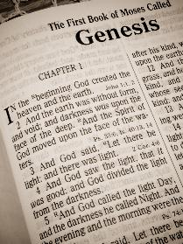
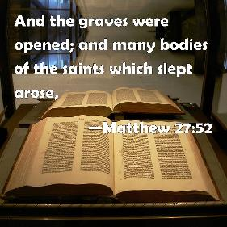
The Context
Examples of inspired fiction:
Genesis 1-3
The book of Job.
The book of Jonah.
The resurrection of the of saints in Matthew 27.
Notes:
Examples of inspired fiction:
• Genesis 1-3 is fiction with a little bit of history underlying it. There were two people named Adam and Eve. But they were not directly created by God. They were chosen out of a group of humans who lived at that time.
• Job was an actual person. But the account in the Bible is inspired fiction.
• Jonah was probably a real prophet, but the book of Jonah is a parable. Jonah was never swallowed by a large fish. He never went to Nineveh.
• The account of saints rising from the grave in Matthew 27 is inspired fiction. It never really happened.

Slide 17
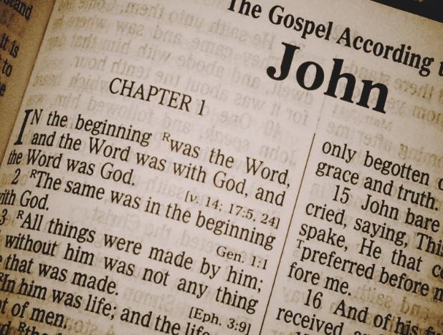
The Context
John 20:30–31 And truly Jesus did many other signs in the presence of His disciples, which are not written in this book; but these are written that you may believe that Jesus is the Christ, the Son of God, and that believing you may have life in His name.
Not just a collection of “Bible stories!”
Notes:
Narrative accounts in God’s Word are not simply “Bible Stories” written for our entertainment. They were chosen with a purpose in mind. For example:
<click>
John 20:30–31 And truly Jesus did many other signs in the presence of His disciples, which are not written in this book; but these are written that you may believe that Jesus is the Christ, the Son of God, and that believing you may have life in His name.

Slide 18
The Context
Luke and Acts were written with a purpose in mind. Luke is a historical account of the life of Christ. Acts is a historical account of the growth of the church.
Notes:
Luke wrote both The Gospel of Luke and The Acts of the Apostles. He wrote these books to give an accurate, historical account of Jesus and his followers. Both books are addressed to a man named Theophilus.
The Gospel of Luke focuses on the life and ministry of Jesus Christ. Acts portrays the church as God’s instrument of redemption on Earth. It provides a historical account of the early Christian church, its growth, and spread.

Slide 19
The Context
Luke 1:1–4 Inasmuch as many have taken in hand to set in order a narrative of those things which have been fulfilled among us, just as those who from the beginning were eyewitnesses and ministers of the word delivered them to us, it seemed good to me also, having had perfect understanding of all things from the very first, to write to you an orderly account, most excellent Theophilus, that you may know the certainty of those things in which you were instructed.
Notes:
Luke 1:1–4 Inasmuch as many have taken in hand to set in order a narrative of those things which have been fulfilled among us, just as those who from the beginning were eyewitnesses and ministers of the word delivered them to us, it seemed good to me also, having had perfect understanding of all things from the very first, to write to you an orderly account, most excellent Theophilus, that you may know the certainty of those things in which you were instructed.

Slide 20
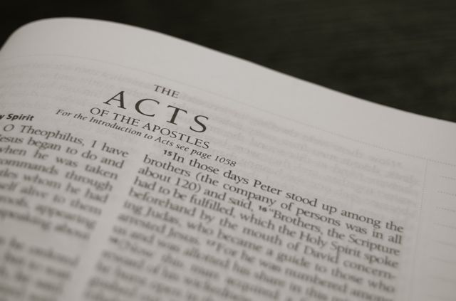
The Context
Acts 1:1–2 The first account I composed, Theophilus, about all that Jesus began to do and teach, until the day when He was taken up to heaven, after He had by the Holy Spirit given orders to the apostles whom He had chosen.
Notes:
Acts 1:1–2 The first account I composed, Theophilus, about all that Jesus began to do and teach, until the day when He was taken up to heaven, after He had by the Holy Spirit given orders to the apostles whom He had chosen.

Slide 21
The Context
Acts 2:41, 47b Then those who gladly received his word were baptized; and that day about three thousand souls were added to them. … And the Lord added to the church daily those who were being saved.
The spread of the gospel and the growth of the church.
Notes:
The account we read in Acts 8 is found in a larger context. Acts is about the spread of the gospel and the growth of the church.
<click>
Acts 2:41, 47b Then those who gladly received his word were baptized; and that day about three thousand souls were added to them. … And the Lord added to the church daily those who were being saved.

Slide 22
The Context
Luke chose these stories for a specific purpose:
Stephen was martyred for his faith (8:2).
Saul/Paul persecuted the church (8:3) and later believed the gospel (Ch. 9).
The Samaritans believed and were baptized (8:13).
Simon the Sorcerer believed and was baptized (8:5–25).
The Ethiopian eunuch believed and was baptized (8:26-40).
Notes:
The account we just read in Acts 8 is found in a larger context. Acts chapter 8 begins with an account about the transition of the gospel message from Jerusalem to Samaria. In this section of Scripture, we find several “Bible stories.” I believe that Luke chose these stories for a specific purpose.
• Stephen was martyred for his faith (8:2).
• Saul/Paul persecuted the church (8:3) and later believed the gospel (Ch. 9).
• The Samaritans believed and were baptized (8:13).
• Simon the Sorcerer believed and was baptized (8:5–25).
• The Ethiopian eunuch believed and was baptized (8:26-40).

Slide 23
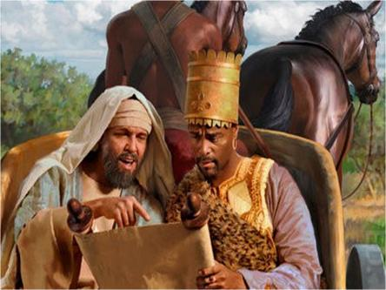
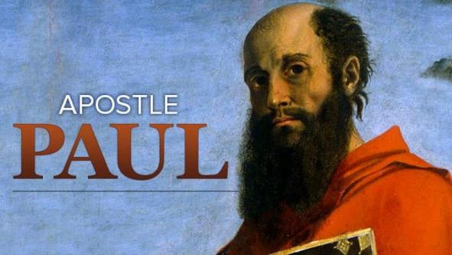
The Context
The reach of the gospel is comprehensive!
Ethiopian Eunuch
Notes:
These stories show that the reach of the gospel is comprehensive. The gospel can save a hardened unbeliever like Saul/Paul. It can save an open seeker like the Ethiopian eunuch. If this is the case, then these are all examples of genuine believers.

Slide 24
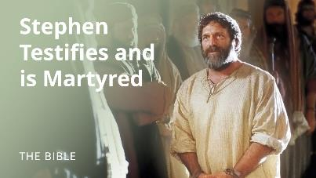
The Context
No one doubts the salvation of Stephen, Paul or the Ethiopian Eunuch.
Ethiopian Eunuch
Simon the Sorcerer
Notes:
No one doubts the salvation of Stephen, Paul, or the Ethiopian eunuch. But we seem to have a problem believing that Simon the Sorcerer was genuinely saved. However, if Simon was not a genuine believer, then you have to wonder what purpose Luke had in including this story with other believers of the gospel.

Slide 25
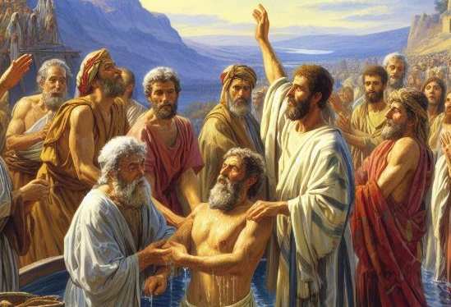
The Problem
Simon was doing miracles and amazed the people.
Simon believed and was baptized.
Notes:
Simon the Sorcerer was performing miracles before he believed in Christ. No doubt, he did this through the power of the occult. Satan can imitate many of God’s miracles. In the book of Exodus, Pharaoh’s magicians were able to duplicate some of the miracles performed by Moses and Aaron.
<click>
Then Philip preached Jesus to Simon. As a result, Simon believed and was baptized.

Slide 26
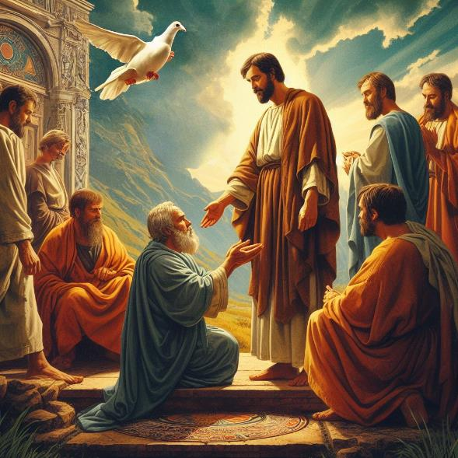
The Problem
Peter and John prayed that the Holy Spirit would come upon the Samaritans who had believed in Christ.
When Simon saw this miracle, he asked to purchase that power.
Notes:
The Holy Spirit had not come upon the Samaritans until that point in time. They did not receive the Holy Spirit until the Jerusalem saints prayed for them and laid hands on them. Simon saw this transfer of power and wanted to be able to perform this miracle himself. He actually tried to purchase that power.

Slide 27
The Problem
Our dilemma:
Simon believed in Christ and was baptized (Acts 8:13).
Simon’s actions seem inconsistent with a genuine believer.
Peter had very harsh words for Simon.
Notes:
Here is the problem. Verse 13 clearly says that Simon believed and yet his actions did not seem to match his profession of faith. Though he “talked the talk” he did not “walk the walk.” Some would say that Simon’s actions betrayed his profession of faith. Not only that, but Peter also had some very harsh words for Simon which make many doubt that he was genuinely saved.

Slide 28
The Problem
Question #1: Was Simon really saved?
Question #2: How many conditions are there for salvation?
Simon believed and was baptized.
Notes:
Was Simon really saved? To answer that, we need to ask another question. How many conditions are there for salvation? In other words, how many things does a person need to do to be saved?

Slide 29
The Problem
Question: What does a person need to do to be saved?
• Confess Jesus Christ.
• Be baptized.
• Turn from your sins.
• Believe in Jesus Christ.
• Keep the commandments.
• Try to live by the Bible.
• Attend a good church.
• Give your heart to Jesus.
• Make Jesus Lord of your life.
Only 1 Condition for Salvation:
Faith Alone in Christ alone!
Notes:
What does a person need to do to be saved?
• Confess Jesus Christ.
• Be baptized.
• Turn from your sins.
• Believe in Jesus Christ as Savior from sin.
• Keep the commandments.
• Try to live by the Bible.
• Attend a good church.
• Give your heart to Jesus.
• Make Jesus Lord of your life.
<click>
There is only one condition for salvation which is faith alone in Christ alone. Dr. J. B. Hixson, in his book Getting the Gospel Wrong, lists 160 verses in the Bible that teach salvation is by faith alone.

Slide 30
The Problem
Faith alone in Christ alone is the only condition for salvation!
John 3:16 For God so loved the world that He gave His only begotten Son, that whoever believes in Him should not perish but have everlasting life.
John 5:24 Most assuredly, I say to you, he who hears My word and believes in Him who sent Me has everlasting life and shall not come into judgment but has passed from death into life.
Notes:
There is only one condition for salvation which is faith alone in Christ alone.
• Jn. 3:16 For God so loved the world that He gave His only begotten Son, that whoever believes in Him should not perish but have everlasting life.
<click>
• Jn. 5:24 Most assuredly, I say to you, he who hears My word and believes in Him who sent Me has everlasting life and shall not come into judgment but has passed from death into life.

Slide 31
The Problem
Faith alone in Christ alone is the only condition for salvation!
John 11:25-26 Jesus said to her, “I am the resurrection and the life. He who believes in Me, though he may die, he shall live. And whoever lives and believes in Me shall never die. Do you believe this?”
Romans 3:28 Therefore we conclude that a man is justified by faith apart from the deeds of the law.
Romans 4:5 But to him who does not work but believes on Him who justifies the ungodly, his faith is accounted for righteousness.
Notes:
• Jn. 11:25-26 Jesus said to her, “I am the resurrection and the life. He who believes in Me, though he may die, he shall live. And whoever lives and believes in Me shall never die. Do you believe this?”
<click>
• Rom. 3:28 Therefore we conclude that a man is justified by faith apart from the deeds of the law.
<click>
• Rom. 4:5 But to him who does not work but believes on Him who justifies the ungodly, his faith is accounted for righteousness.

Slide 32
The Problem
Acts 8:13
Then Simon himself also believed; and when he was baptized he continued with Philip, and was amazed, seeing the miracles and signs which were done.
Simon believed and was baptized.
Simon’s problem was that his halo was on crooked!
Notes:
According to Acts 8:13, Simon met that one and only requirement. Yet, many people claim that Simon was not really saved. Why is that? They say that Simon did not show enough change of life if he was saved. Many have trouble accepting that a true believer would try to buy the apostles’ unique power to bestow the Holy Spirit.
<click>
Simon’s problem was that his halo was on crooked! Simon’s life did not match up to the check list of the doubters who claim that he was never truly saved.

Slide 33
The Problem
Peter’s words could only apply to an unbeliever:
Peter curses Simon indicating he will perish (v. 20).
Peter says Simon does not have any part in “this matter” (v. 21).
Peter says Simon’s heart is not right with God (v. 21).
Peter tells Simon to repent of his wickedness to be forgiven (v. 22).
Peter says Simon is poisoned by bitterness and bound by iniquity (v. 23).
Notes:
People also think that Peter’s words could only apply to an unbeliever:
• Peter curses Simon indicating he will perish (v. 20).
• Peter says Simon does not have any part in “this matter” (v. 21).
• Peter says Simon’s heart is not right with God (v. 21).
• Peter tells Simon to repent of his wickedness to be forgiven (v. 22).
• Peter says Simon is poisoned by bitterness and bound by iniquity (v. 23).

Slide 34
The Arminian Solution
Simon believed and was baptized.
But he lost his salvation.
Notes:
The Arminian Solution
Arminians would say that Simon was saved but he lost his salvation. At least Arminians acknowledge that the man was truly a believer at. The problem is that scripture clearly teaches that believers can NEVER lose their salvation.

Slide 35
The Calvinistic Solution
Simon did not have the right kind of faith.
Simon had a false faith.
Simon only believed with his head and not with his heart.
Notes:
The Calvinistic Solution
Calvinists claim that Simon did not have the right kind of faith. They differentiate between false faith and genuine faith. They claim that there’s a faith that saves and a faith that does not save. They attempt to make a difference between head knowledge and heart knowledge. According to Calvinism, simple faith is not enough.

Slide 36
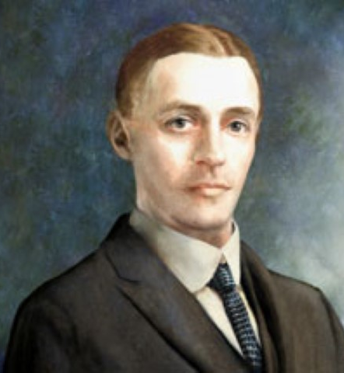
The Calvinistic Solution
A. W. Pink:
“There is a deadly and damnable heresy being widely propagated today to the effect that, if a sinner truly accepts Christ as his personal Saviour … he cannot perish. That is a satanic lie… Something more than believing in Christ is necessary to ensure the soul’s reaching heaven.”
Notes:
The Calvinistic Solution
A. W. Pink: “There is a deadly and damnable heresy being widely propagated today to the effect that, if a sinner truly accepts Christ as his personal Saviour … he cannot perish. That is a satanic lie… Something more than believing in Christ is necessary to ensure the soul’s reaching heaven.”

Slide 37
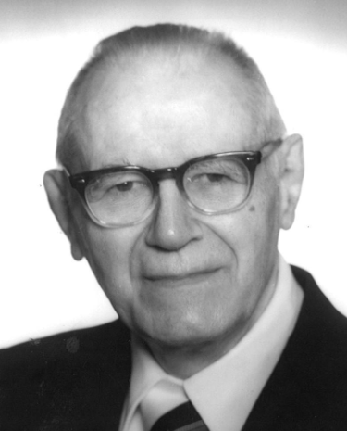
The Calvinistic Solution
William Hendrickson:
“Many trusted in his name; i.e., because of the manner in which his power was displayed they accepted him as a great prophet and perhaps even as the Messiah. This, however, is not the same as saying that they surrendered their hearts to him. Not all faith is saving faith...”
Notes:
The Calvinistic Solution
William Hendrickson: “Many trusted in his name; i.e., because of the manner in which his power was displayed they accepted him as a great prophet and perhaps even as the Messiah. This, however, is not the same as saying that they surrendered their hearts to him. Not all faith is saving faith...”

Slide 38
The Calvinistic Solution
Did I really believe?
Do I have the right kind of faith?
How can I know for sure?
Notes:
The Calvinistic Solution
If you believe that teaching, then you will spend your whole life wondering if you have the right kind of faith or not.

Slide 39
The Compelling Evidence
Simon was a true believer.
Notes:
The Compelling Evidence
Next we will look at the compelling evidence that Simon was a true believer.

Slide 40
The Compelling Evidence
The Gospels and Acts are not simply “Bible Stories” written for our entertainment!
Notes:
As mentioned previously, the Gospels and Acts are not just a collection of random stories. The stories are part of a larger narrative. They were included with a purpose in mind.

Slide 41
The Compelling Evidence
Acts chapter 8:
Stephen was martyred for his faith (8:2).
Saul/Paul persecuted the church (8:3) and later believed the gospel (Ch. 9).
The Samaritans believed and were baptized (8:12).
Simon the Sorcerer believed and was baptized (8:5–25).
The Ethiopian eunuch believed and was baptized (8:26-40).
If Simon was not saved, he is the exception in this narrative.
Notes:
Acts 8 describes a number of people who believed the gospel:
• Stephen was martyred for his faith (8:2).
• Saul/Paul persecuted the church (8:3) and later believed the gospel (Ch. 9).
• The Samaritans believed and were baptized (8:12).
• Simon the Sorcerer believed and was baptized (8:5–25).
• The Ethiopian eunuch believed and was baptized (8:26-40).
If Simon was not saved, he would be the exception in the narrative.

Slide 42
The Compelling Evidence
Luke wrote:
• The Samaritans believed and were baptized (v. 12).
• Simon believed and was baptized (v. 13).
• The Ethiopian eunuch believed and was baptized (v. 37-38).
If Simon did not truly believe, why did not Luke make that absolutely clear?
If Philip had any doubts about Simon, why did he baptize him?
Notes:
Luke, writing under the inspiration of the Holy Spirit, said:
• The Samaritans believed and were baptized (v. 12).
• Simon believed and was baptized (v. 13).
• The Ethiopian eunuch believed and was baptized (v. 37-38).
The terms are exactly the same in all 3 cases. They all believed and were baptized. If Simon was not actually saved, it seems the Luke would have made that absolutely clear.
If we assume that the Samaritans and the Ethiopian eunuch were saved then why would we jump to the conclusion that Simon was not saved?
No doubt Philip was convinced that they had all believed and been saved, since he baptized them all (see v. 37).

Slide 43
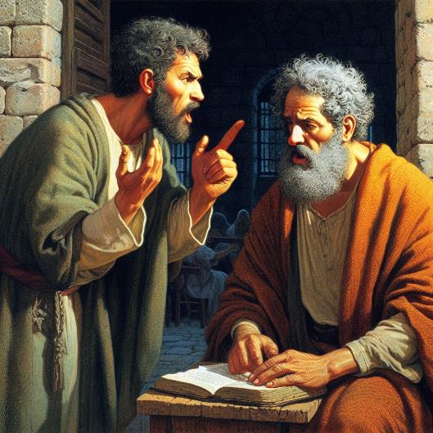
The Compelling Evidence
Peter’s Rebuke:
Peter never said that Simon did not believe the gospel.
Peter never said that Simon rejected Christ.
Notes:
Peter’s Rebuke
But what about Peter’s stinging rebuke?! Certainly, that indicates that Simon was not saved.
It is important to observe that Peter never says anything about Simon not believing or Simon rejecting Christ.

Slide 44
The Compelling Evidence
Peter said:
Your money perish with you!
John 3:16 … whoever believes in Him should not perish but have everlasting life.
Notes:
Peter indicates that Simon will perish with his money. When people read the word “perish” they automatically think of hell. After all, John 3:16 contrasts “eternal life” with “perishing.”
John 3:16 … whoever believes in Him should not perish but have everlasting life.

Slide 45
The Compelling Evidence
Will there be actual money in hell? Will money perish in hell?
1 Cor. 8:11 And because of your knowledge shall the weak brother perish, for whom Christ died?
(ESV) this weak person is destroyed.
(NASB) he who is weak is ruined.
Notes:
If Peter were speaking of that actual place called hell, then why would he say that Simon’s money would end up in this place of eternal punishment? Will money be punished in hell? The word “perish” (ἀπώλεια; apōleia) can refer to hell. But also has the meaning of ruin or waste.
Paul wrote:
1 Cor. 8:11 And because of your knowledge shall the weak brother perish, for whom Christ died?
In this case, Paul spoke about a genuine believer perishing because of the thoughtless actions of another Christian. The idea is that the weak brother is destroyed or ruined.
(ESV) this weak person is destroyed.
(NASB) he who is weak is ruined.

Slide 46
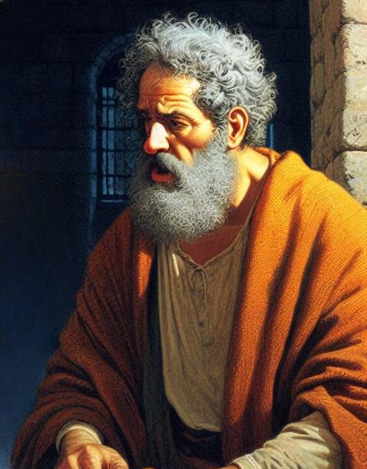
The Compelling Evidence
Simon had problems:
He had a distorted view of the apostle’s authority.
He did not understand the bestowal of the Holy Spirit.
He did not realize that his sin of coveting could have ruinous results for his newfound faith in Christ.
Notes:
Simon’s misguided request reveals a distorted view of the authority held by the apostles and the bestowal of the Holy Spirit. This misunderstanding could result in the ruin of Simon’s new life in Christ. Peter was simply warning Simon about his sin of coveting.

Slide 47
The Compelling Evidence
Keep in mind that Simon is a brand-new believer.
Babies are not expected to act as adults.
Growth takes time.
Notes:
Two things need to be kept in mind:
First we should consider that Simon is a brand-new Christian. As a result, Simon’s thought patterns have not yet undergone the renewing process that comes with sanctification. As a baby in Christ, he certainly cannot be expected to act like a mature believer.
Think for a moment about the life that Simon led prior to his conversion. Before his conversion, he astounded an entire city with satanic miracles. He is transitioning out of a life of occultic practices. He has had very little time to grow in his Christian life. The fact is that growth in the Christian life takes time. It is a process. It does not happen overnight. We live in a day of instant everything. Growth takes time.

Slide 48
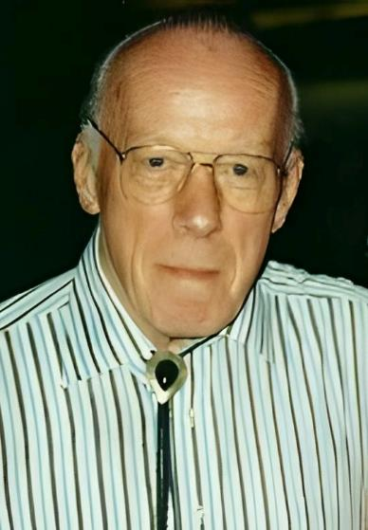
The Compelling Evidence
Miles Stanford:
“It seems that most believers have difficulty in realizing and facing up to the fact that God does not hurry in His development of our Christian life. He is working from and for eternity!”
Notes:
Miles Stanford: “It seems that most believers have difficulty in realizing and facing up to the fact that God does not hurry in His development of our Christian life. He is working from and for eternity!”

Slide 49
The Compelling Evidence
Simon was still thinking as a pagan.
He had a huge following.
He had power and influence.
He desired to regain that status.
He carried a lot of pagan baggage into his new-found faith.
Notes:
Simon is a very young Christian who still thinks like a pagan. He once had a huge following because of his occultic practices. He had tremendous power and influence. As a baby Christian he desired to regain that power. He wanted to be recognized as a person of great significance. Simon carried a lot of pagan baggage from his former life into his newfound Christian faith.
That is typical of those of us who were saved out of a pagan lifestyle.

Slide 50
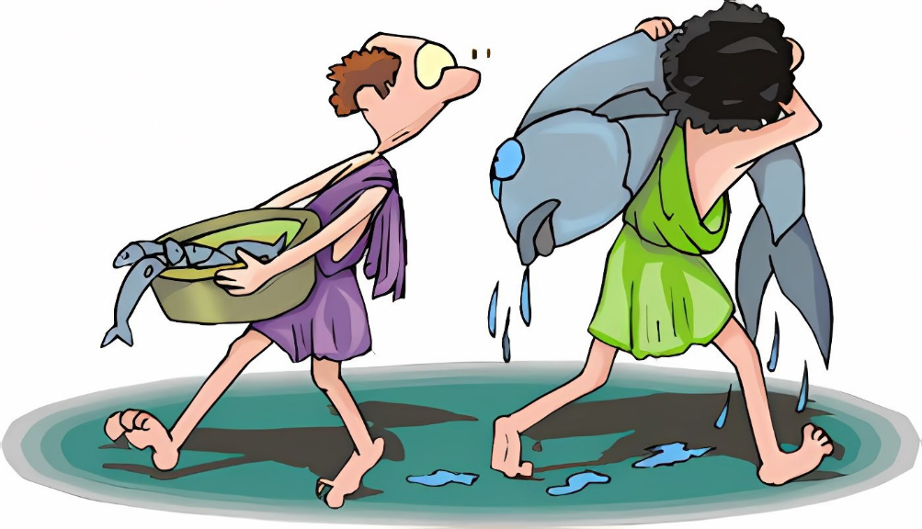
The Compelling Evidence
Thou shalt not covet!
Notes:
Second we should consider this: If the sin of coveting is the grounds for questioning someone’s salvation, then you and I are in BIG trouble. How many of us can honestly say that we have never coveted anything from the time we first trusted Christ for salvation?

Slide 51
The Compelling Evidence
Those who want to throw Simon under the bus might want to examine their own lives first for greediness.
Notes:
People want to throw Simon under the bus because he coveted a gift that the apostles had. Those who want to cast stones at Simon might want to examine their own lives to see if they have ever had greedy desires in their past.

Slide 52
The Compelling Evidence
Simon is not the first or the last person in the history of Christianity to covet power, prominence, or the spotlight.
Notes:
Simon is not the first or the last person in the history of Christianity to covet power, prominence, or the spotlight. Even today, we see many individuals pursuing ministry hoping to achieve fame or fortune. The pages of Christian history spanning 2,000 years are filled with such stories.

Slide 53
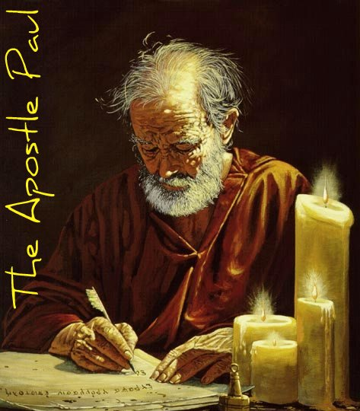
The Compelling Evidence
Some indeed preach Christ even from envy and strife, and some also from goodwill: The former preach Christ from selfish ambition…
Phil 1:15–16
Notes:
Paul spoke of individuals with questionable motives in the early Church. In his letter to the Philippians, he mentions that some fellow believers were preaching Christ out of envy and strife, driven by selfish ambition rather than pure motives (Phil. 1:14-17). Simon’s problem is similar to these individuals.

Slide 54
The Compelling Evidence
What is the real issue?
Justification?
The 1st tense of Salvation?
Sanctification?
The 2nd tense of Salvation?
or
Notes:
What is the issue that Peter is dealing with? Was Peter concerned with Simon’s salvation? Or was Peter concerned with Simon’s sanctification? The issue at hand is not a matter of justification. Rather, it’s a matter of Christian growth (aka progressive sanctification). Simon, like those Paul mentions in Philippians, is still grappling with impure motives and a mindset that has not yet been fully renewed by the work of the Holy Spirit.

Slide 55
The Compelling Evidence
Peter said:
“You have neither part nor portion in this matter” (v. 21).
Peter was not saying that Simon had no portion in salvation.
Notes:
Peter also said, “You have neither part nor portion in this matter” (v. 21). No portion in what? He has no portion in the apostolic privilege of bestowing the gift of the Holy Spirit. Peter was not saying that Simon had no portion in salvation.

Slide 56
The Compelling Evidence
Peter said:
“Your heart is not right in the sight of God.” (v. 21)
Notes:
Then Peter says that Simon’s heart is not right with God (v. 21).
People say this proves that Simon was an unbeliever. Only an unbeliever’s heart is not right with God.
David’s heart was not right with God after he committed adultery with Bathsheba and had Uriah murdered. David lived with his sin for about a year before Nathan confronted him. During this time, David’s conscience was overwhelmed with guilt and “the hand of the Lord was heavy” upon him. Despite the guilt, David did not confess his sin until Nathan confronted him. Psalm 51 is an account of David getting his heart right with God.

Slide 57
The Compelling Evidence
Peter said:
“Therefore repent of this wickedness of yours, and pray to the Lord that the intent of your heart may be forgiven you.” (v. 22)
Notes:
Peter told Simon:
Acts 8:22 Therefore repent of this wickedness of yours, and pray to the Lord that the intent of your heart may be forgiven you. (HCSB)
Some claim that this proves Simon was not saved. They reason that only an unbeliever needs to repent. Or that only unsaved people need forgiveness. The fact is that believers also need forgiveness.

Slide 58
The Compelling Evidence
1 John 1:9:
If we confess our sins, He is faithful and just to forgive us our sins and to cleanse us from all unrighteousness.
Fact: Even believers need forgiveness!
Notes:
This is precisely what 1 John 1:9 says:
If we confess our sins, He is faithful and just to forgive us our sins and to cleanse us from all unrighteousness.

Slide 59
The Compelling Evidence
Peter said:
“You are poisoned by bitterness and bound by iniquity.” (v. 22)
Peter did not say, “you are dead in sin and separated from God.”
Notes:
Peter told Simon that he was “poisoned by bitterness and bound by iniquity.” He did not tell Simon that he was dead in sin or separated from God.

Slide 60
The Compelling Evidence
Believers can yield to bitterness and sin.
Eph. 4:31 Let all bitterness, wrath, anger, clamor, and evil speaking be put away from you, with all malice.
Heb. 12:15 Looking carefully lest anyone fall short of the grace of God; lest any root of bitterness springing up cause trouble, and by this many become defiled.
Notes:
The fact is that believers can yield to bitterness and sin.
Eph. 4:31 Let all bitterness, wrath, anger, clamor, and evil speaking be put away from you, with all malice.
<click>
Heb. 12:15 Looking carefully lest anyone fall short of the grace of God; lest any root of bitterness springing up cause trouble, and by this many become defiled.

Slide 61
The Compelling Evidence
Simon said:
“Pray to the Lord for me, that none of the things which you have spoken may come upon me.” (v. 24)
Simon’s request describes the response of a believer; not an unbeliever.
Notes:
After hearing Peter’s rebuke, Simon responded by asking the apostles to pray for him so that none of Peter’s words would become reality. Simon did not ask for salvation. Rather, he repented of the specific sin that Peter addressed. This describes the response of a believer; not an unbeliever.

Slide 62
Conclusion
Simon was a new believer.
His faith was genuine.
He was saved out of a pagan lifestyle.
He had no time for growth.
Notes:
Conclusion
We should view Simon the Sorcerer as a recent convert. His faith was genuine. He recently came out of a background deeply entrenched in the occult. He had little or no time to grow in his faith.

Slide 63
Conclusion
Peter’s harsh words can apply to believers.
Notes:
When we examine Peter’s words to Simon, we can see that these rebukes can be applied to believers. In this light, we can better understand Simon as a new believer in need of spiritual growth.

Slide 64
Conclusion
Arminian’s claim that Simon lost his salvation.
Calvinists question the genuineness of Simon’s faith.
There is no basis for either of these views.
Notes:
There’s no compelling reason to claim that Simon lost his salvation, as Arminians claim. Likewise, there is very little basis to question the genuineness of Simon’s faith.

Slide 65
Conclusion
The Samaritans believed and were baptized.
Simon believed and was baptized.
Notes:
In fact, there is more than enough evidence to support the view that Simon was saved. Simon believed in Jesus Christ like the other Samaritans. Simon was saved and baptized like the Samaritans.
But as an immature believer, he fell back into his pagan way of thinking. He was in danger of experiencing God’s temporal judgment for desiring to purchase an apostolic power.
The fact is that all Christians are prone to sin. And this is especially true for new converts.

Slide 66
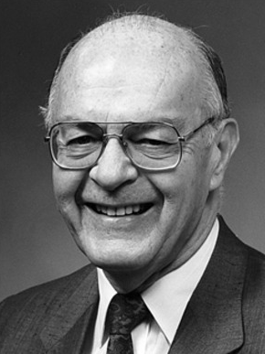
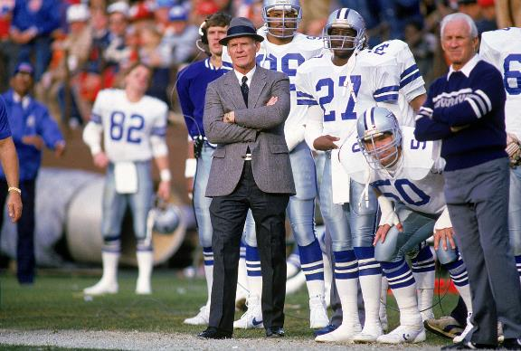
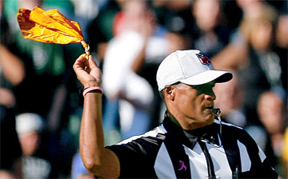
Conclusion
Dr. Howard Hendricks was chaplain of the Dallas Cowboys from 1976 to 1984
Notes:
Howard Hendricks served as chaplain for the Dallas Cowboys from 1976-1984. He led a number of players to the Lord. He said that he always hated to say who was the latest football player to receive Christ.
<click>
Because invariably on the following Sunday that brand new baby Christian would have a 15-yard penalty called upon him for unsportsmanlike conduct.
<click>
The problem is that baby Christians are just like newborn infants. They often mess their diapers.

Slide 67
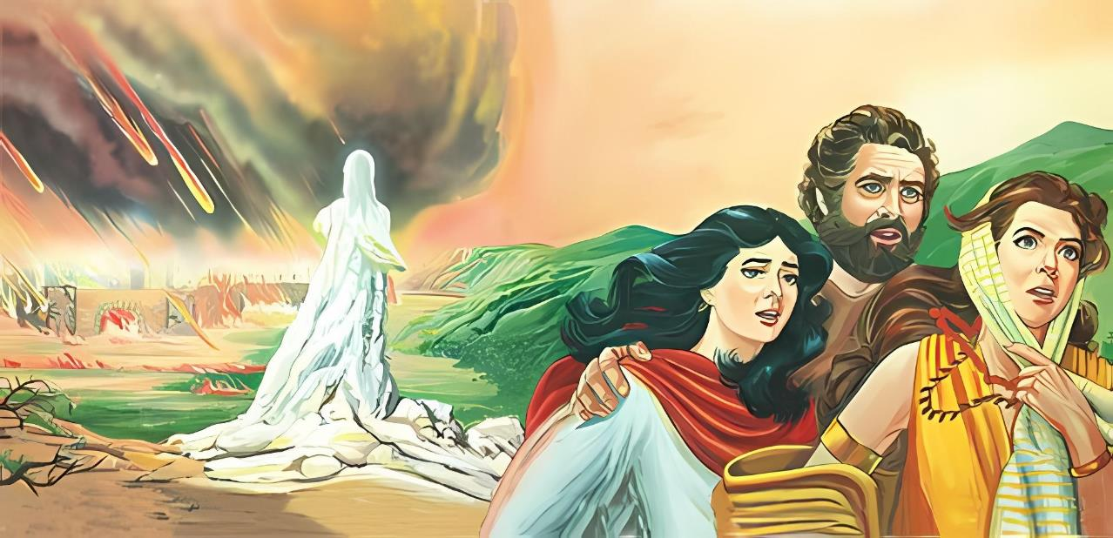
Conclusion
2 Peter 2:7–8 [God] delivered righteous Lot, who was oppressed by the filthy conduct of the wicked (for that righteous man, dwelling among them, tormented his righteous soul from day to day by seeing and hearing their lawless deeds).
Notes:
Theologians seem to write people off much quicker than God does.
Example: Lot sure looked like an unbeliever in the O.T. Yet, we get a whole different view of Lot in the N.T.
<click>
2 Peter 2:7–8 [God] delivered righteous Lot, who was oppressed by the filthy conduct of the wicked (for that righteous man, dwelling among them, tormented his righteous soul from day to day by seeing and hearing their lawless deeds).

Slide 68
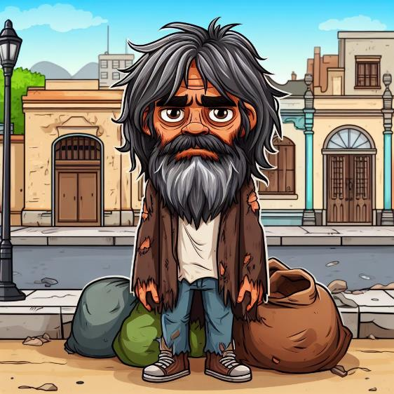
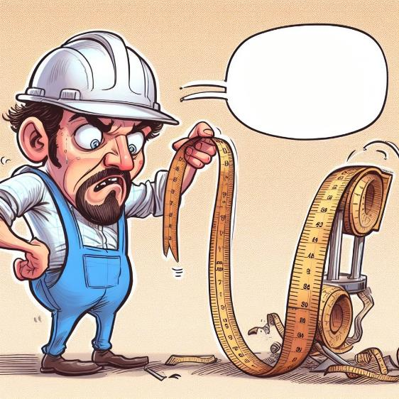
Conclusion
Say what?!
He must not be a true Christian!
Good works make a bad measuring rod!
Notes:
I hear people say that “________” must not be saved because of x, y, or z.
<click>
Good works or lack of good works is a horrible measuring rod to determine someone’s salvation.
The sad fact is that many of us tend to write people off simply because they are not living up to our standards.

Slide 69
Conclusion
Mt. 7:16a You will know them by their fruit.
This verse is talking about false teachers!
Self appointed fruit inspector
Notes:
We justify ourselves by quoting: Mt. 7:16a You will know them by their fruit.
Newsflash: That verse is talking about false teachers. It has absolutely nothing to do with judging the genuineness of another believer’s salvation. There is an inherent danger in being a fruit inspector. Many times, our list of fruit does not match up with God’s list of fruit.

Slide 70
Conclusion
Will a Christian always bear fruit?
Notes:
A point of contention in the debate between lordship salvation and free grace has to do with bearing fruit. Will a Christian always bear fruit?
Charles Ryrie, a free grace theologian, had this to say about that question:

Slide 71
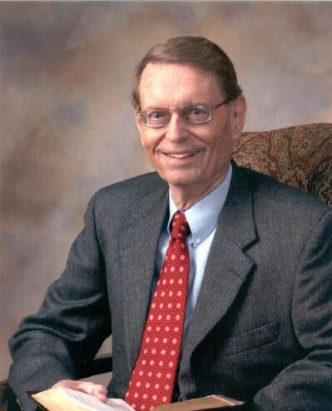
Conclusion
Charles Ryrie:
Every Christian will bear spiritual fruit. Somewhere, sometime, somehow.… Having said that, some caveats are in order.
Notes:
Charles Ryrie, a free grace theologian, had this to say about that question:
Every Christian will bear spiritual fruit. Somewhere, sometime, somehow.… Having said that, some caveats are in order.

Slide 72
Conclusion
Charles Ryrie:
One, this does not mean that a believer will always be fruitful.
Notes:
One, this does not mean that a believer will always be fruitful. Certainly, we can admit that if there can be hours and days when a believer can be unfruitful, then why may there not also be months and even years when he can be in that same condition? Paul exhorted believers to engage in good works so they would not be unfruitful (Titus 3:14). Peter also exhorted believers to add the qualities of Christian character to their faith lest they be unfruitful (2 Peter 1:8). Obviously, both of those passages indicate that a true believer might be unfruitful. And the simple fact that both Paul and Peter exhort believers to be fruitful shows that believers are not always fruitful.

Slide 73
Conclusion
Charles Ryrie:
Two, this does not mean that a certain person’s fruit will necessarily be outwardly evident.
Notes:
Two, this does not mean that a certain person’s fruit will necessarily be outwardly evident. Even if I know the person and have some regular contact with him, I still may not see his fruit. Indeed, I might even have legitimate grounds for wondering if he is a believer because I have not seen fruit. His fruit may be very private or erratic, but the fact that I do not see it does not mean it is not there.

Slide 74
Conclusion
Charles Ryrie:
Three, my understanding of what fruit is and therefore what I expect others to bear may be faulty and/or incomplete.
Notes:
Three, my understanding of what fruit is and therefore what I expect others to bear may be faulty and/or incomplete. It is all too easy to have a mental list of spiritual fruits and to conclude if someone does not produce what is on my list that he or she is not a believer. But the reality is that most lists that we humans devise are too short, too selective, too prejudiced, and often extra-biblical. God likely has a much more accurate and longer list than most of us do.

Slide 75
The landowner said, “No! If you pull out the weeds, you might pull out the wheat with them (Mt. 13:29).”
Notes:
Jesus told a parable about the wheat and the tares (aka weeds). An enemy of a certain landowner planted weeds among the wheat. The servants of the landowner asked if they should tear out the weeds. But the landowner said, “No! If you pull out the weeds, you might pull out the wheat with them (Mt. 13:29).”

Slide 76
Conclusion
Many people write off the Simons of this world.
In doing so, they damage the lives of baby believers.
Fact: Babies mess their diapers!
Notes:
Many Christians are more than willing to pass judgment on the Simons of this world. They write off immature believers as simply being weeds rather than genuine wheat. In doing so, they end up damaging the lives of these baby believers. The fact is that babies mess their diapers.

Slide 77
Conclusion
Old saying: Don’t throw the baby out with the bathwater!
New saying: Don’t throw the baby out with the messy diaper!
Notes:
Old saying: Don’t throw the baby out with the bathwater!
<click>
New saying: Don’t throw the baby out with the messy diaper!

Slide 78
Conclusion
The grace that freely saves unbelievers will also abundantly forgive believers.
Notes:
We all need God’s grace and forgiveness! The grace that freely saves unbelievers will also abundantly forgive believers.

Slide 79
title
text

Slide 80
title
text

Slide 81
text

