Slide 1

Notes:
Even growing up in an unsaved family, I always enjoyed Christmas. I did not understand what Christmas was all about. But I still enjoyed that time of the year.

Slide 2
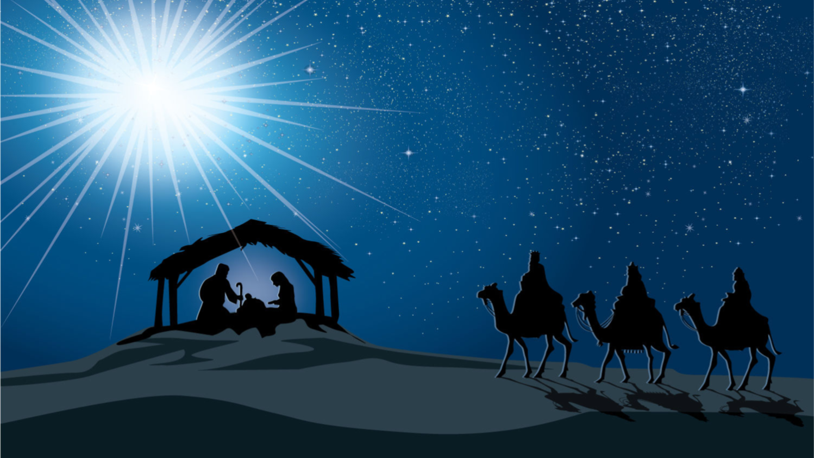
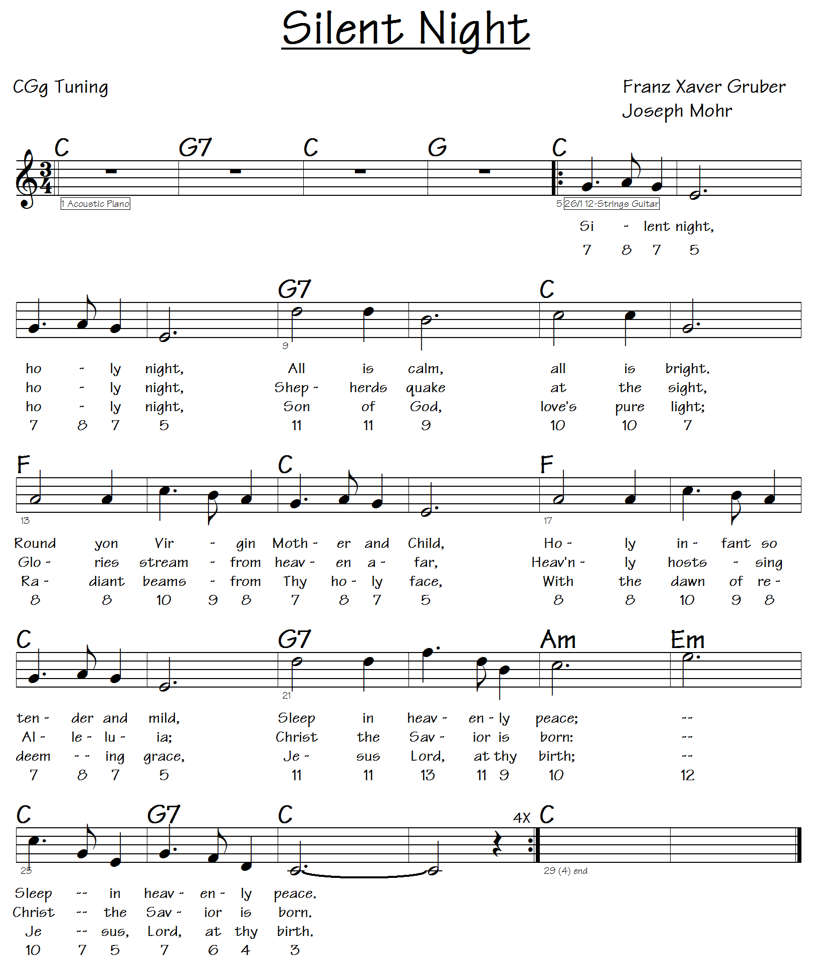
Notes:
I enjoyed singing Christmas carols, but I was clueless as to what the words meant. It wasn’t until I was saved in 1973, that I began to understand the words of those songs. As I began growing in my faith, I learned that Jesus probably was not born at the time of the year when we celebrate Christmas.

Slide 3
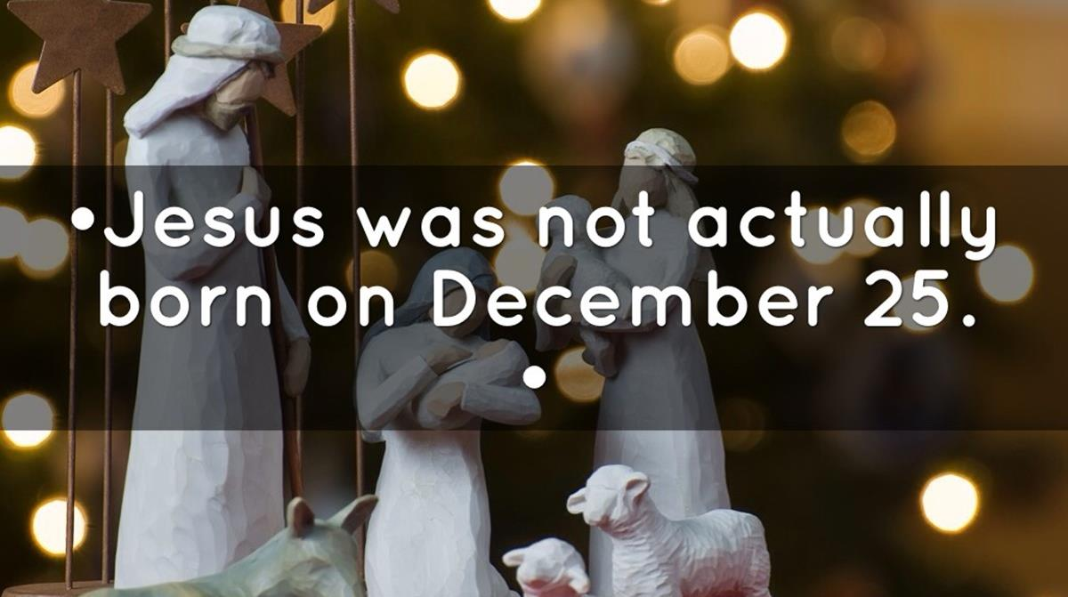
Notes:
According to many scholars, Jesus was not born on December 25th. In fact, many claim that Jesus was not born in December at all.

Slide 4
Encyclopedia Americana
“The reason for establishing December 25 as Christmas is somewhat obscure, but it is usually held that the day was chosen to correspond to pagan festivals that took place around the time of the winter solstice, when the days begin to lengthen, to celebrate the ‘rebirth of the sun.’ . . . The Roman Saturnalia (a festival dedicated to Saturn, the god of agriculture, and to the renewed power of the sun), also took place at this time.”
Notes:
Encyclopedia Americana: “The reason for establishing December 25 as Christmas is somewhat obscure, but it is usually held that the day was chosen to correspond to pagan festivals that took place around the time of the winter solstice, when the days begin to lengthen, to celebrate the ‘rebirth of the sun.’ . . . The Roman Saturnalia (a festival dedicated to Saturn, the god of agriculture, and to the renewed power of the sun), also took place at this time.”

Slide 5
Encyclopedia Britannica
“One widespread explanation of the origin of this date is that December 25 was the Christianizing of … a popular holiday in the Roman Empire that celebrated the winter solstice as a symbol of the resurgence of the sun, the casting away of winter and the heralding of the rebirth of spring and summer.”
Notes:
Encyclopedia Britannica: “One widespread explanation of the origin of this date is that December 25 was the Christianizing of … a popular holiday in the Roman Empire that celebrated the winter solstice as a symbol of the resurgence of the sun, the casting away of winter and the heralding of the rebirth of spring and summer.”

Slide 6
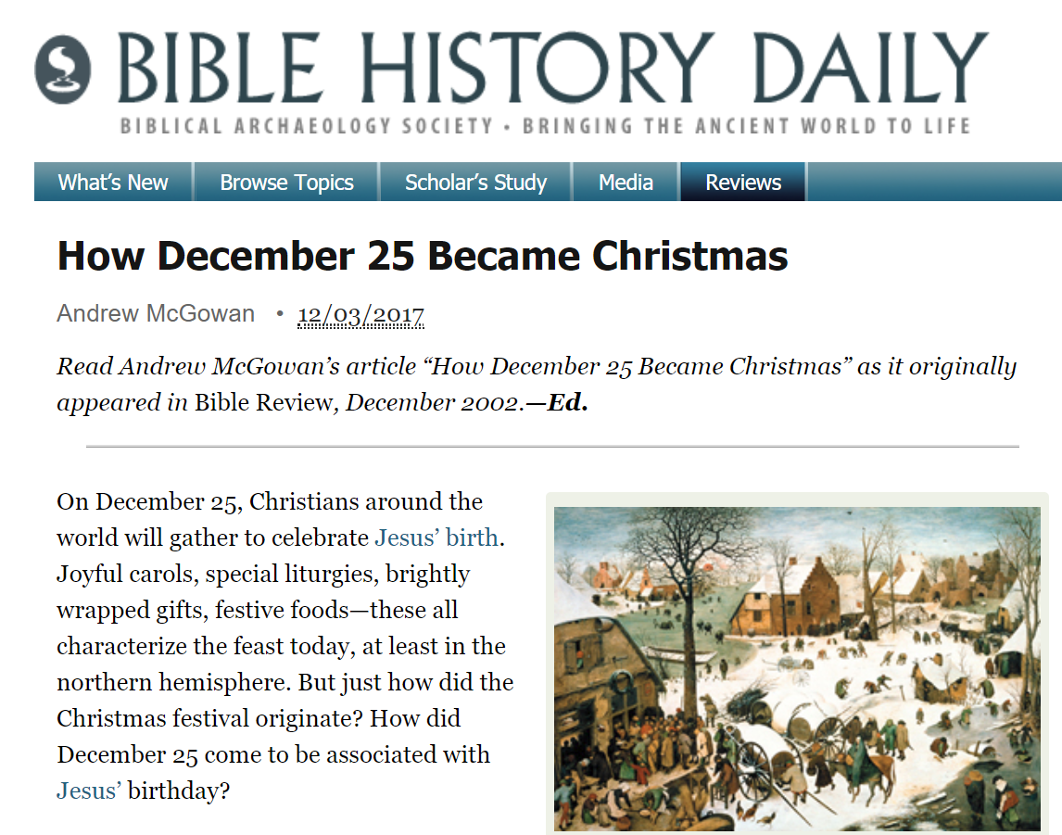
Notes:
The Biblical Archaeology Society questions the birth of Jesus being in December.

Slide 7
Christmas is a Pagan Holiday
Many claim that:
  The date of Christmas is based on a pagan festival.
  Jesus’ birth probably happened in the Spring or Fall.
  Shepherds were never in the fields during winter.
  Pope Liberius popularized December 25 in 354.
  The first ‘Christ mass’ was officiated by Pope Sixtus III in 435.
Notes:
Many claim that Christmas is just a pagan holiday. They claim:
The date of Christmas is based on a pagan winter festival.
The birth probably happened in the Spring or Fall.
Shepherds were not in the fields in winter.
December 25 was made popular by Pope Liberius in 354.
It became the rule in the West in 435 when the first "Christ mass" was officiated by Pope Sixtus III.
For this reason, many dismiss the celebration of Christmas because of its “pagan roots.”

Slide 8
Christmas is a Pagan Holiday
Notes:
Cartoon: You see, son, we buy a Christmas tree to celebrate an ancient Pagan tradition stolen by Christians.
They even belittle the beloved holiday special “A Charlie Brown Christmas.”

Slide 9
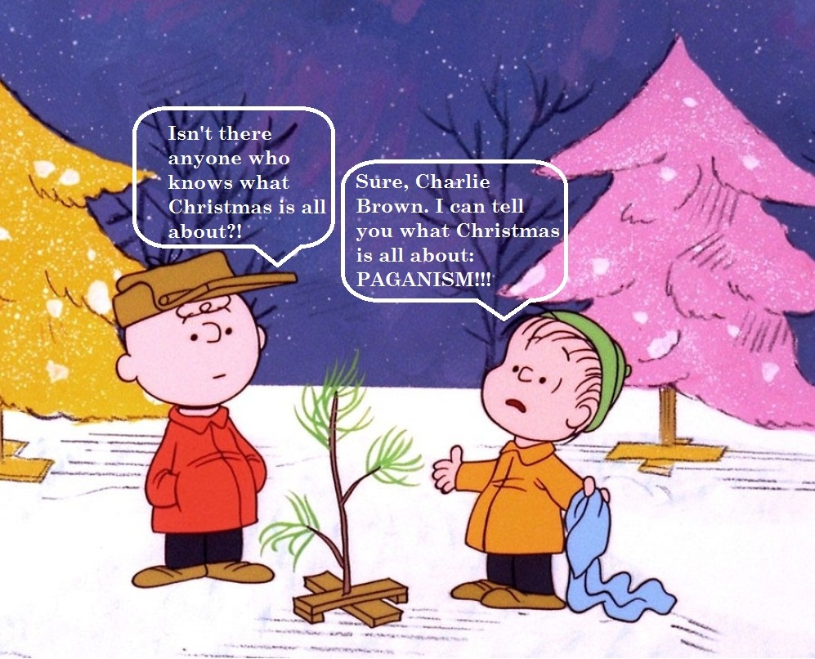
Christmas is a Pagan Holiday
Notes:
Cartoon:
Charlie Brown: Isn't there anyone who knows what Christmas is all about?!
Linus: Sure, Charlie Brown. I can tell you what Christmas is all about: PAGANISM!!!

Slide 10
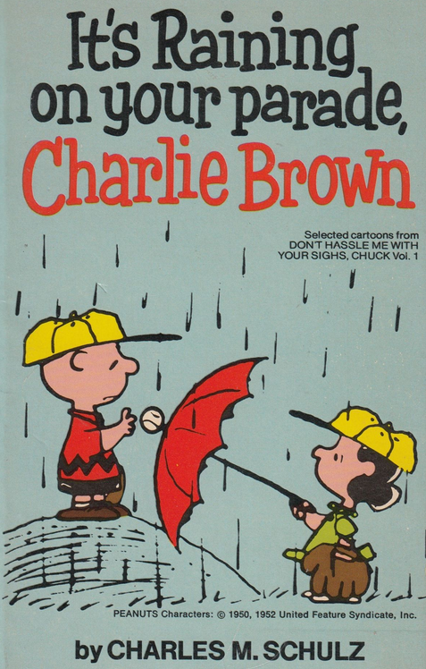
Christmas is a Pagan Holiday
Notes:
It seems like everyone wants to rain on Charlie Brown’s parade.

Slide 11

Christmas is a Pagan Holiday
Notes:
Even many who name the name of Christ hold to this tradition which has been taught by historians. Just do a search on Google and you will find many who refuse to celebrate Christmas.
Many religious organizations refuse to celebrate Christmas:

Slide 12
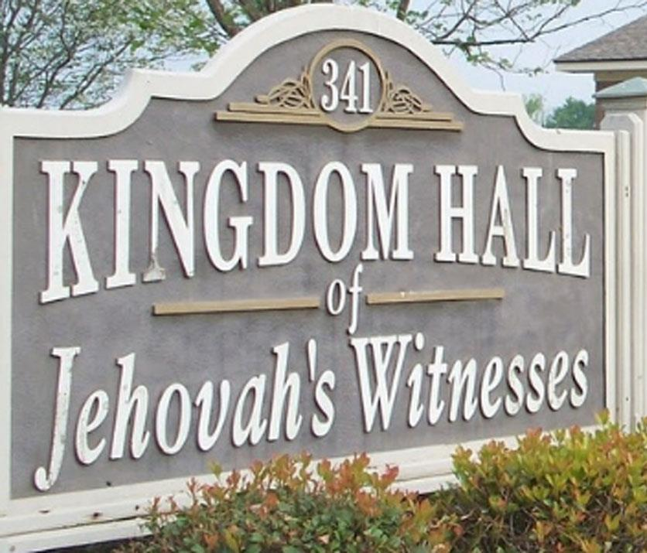
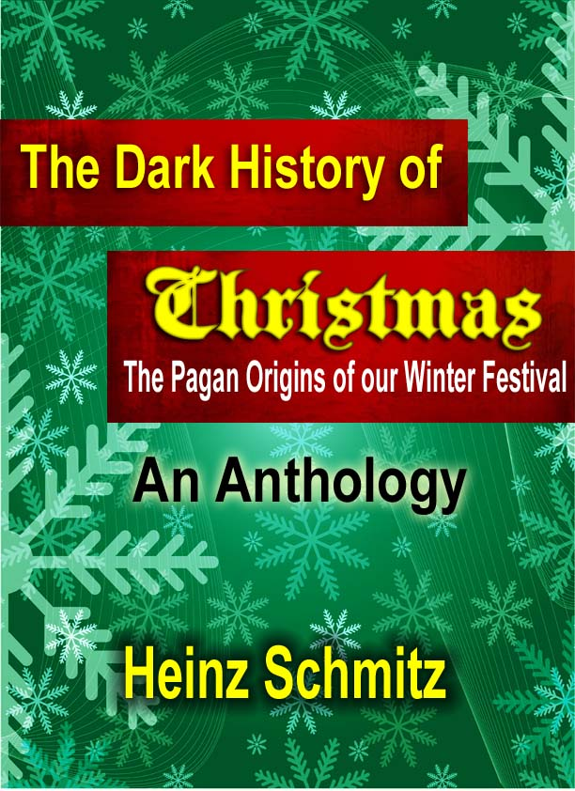
Do Not Celebrate Christmas!
Notes:
Jehovah's Witnesses

Slide 13
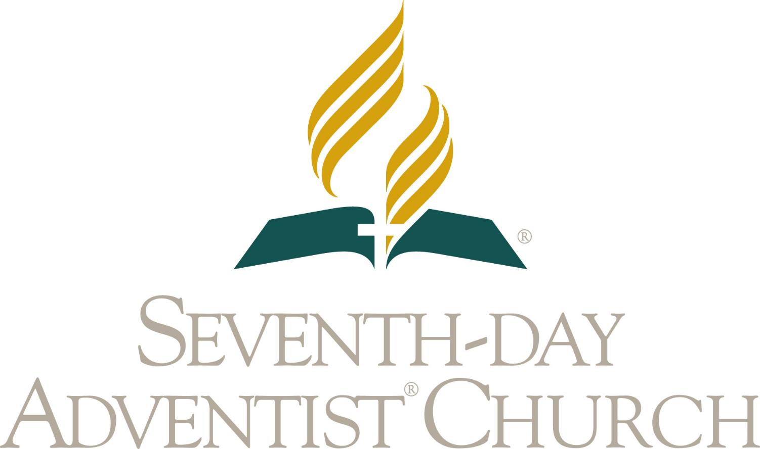
Do Not Celebrate Christmas!
Notes:
Seventh-day Adventists

Slide 14

Do Not Celebrate Christmas!
Notes:
United Church of God

Slide 15

Do Not Celebrate Christmas!
Notes:
Church of Christ

Slide 16
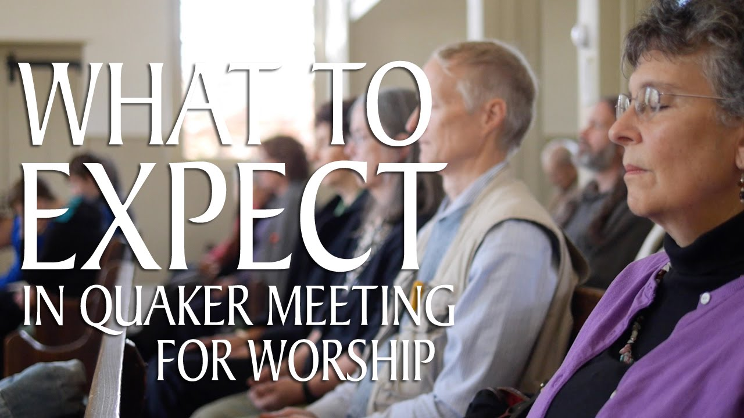
Do Not Celebrate Christmas!
Notes:
Some conservative Quakers

Slide 17

Do Not Celebrate Christmas!
Notes:
There is even a Facebook page for Christians who do not celebrate Christmas.

Slide 18
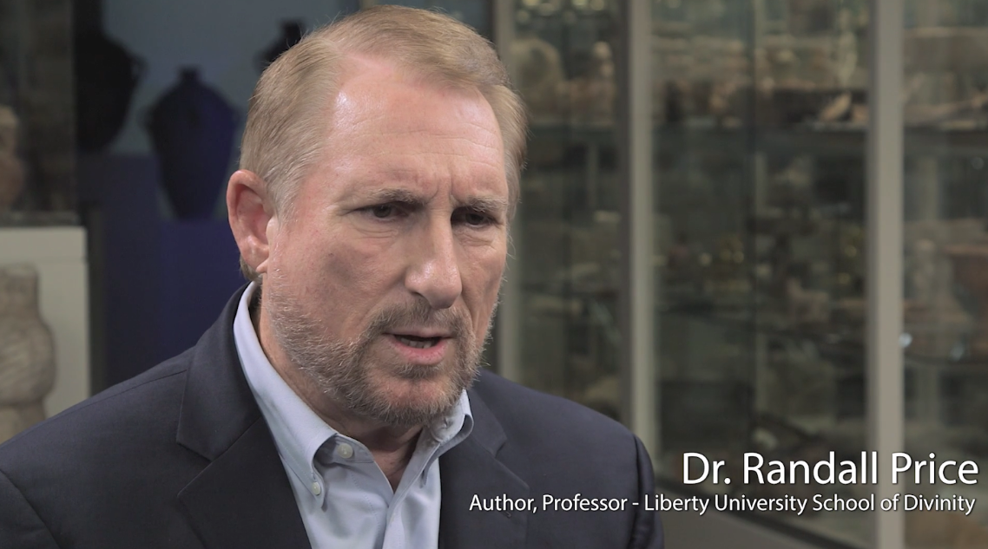
Dr. Randall Price
“Many scholars believe that Jesus was born in December.”
Notes:
However, not all Bible scholars hold to the tradition that Jesus was not born in December. Dr. Randall Price wrote that many scholars believe that Jesus was born in December. That surprised me since I had always heard that Jesus was not born in December.

Slide 19
Dr. Randall Price
Th.M. in Old Testament and Semitic Languages from Dallas Theological Seminary
Ph.D. in Middle Eastern Studies from the University of Texas at Austin
Studied at the Hebrew University of Jerusalem
Distinguished Research Professor and Executive Director of the Center for Judaic Studies at Liberty University
Director of Excavations on the Qumran Plateau in Israel (site of the Dead Sea Scrolls)
President of World of the Bible Ministries
Notes:
Who is Dr. Randall Price?
• Th.M. in Old Testament and Semitic Languages from Dallas Theological Seminary
• Ph.D. in Middle Eastern Studies from the University of Texas at Austin
• Studied at the Hebrew University of Jerusalem
• Distinguished Research Professor and Executive Director of the Center for Judaic Studies at Liberty University
• Director of Excavations on the Qumran Plateau in Israel (site of the Dead Sea Scrolls)
• President of World of the Bible Ministries

Slide 20
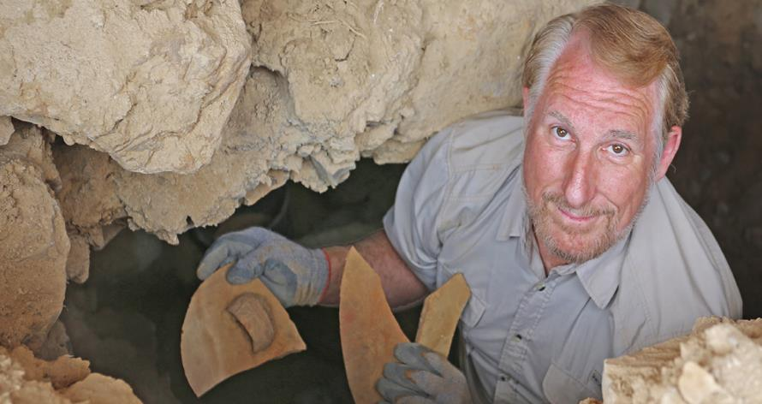
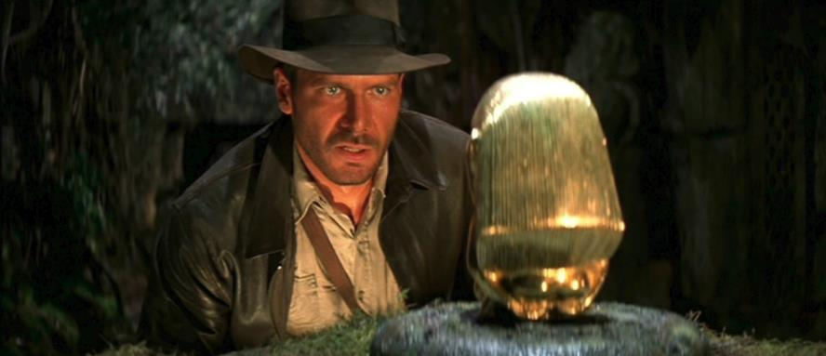
Dr. Randall Price—The Real-life Version of Indiana Jones
Notes:
Dr. Price is a distinguished Biblical archeologist. You might say that he is the real-life version of Indiana Jones.

Slide 21
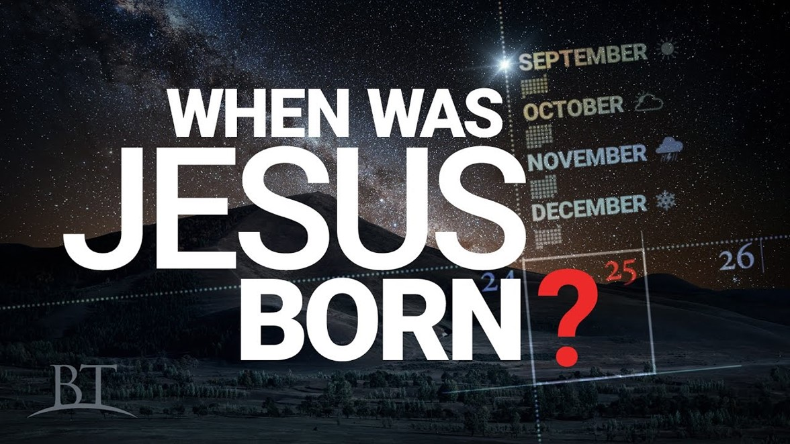
Notes:
This morning I would like to consider what time of the year that Jesus was actually born.

Slide 22
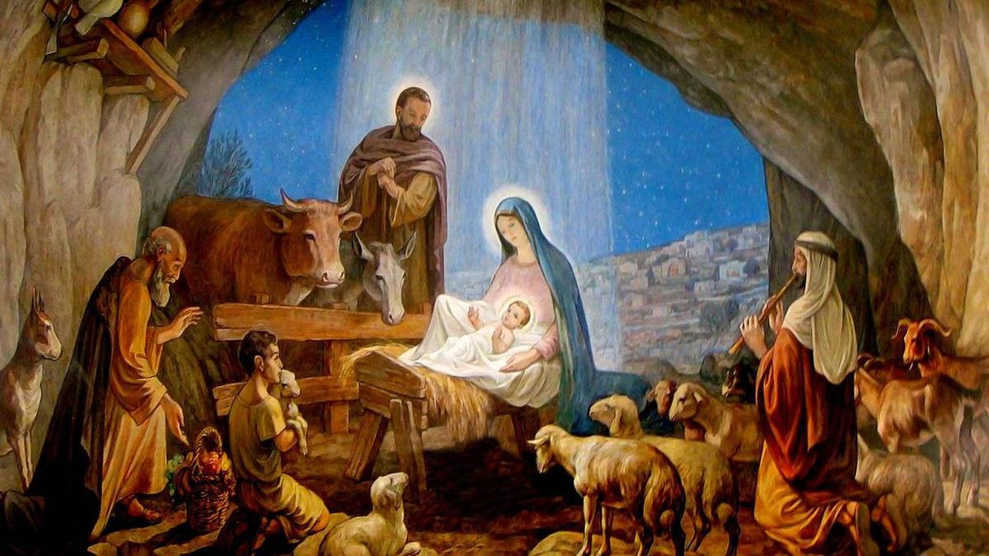
Did Christians Borrow a Pagan Holiday?
Notes:
This morning I would like to consider the question, “did Christians really borrow a pagan holiday?

Slide 23

Notes:
As we consider this question, we will look at 5 myths about Christmas which are often presented as historical facts.

Slide 24
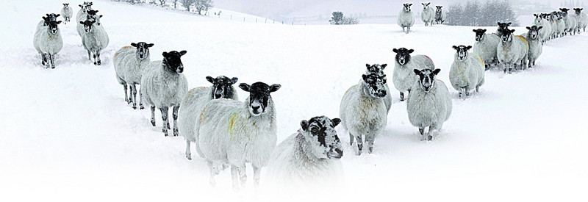
Myth #1
Claim: In December it would have been too cold for shepherds to be tending their flocks in the fields.
Notes:
Myth #1
Claim: In December it would have been too cold for shepherds to be tending their flocks in the fields.

Slide 25
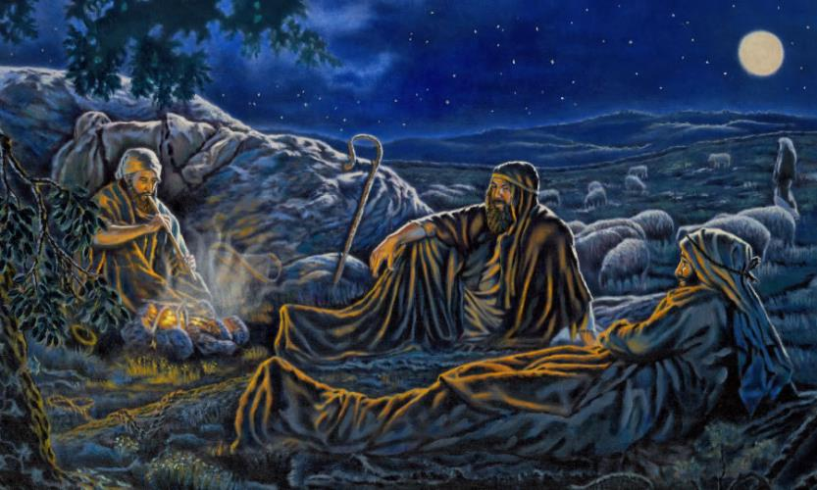
Myth #1
Luke 2:8 Now there were in the same country shepherds living out in the fields, keeping watch over their flock by night.
Notes:
Luke 2:8 Now there were in the same country shepherds living out in the fields, keeping watch over their flock by night.
According to God's word there were shepherds in the fields that night watching their flock. How could they have survived those frigid December nights near Bethlehem?

Slide 26
Myth #1
The first Noel the angel did say
Was to certain poor shepherds in fields as they lay;
In fields where they lay keeping their sheep,
On a cold winter's night that was so deep.
Notes:
I guess we should stop singing The First Noel, since obviously it is wrong!
The first Noel the angel did say was to certain poor shepherds in fields as they lay; In fields where they lay keeping their sheep, on a cold winter’s night that was so deep.

Slide 27



Myth #1
Fact: The normal low temperature for Bethlehem on December 25th is 44°F.
Notes:
Fact: The normal low temperature for Bethlehem on December 25th is 44 degrees. That would be equivalent to the normal low temperature for Jacksonville Fl, on Christmas Day.

Slide 28
Myth #1
Fact: Throughout the month of December daytime temperatures will generally reach highs of around 58°F in Bethlehem. At night the average minimum temperature drops down to around 44°F.
Notes:
Fact: Throughout the month of December daytime temperatures will generally reach highs of around 58°F in Bethlehem. At night the average minimum temperature drops down to around 44°F.

Slide 29
Myth #1
Fact: The lowest recorded temperature for Bethlehem in December was 30°F.
Notes:
Fact: The lowest recorded temperature in December was 30°F.

Slide 30
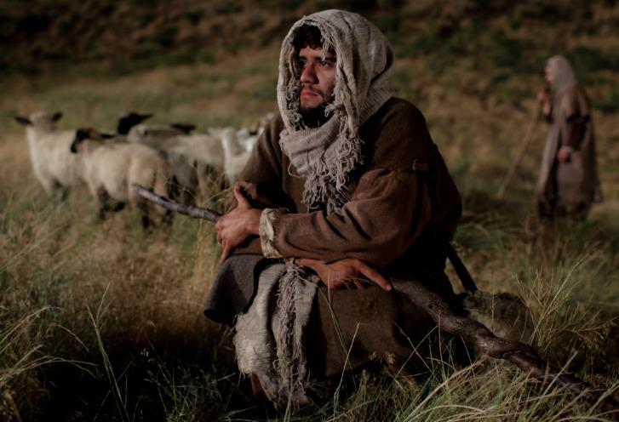
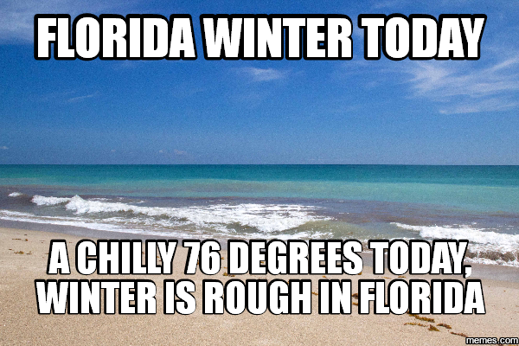
Myth #1
Fact: Shepherds in 1st century Israel would have been used to the outdoors climate.
Notes:
Fact: The shepherds in first century Israel would have been used to the outdoors climate in the winter. Here in Florida, we complain if the temperature drops into the 60’s!

Slide 31
Myth #2
The Argument: Lambing season is in the Spring of the year, not in December.
Adult shepherds spend nights with their flocks only during lambing season which is in the Spring.
Notes:
Myth #2
Claim: Lambing season is not in December.
The Argument:
Normally an older child or young teenager in the family stays with the sheep through the night rather than an adult. Even today, children of Middle Eastern shepherds mind the sheep through the night. The adults spend nights with their flocks only during lambing season. Ewes are basically helpless when giving birth. So, the shepherds stay with them to see that the newborn lambs are dried off and kept warm during that first cold night. Therefore, this must have occurred during the Spring of the year rather than winter.

Slide 32
Myth #2
Rebuttal: Lambing season varies greatly around the world. It is dependent on 2 factors:
1) Climate
2) The type of sheep being bred.
Notes:
The Rebuttal: This argument is based on lambing season in Great Britain and North America. The fact is that lambing season varies greatly around the world. Lambing season is dependent on 2 factors: 1) climate and 2) the type of sheep being bred.

Slide 33
Myth #2
Dr. Epstein:
  In Iraq, lambing is in November.
  In Lebanon, lambing is from Dec to Jan.
  In Syria, lambing is from Dec to Jan.
  In Israel, lambing is from Dec to Jan.
Notes:
Dr Epstein is Professor Emeritus of Animal Breeding at the Hebrew University of Jerusalem. He has no religious agenda. He says in Israel shepherds raise mainly Awassi sheep. He listed the normal lambing season of Awassi sheep in that region of the world. In Iraq, the principal lambing season of Awassi ewes is in November. In Lebanon, Syria and Israel in lambing season is from December to January.

Slide 34
Myth #2
Fact:
  Early Jewish sources say that the sheep around Bethlehem were outside year-round.
Notes:
Fact:
Early Jewish sources say that the sheep around Bethlehem were outside year-round.

Slide 35
Myth #2
Fact:
  Shepherds did watch their flocks in the fields near Bethlehem during that part of the year, especially sheep that were going to be offered in sacrifice at the Temple.
Notes:
Fact:
Shepherds did watch their flocks in the fields near Bethlehem during that part of the year, especially sheep that were going to be offered in sacrifice at the Temple.

Slide 36

Myth #3
Claim: The Church Fathers borrowed the date of Christ’s birth from a pagan festival.
Jehovah’s Witnesses
United Church of God
Seventh-day Adventists
Church of Christ
Quakers
Notes:
Myth #3
Claim: The Church Fathers borrowed the date of Christ’s birth from a pagan festival.
A few fringes groups within Evangelical circles seem to think that this makes Christmas itself a pagan festival. Most Christians are not concerned with the actual date of Christ’s birth. They celebrate His birth on December 25th and are not bothered by the fact that He may have been born at a different time of the year.

Slide 37
Myth #3
The Argument:
Christians first began celebrating December 25th as the date of Jesus’ birth in A.D. 336. They took this date from a pagan feast which was instituted by Aurelian in A.D. 274. Therefore, the date for Christmas is based on a pagan festival.
Notes:
Myth #3
The Argument: Christians first began celebrating December 25th as the date of Jesus’ birth in A.D. 336. They took this date from a pagan feast which was instituted by Aurelian in A.D. 274. Therefore, the date for Christmas is based on a pagan festival.

Slide 38
Myth #3
Fact:
The Church Fathers did not borrow the date from a pagan festival. December 25th was chosen because early Christians prior to A.D. 274 actually believed that’s when Jesus was born.
Notes:
Fact: The Church Fathers did not borrow the date from a pagan festival. December 25th was chosen because early Christians prior to A.D. 274 actually believed that’s when Jesus was born.

Slide 39
Myth #3
Bishop Hippolytus ( A.D. 202):
Jesus was born on December 25th.
That’s 72 years before Emperor Aurelian began his pagan festival.
Notes:
Bishop Hippolytus of Rome wrote a commentary around A.D. 202. He proposed that Jesus was born on December 25th. That’s 72 years before Emperor Aurelian began his pagan festival.

Slide 40
Myth #3
Julius Sextus Africanus (A.D. 221):
Jesus was born on December 25th.
That’s 53 years before Emperor Aurelian began his pagan festival.
Notes:
Julius Sextus Africanus was a Christian historian who lived around the time of Bishop Hippolytus. His greatest work was a treatise called Chronographiai. It was written in A.D. 221—53 years before the beginning of the pagan festival. In it, he claimed the same date as Bishop Hippolytus.

Slide 41
Myth #3
Aurelian’s pagan festival was probably an attempt to create an alternative to the date that the Church already taught as being the day of Christ’s birth.
Notes:
Actually, the pagan festival instituted by the Roman Emperor, Aurelian, in 274 was probably an attempt to create a pagan alternative to the date that the Church already taught as being the day of Christ’s birth

Slide 42
Myth #3
Aurelian instituted his pagan festival to unify the cults of the Roman Empire. His empire was collapsing from unrest, and economic decay. He hoped this new feast would reunite the Roman Empire.
Notes:
Aurelian instituted the festival of the “Birth of the Unconquered Sun.” He did this to unify the pagan cults of the Roman Empire around a the annual “rebirth” of the sun. His empire was collapsing from unrest, and economic decay. By creating this new feast, he hoped to unite the Roman Empire around the so-called gods which were thought to have brought Rome to its greatness and world domination. And if this festival co-opted the Christian celebration, so much the better.

Slide 43
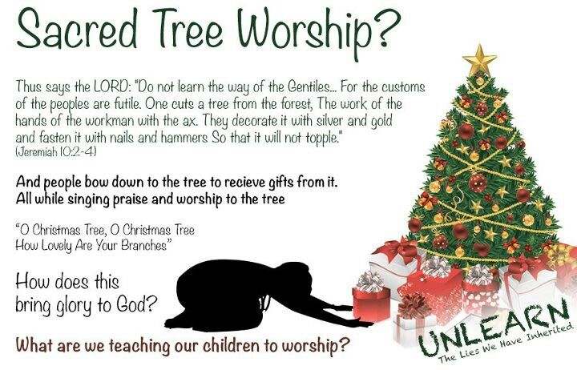
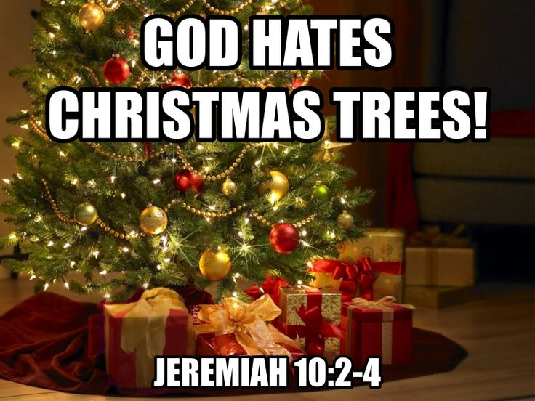
Myth #4
Claim: The Bible forbids decorating Christmas trees.
Notes:
Myth #4
Claim: The Bible forbids decorating Christmas trees.
People use Jeremiah 10:2-4 to support their claim. But does Jeremiah really say that God hates Christmas trees?

Slide 44
Myth #4
Jeremiah 10:1-2
Hear the word which the Lord speaks to you, O house of Israel. Thus says the Lord: “Do not learn the way of the Gentiles; Do not be dismayed at the signs of heaven, For the Gentiles are dismayed at them.
Notes:
Jeremiah 10:1-2 Hear the word which the Lord speaks to you, O house of Israel. Thus says the Lord: “Do not learn the way of the Gentiles; Do not be dismayed at the signs of heaven, For the Gentiles are dismayed at them.
First Question: Who is this text written to? It is not written to the church. The first clue to false doctrine is when the teacher applies truths written to Israel to the church!
Second Question: Are we Jews or Gentiles?
If the false teachers are correct, then God saying that we Gentiles should not learn from ourselves since we are Gentile. This makes no sense whatsoever. But this is what passes for good Bible interpretation from those who attempt to make the Bible say things that it absolutely does not say!

Slide 45
Myth #4
Jeremiah 10:3-4
For the customs of the peoples are futile; For one cuts a tree from the forest, The work of the hands of the workman, with the ax. They decorate it with silver and gold; They fasten it with nails and hammers So that it will not topple.
Notes:
Jeremiah 10:3-4 For the customs of the peoples are futile; For one cuts a tree from the forest, The work of the hands of the workman, with the ax. They decorate it with silver and gold; They fasten it with nails and hammers So that it will not topple.

Slide 46

Myth #4
Jeremiah 10:5
They are upright, like a palm tree, And they cannot speak; They must be carried, Because they cannot go by themselves. Do not be afraid of them, For they cannot do evil, Nor can they do any good.”
Notes:
Jeremiah 10:5 They are upright, like a palm tree, And they cannot speak; They must be carried, Because they cannot go by themselves. Do not be afraid of them, For they cannot do evil, Nor can they do any good.”
Since when are Christmas trees palm trees? Well, I guess in Florida some people decorate palm trees.

Slide 47
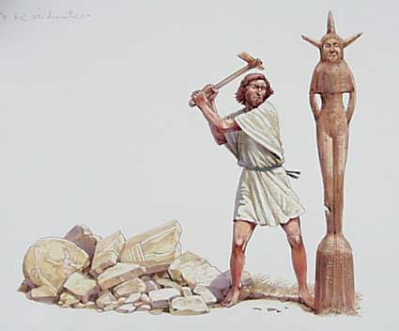
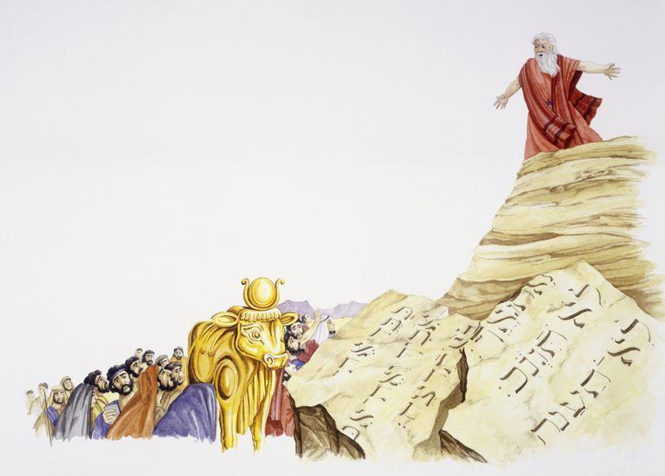

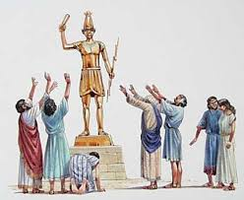
Myth #4
Claim: The Bible forbids decorating Christmas trees.
Notes:
Jeremiah is obviously dealing with idolatry and not Christmas trees.
This is a case simply ripping verses out of context to justify their nonsensical claim.

Slide 48

Pagan Rituals
Christians should not engage in Pagan rituals!
Notes:
Some people say that Christians should not engage in Pagan rituals!
Question: Which pagan rituals in our culture should we avoid? The problem is that we have so many of them.

Slide 49

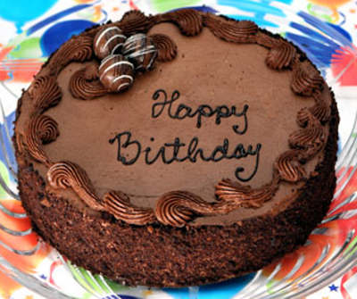
Pagan Rituals
Reply: Then why do you engage in Pagan rituals?!
Notes:
The idea of celebrating the date of your birth is a pagan tradition. In fact, many Christians didn’t celebrate birthdays historically, because of that link to paganism. Pagans thought that evil spirits lurked on days of major changes, like the day you turn a year older.

Slide 50
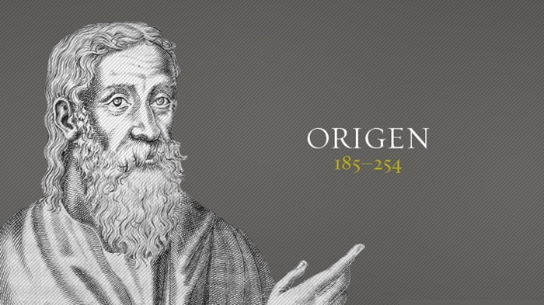
Pagan Rituals
Reply: Then why do you engage in Pagan rituals?!
Christians should not only refrain from celebrating their birthdays but should look on them with disgust.
Notes:
Documentation:
"Some one of those before us has observed what is written in Genesis about the birthday of Pharaoh, and has told that the worthless man who loves things connected with birth keeps birthday festivals; and we, taking this suggestion from him, find in no Scripture that a birthday was kept by a righteous man. " (Origen's Commentary on the Gospel of Matthew)
"None of the saints can be found who ever held a feast or a banquet upon his birthday, or rejoiced on the day when his son or daughter was born. But sinners rejoice and make merry on such days. For we find in the Old Testament that Pharaoh, king of Egypt, celebrated his birthday with a feast, and that Herod, in the New Testament did the same. But the saints not only neglect to mark the day of their birth with festivity, but also, filled with the Holy Spirit, they curse this day, after the example of Job and Jeremiah and David." (Origen's dissertation on Leviticus)

Slide 51
Pagan Rituals
Reply: Then why do you engage in Pagan rituals?!
Notes:
Baby Shower: Ancient Egyptians viewed pregnancy and childbirth as an important rite of passage, and they were celebrated with female-centred rituals. Ancient Greeks marked the birth of a child with celebratory rituals, including the dedication of gifts to the birth-goddess, Eileithyia.

Slide 52

Pagan Rituals
Reply: Then why do you engage in Pagan rituals?!
Notes:
Bridal Veil: The veiling of the bride has origins in the idea that she's vulnerable to enchantment, so she must be hidden from evil spirits. The Romans veiled brides in flame-colored veils to actually scare off those spirits and be protected from the “evil eye.”

Slide 53

Pagan Rituals
Reply: Then why do you engage in Pagan rituals?!
Notes:
Bridal Bouquet: Ancient Greek brides would carry clusters of herbs and spices to ward off evil spirits.

Slide 54
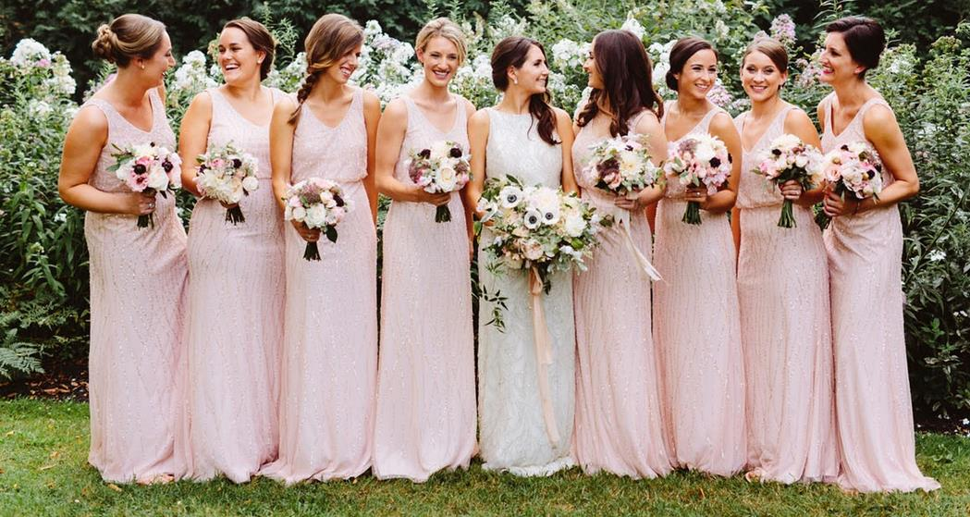
Pagan Rituals
Reply: Then why do you engage in Pagan rituals?!
Notes:
Bridesmaids dresses: Ever wonder why bridesmaids are often asked to wear matching dresses to support the bride during the processional? It wasn't always to ensure the bride stood out, while her besties donned tacky gowns. Quite the opposite, as bridesmaids originally wore similar dresses to the bride to confuse the evil spirits. That way, the evil spirits wouldn't know which woman in the group was getting married.

Slide 55
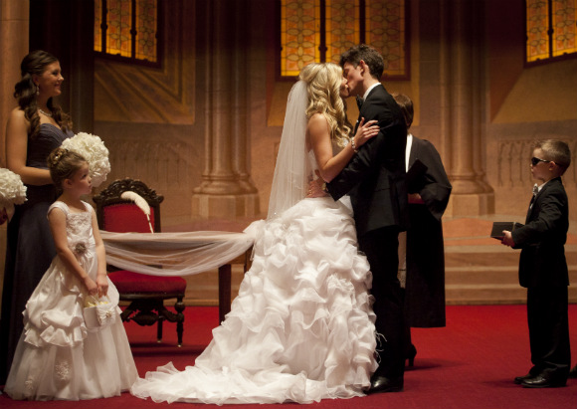
Pagan Rituals
Reply: Then why do you engage in Pagan rituals?!
Notes:
The First Kiss: It was customary for the priest to give a holy "kiss of peace" to the groom, who would then pass the kiss on the bride.

Slide 56

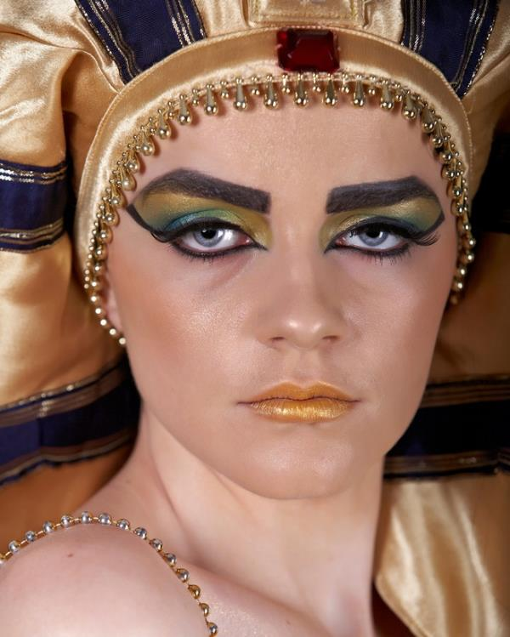
Pagan Rituals
Reply: Then why do you engage in Pagan rituals?!
Notes:
Eye shadow: Was worn in ancient Egypt by both men and women. It was believed that eye make-up could ward off evil spirits and improve the sight.

Slide 57
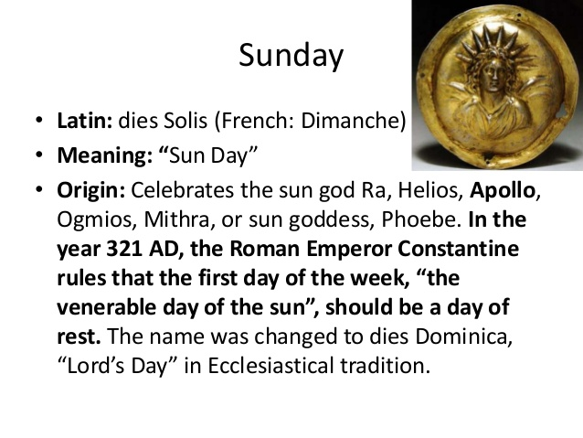
Pagan Rituals
Reply: Then why do you engage in Pagan rituals?!
Notes:
We better throw out all of our calendars:
Sunday: Lit. Sun Day which celebrates the Sun god.

Slide 58
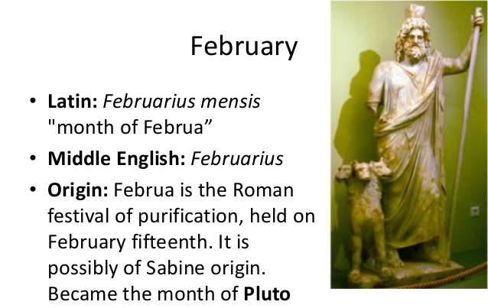
Pagan Rituals
Reply: Then why do you engage in Pagan rituals?!
Notes:
Februa is the Roman festival of purification.

Slide 59
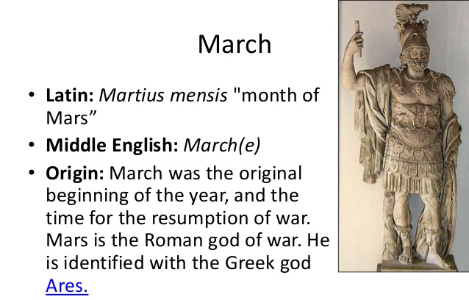
Pagan Rituals
Reply: Then why do you engage in Pagan rituals?!
Notes:
March was named for Mars the Roman god of war.

Slide 60
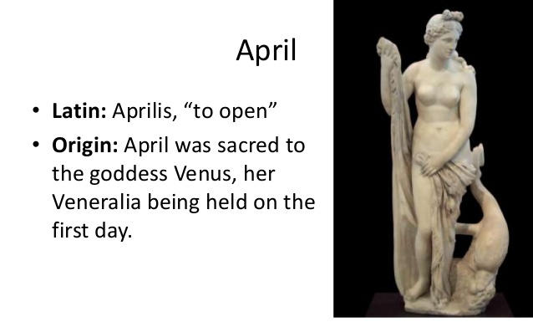
Pagan Rituals
Reply: Then why do you engage in Pagan rituals?!
Notes:
April was sacred to the goddess Venus.

Slide 61
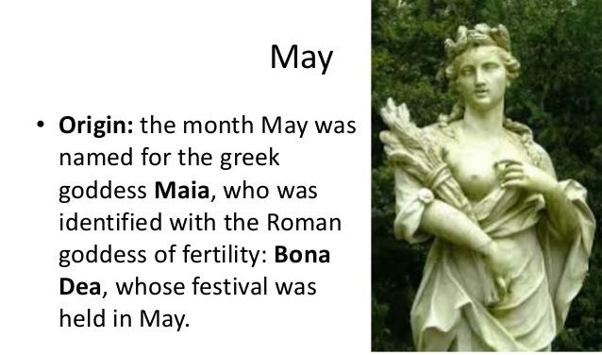
Pagan Rituals
Reply: Then why do you engage in Pagan rituals?!
Notes:
May was named for the Greek goddess Maia.

Slide 62
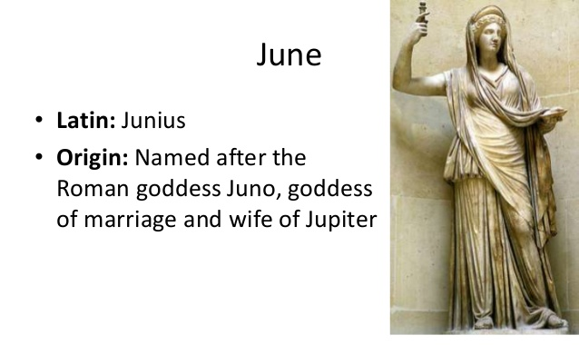
Pagan Rituals
Reply: Then why do you engage in Pagan rituals?!
Notes:
June was named after the Roman goddess Juno.

Slide 63

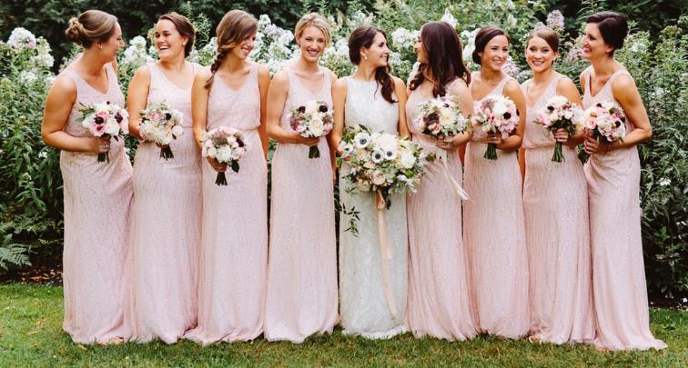
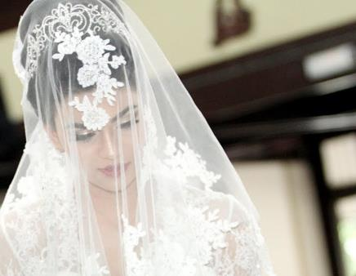
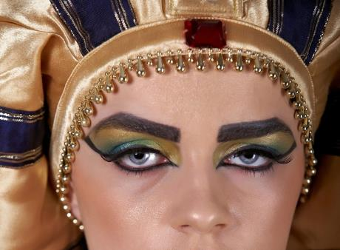
Pagan Rituals
Which Pagan rituals will you give up?!
Notes:
Which Pagan rituals will you give up?!

Slide 64


Myth #5
Claim: There is no evidence in the Bible that Jesus was born in December.
Notes:
Myth #5
There is no evidence in the Bible that Jesus was born in December.

Slide 65
Myth #5
Fact: The Bible does not explicitly say that Jesus was born in December. However, if you piece together the Biblical evidence, a case can be made for the birth of Jesus being in December.
Notes:
Fact: The Bible does not explicitly say that Jesus was born in December. However, if you piece together the Biblical evidence, a case can be made for the birth of Jesus being in December.

Slide 66
Myth #5
Evidence from Scripture.
Luke 1:5 There was in the days of Herod, the king of Judea, a certain priest named Zacharias, of the division of Abijah. His wife was of the daughters of Aaron, and her name was Elizabeth.
Notes:
Evidence from Scripture.
Luke 1:5 There was in the days of Herod, the king of Judea, a certain priest named Zacharias, of the division of Abijah. His wife was of the daughters of Aaron, and her name was Elizabeth.
While Zacharias was ministering in the temple an angel announced to him the birth of John the Baptist.

Slide 67
Myth #5
Evidence from Scripture.
Luke 1:23-24 So it was, as soon as the days of his service were completed, that he departed to his own house. Now after those days his wife Elizabeth conceived; and she hid herself five months.
Notes:
Luke 1:23-24 So it was, as soon as the days of his service were completed, that he departed to his own house. Now after those days his wife Elizabeth conceived; and she hid herself five months.
Is it possible to determine when in the calendar year his days of service occurred? If we can determine when John the Baptist was conceived, then we can roughly estimate when Jesus may have been conceived.

Slide 68
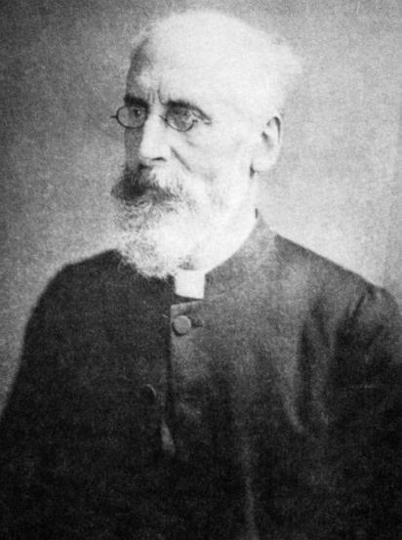
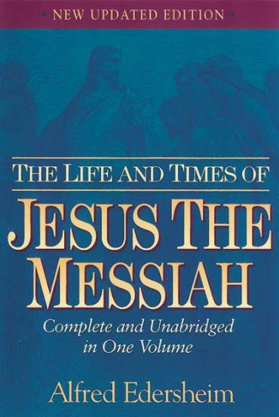
Myth #5
Alfred Edersheim:
Elisabeth probably conceived in October.
Notes:
Alfred Edersheim (The Life and Times of Jesus the Messiah, Appendix 7) used Jewish historical records to calculate when the priestly course of Abijah served in the temple. He concluded that Elisabeth probably conceived in October.

Slide 69
Myth #5
Zacharias performed his priestly duties on the Day of Atonement, also known as Yom Kippur.
Yom Kippur always falls in late September or early October.
Notes:
Other scholars say that Zacharias performed his priestly duties on the Day of Atonement, also known as Yom Kippur. That Jewish holy day always falls in late September or early October.

Slide 70
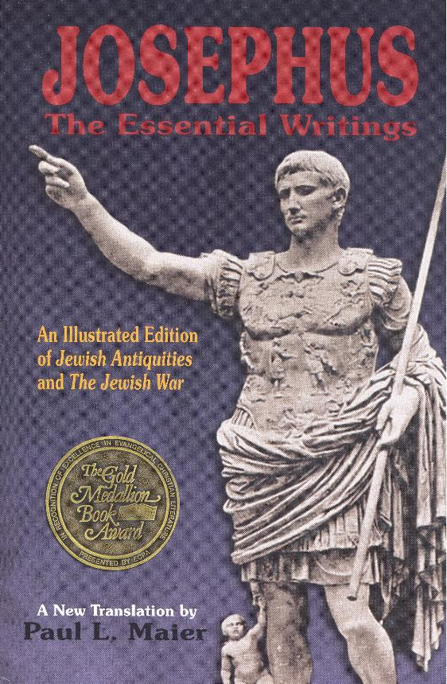
Myth #5
The priestly course of Abijah ministered on the Day of Atonement.
Notes:
A statement by Josephus also confirms that the priestly course of Abijah ministered on the Day of Atonement.

Slide 71
Myth #5
Evidence from Scripture.
Luke 1:26-27 Now in the sixth month the angel Gabriel was sent by God to a city of Galilee named Nazareth, to a virgin betrothed to a man whose name was Joseph, of the house of David. The virgin’s name was Mary.
Notes:
Luke 1:26-27 Now in the sixth month the angel Gabriel was sent by God to a city of Galilee named Nazareth, to a virgin betrothed to a man whose name was Joseph, of the house of David. The virgin’s name was Mary.

Slide 72
Myth #5
Evidence from Scripture.
Luke 1:35-36 And the angel answered and said to her, “The Holy Spirit will come upon you, and the power of the Highest will overshadow you; therefore, also, that Holy One who is to be born will be called the Son of God. Now indeed, Elizabeth your relative has also conceived a son in her old age; and this is now the sixth month for her who was called barren.
Notes:
Luke 1:35-36 And the angel answered and said to her, “The Holy Spirit will come upon you, and the power of the Highest will overshadow you; therefore, also, that Holy One who is to be born will be called the Son of God. Now indeed, Elizabeth your relative has also conceived a son in her old age; and this is now the sixth month for her who was called barren.

Slide 73
Myth #5
Evidence from Scripture.
Luke 1:39-44 Now Mary arose in those days and went into the hill country with haste, to a city of Judah, and entered the house of Zacharias and greeted Elizabeth. And it happened, when Elizabeth heard the greeting of Mary, that the babe leaped in her womb; and Elizabeth was filled with the Holy Spirit.
Notes:
Luke 1:39-44 Now Mary arose in those days and went into the hill country with haste, to a city of Judah, and entered the house of Zacharias and greeted Elizabeth. And it happened, when Elizabeth heard the greeting of Mary, that the babe leaped in her womb; and Elizabeth was filled with the Holy Spirit. …

Slide 74
Myth #5
Evidence from Scripture.
Luke 1:39-44 Then she spoke out with a loud voice and said, “Blessed are you among women, and blessed is the fruit of your womb! But why is this granted to me, that the mother of my Lord should come to me? For indeed, as soon as the voice of your greeting sounded in my ears, the babe leaped in my womb for joy.
Notes:
… Then she spoke out with a loud voice and said, “Blessed are you among women, and blessed is the fruit of your womb! But why is this granted to me, that the mother of my Lord should come to me? For indeed, as soon as the voice of your greeting sounded in my ears, the babe leaped in my womb for joy.
If Elizabeth conceived in late September, and Mary visited her in her sixth month, that means Mary conceived Jesus and visited Elizabeth in late March. And if Mary conceived Jesus in late March, that places his birth in late December.

Slide 75
Myth #5
The Integral Age Theory.
Jewish rabbis believed that God appointed for the great prophets an “integral age.” They said that great prophets died on the same day they entered the world through birth or conception.
Notes:
The Integral Age Theory.
Jewish rabbis believed that God appointed for the great prophets an “integral age.” They said that great prophets died on the same day they entered the world through birth or conception.

Slide 76
Myth #5
The Integral Age Theory.
The early church believed that Jesus was crucified on March 25th (the normal date for Passover). Borrowing from Jewish tradition, the early Church Fathers believed that Jesus died the same day that He first entered the world through conception. If Jesus was conceived on March 25th then His birth would have been 9 months later which is December 25th.
Notes:
The early church believed that Jesus was crucified on March 25th (the normal date for Passover). Borrowing from Jewish tradition, the early Church Fathers believed that Jesus died the same day that He first entered the world through conception. If Jesus was conceived on March 25th then His birth would have been 9 months later which is December 25th.

Slide 77
Myth #5
The Integral Age Theory.
The Integral Age Theory cannot be found in scripture. But the Bible’s timeline of Elizabeth’s conception and Mary’s conception would put the birth of Jesus around the end of December or first of January.
Notes:
The Integral Age Theory cannot be found in scripture. But the Bible’s timeline of Elizabeth’s conception and Mary’s conception would put the birth of Jesus around the end of December or first of January.

Slide 78

Myth #5
Alfred Edersheim:
“There is no adequate reason for questioning the historical accuracy of this date. The objections generally made rest on grounds which seem to me historically untenable.”
Notes:
Alfred Edersheim wrote, “There is no adequate reason for questioning the historical accuracy of this date. The objections generally made rest on grounds which seem to me historically untenable.”

Slide 79
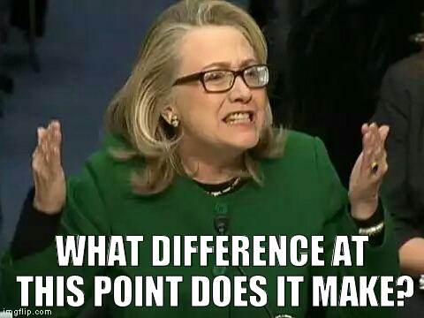
So What?
Notes:
So what?!
What difference does it make?

Slide 80

Notes:
In the grand scheme of things, does it really matter?

Slide 81

The evidence says that the early Christians did NOT borrow a pagan festival!
Notes:
If the scholars are correct, then we are guilty of putting lipstick on a pig by Christianizing pagan practices. However, I believe the evidence says that the early Christians did NOT borrow a pagan festival!

Slide 82
Bottom Line:
It’s a matter of Christian Liberty
So let no one judge you in food or in drink, or regarding a festival or a new moon or sabbaths, which are a shadow of things to come, but the substance is of Christ.
Col. 2:16-17
Notes:
Bottom Line: It’s a matter of Christian Liberty
So let no one judge you in food or in drink, or regarding a festival or a new moon or sabbaths, which are a shadow of things to come, but the substance is of Christ. –Col. 2:16-17

Slide 83
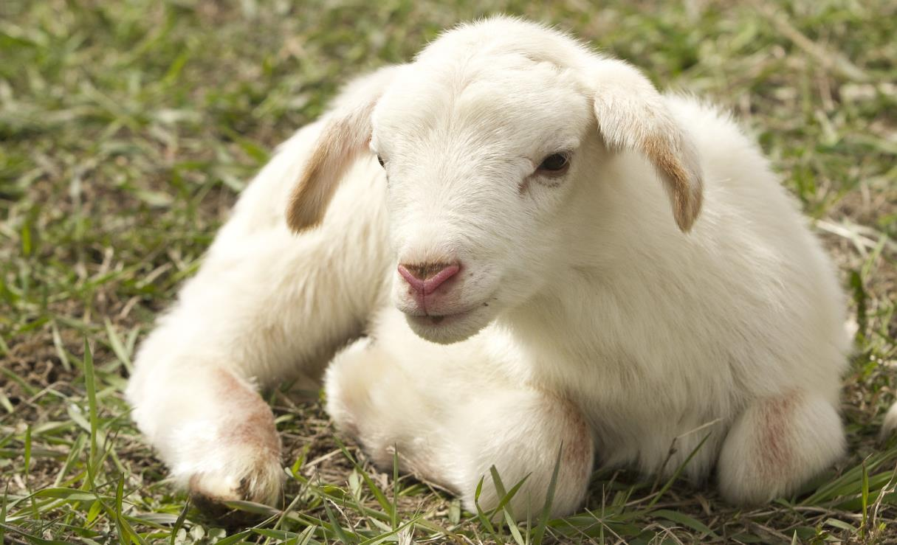
Behold! The Lamb of God who takes away the sin of the world! Jn 1:29
Notes:
Behold! The Lamb of God who takes away the sin of the world! Jn 1:29
It is possible that Jesus, the Lamb of God, may have been born into this world during the lambing season of Jewish sacrificial lambs.

Slide 84
Behold! The Lamb of God who takes away the sin of the world! Jn 1:29
Notes:
Behold! The Lamb of God who takes away the sin of the world! Jn 1:29

