Slide 1
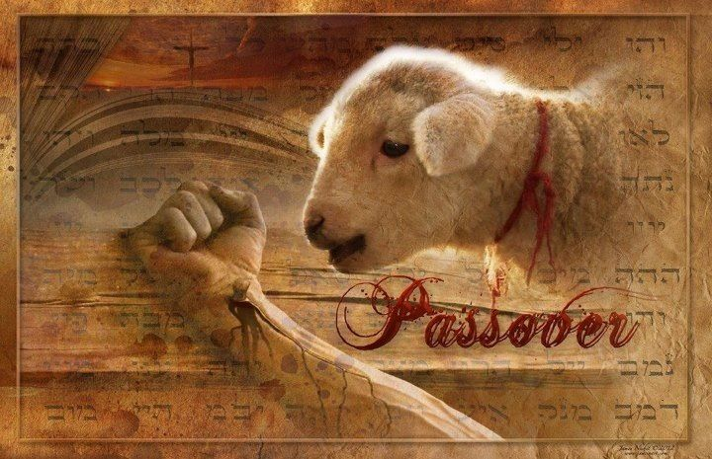
Jesus Our Sacrificial Lamb
Notes:
Jesus Our Sacrificial Lamb

Slide 2
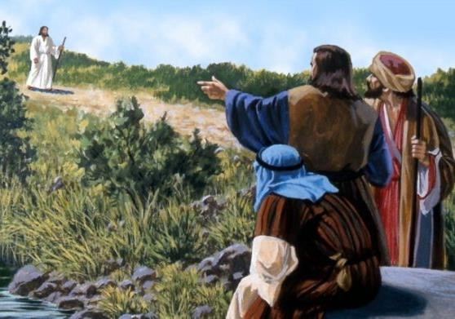
Introduction
John 1:29 The next day John saw Jesus coming toward him, and said, “Behold! The Lamb of God who takes away the sin of the world!
John 1:36 And looking at Jesus as He walked, he said, “Behold the Lamb of God!”
Notes:
Introduction
The apostle John called Jesus, the Lamb of God.
John 1:29 The next day John saw Jesus coming toward him, and said, “Behold! The Lamb of God who takes away the sin of the world!
John 1:36 And looking at Jesus as He walked, he said, “Behold the Lamb of God!”
What did John mean by this? To fully grasp John’s meaning, we need to go back in time before the beginning of creation.

Slide 3
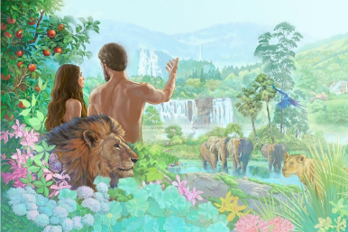
The Conflict of the Ages
The Establishment of the Kingdom
For in six days the LORD made the heavens and the earth, the sea, and all that is in them… –Ex. 20:11
Notes:
The Conflict of the Ages
The Establishment of the Kingdom
In eternity past, God decided to establish a kingdom in which He would rule as sovereign King. Besides having a king to rule, a kingdom requires two other things. First there must be a realm, or a kingdom over which to rule. Moses described the created universe like this: “In six days God created the heavens, the earth, the sea, and all that is in them (Ex. 20:11).” Secondly, a kingdom requires subjects over which to rule. So, God created the beings He would govern. God created two categories of beings—angels and humans.

Slide 4
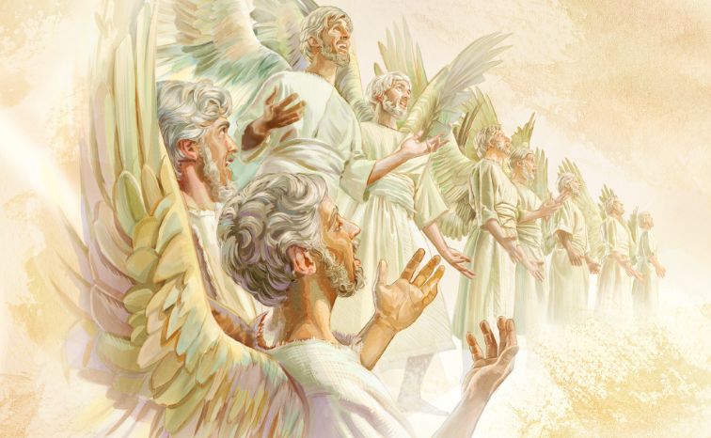
The Conflict of the Ages
The Establishment of the Kingdom
Praise the LORD! Praise the LORD from the heavens; Praise Him in the heights! Praise Him, all His angels; Praise Him, all His hosts! Let them praise the name of the LORD, For He commanded and they were created.
–Ps. 148:1, 2, 5
Notes:
God created angelic beings who were more powerful than any other created thing. Some angels were given greater power and authority than others. The Bible doesn’t specify the exact number of angels created by God, but it does mention a vast number.

Slide 5
The Conflict of the Ages
The Establishment of the Kingdom
So God created man in His own image; in the image of God He created him; male and female He created them. –Gen. 1:27
Notes:
God also created human beings for His kingdom. Since Earth was part of God’s domain, He created a being in His own likeness who would administer His rule over everything else on the planet. God created man and gave him dominion over the entire earthly province of His universal kingdom. Placing them as overseers of the Earth, He held them responsible for managing the planet on His behalf.

Slide 6
The Conflict of the Ages
The Establishment of the Kingdom
Dr. Andy Woods explains:
The biblical story of the kingdom begins as early as the Garden of Eden. Here, God placed Adam and Eve in a position of authority over God’s creation. … It should be noted that Adam and Eve were given authority over the physical realm (fish, birds, living things that move on the earth). Here, God arranged for humanity’s first couple to govern God’s creation on God’s behalf.
Notes:
Dr. Andy Woods explains:
The biblical story of the kingdom begins as early as the Garden of Eden. Here, God placed Adam and Eve in a position of authority over God’s creation. … It should be noted that Adam and Eve were given authority over the physical realm (fish, birds, living things that move on the earth). Here, God arranged for humanity’s first couple to govern God’s creation on God’s behalf.

Slide 7
The Conflict of the Ages
The Establishment of the Kingdom
Dr. Andy Woods explains:
The technical term for this hierarchy, where God rules over a man who in turn governs creation on God’s behalf, is the office of Theocratic Administrator. This term simply refers to someone who governs for God. In other words, God ruled the world indirectly through the first Adam.
Notes:
Dr. Andy Woods explains:
The technical term for this hierarchy, where God rules over a man who in turn governs creation on God’s behalf, is the office of Theocratic Administrator. This term simply refers to someone who governs for God. In other words, God ruled the world indirectly through the first Adam.

Slide 8
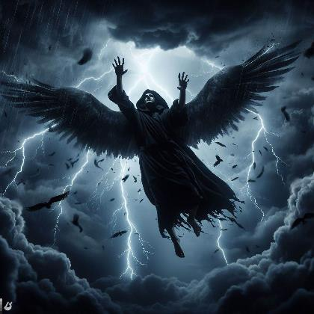
The Conflict of the Ages
The Rebellion of Satan
“How you are fallen from heaven, O Lucifer, son of the morning! … For you have said in your heart: ‘I will ascend into heaven, I will exalt my throne above the stars of God; … I will be like the Most High.’ –Is. 14:12-14
Notes:
The Conflict of the Ages
The Rebellion of Satan
One of the chief angels of God became extremely arrogant. He deluded himself into believing that he could challenge God’s supreme authority. He wanted to become the ruler of the entire universe by establishing his own kingdom. His goal was to wage war against God and ultimately overthrow His kingdom. Because of this angel’s rebellion against God, his name was changed to “Satan,” which means “adversary.” He became a rebel, the enemy of God and adversary of every member of God’s kingdom.

Slide 9
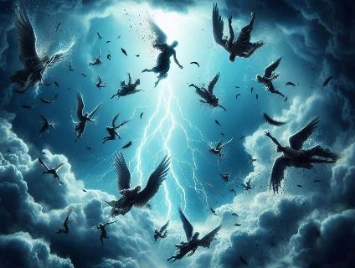
The Conflict of the Ages
The Rebellion of Other Angels
Satan needed to have subjects to rule over. He had to persuade other angels and humans to join him in his rebellion.
Notes:
The Conflict of the Ages
The Rebellion of Other Angels
To establish his own kingdom, Satan needed to have subjects to rule over. Since he was created being, he did not have the ability to create other beings. His only option was to convince God’s other creatures to join him in his rebellion. For his kingdom to include both heavenly and earthly dominions, he had to persuade other angels and humans to join him in his rebellion.

Slide 10
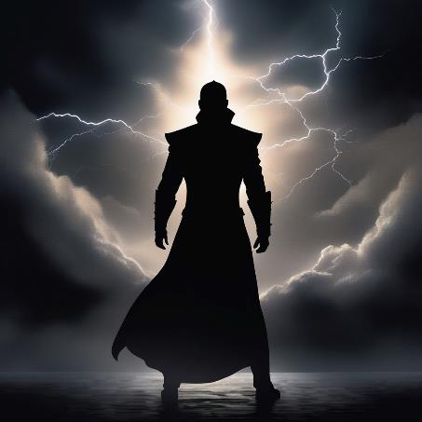
The Conflict of the Ages
The Rebellion of Other Angels
The prince of the power of the air” Eph. 2:2
Notes:
A substantial number of angels chose to join Satan’s rebellion and placed themselves under his authority. Satan became the leader of these fallen angels. Scripture refers to Satan “and his angels” and calls him “the prince of the power of the air” (Eph. 2:2).

Slide 11
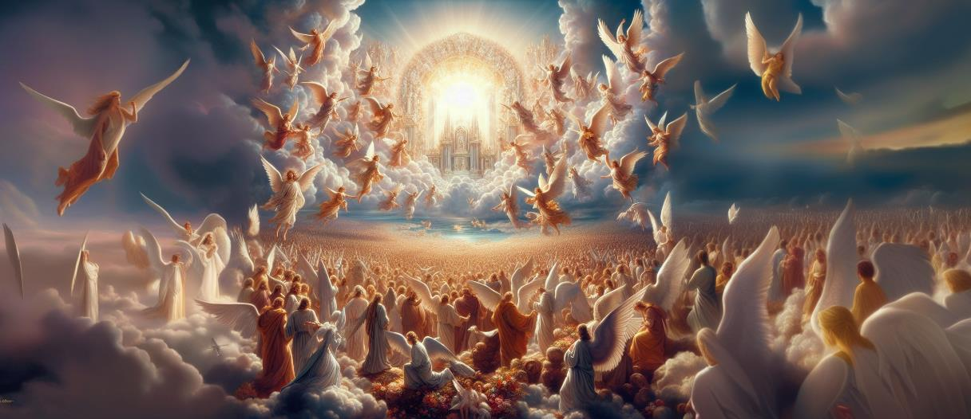
The Conflict of the Ages
The Rebellion of Other Angels
Notes:
Although many angels switched their loyalty from God’s kingdom to Satan’s, a vast host of angels remained faithful to God. These are referred to as the “holy” and “elect” angels. Therefore, God’s kingdom retained a multitude of angelic subjects who remained loyal to Him.

Slide 12
The Conflict of the Ages
The Rebellion of Mankind
Now the serpent was more cunning than any beast of the field which the LORD God had made. And he said to the woman, “Has God indeed said, ‘You shall not eat of every tree of the garden’?” –Gen. 3:1
Notes:
The Conflict of the Ages
The Rebellion of Mankind
Satan infiltrated the perfect environment on earth where humans lived. He enticed them to violate a specific command given to them by God. Satan lied to them, saying that if they disobeyed God’s command, then they would become like God (Gen. 3:15). In other words, he insinuated that humans could be in charge of their own lives and be their own rulers if they rebelled against God. Ignoring God’s warning, our first parents chose to disobey the command of their Creator. As a result, the ones who were responsible for overseeing the earthly part of God’s kingdom joined the rebellion against God.

Slide 13
The Conflict of the Ages
The Consequences of Rebellion
Adam and his wife hid themselves from the presence of the LORD God among the trees of the garden. –Gen. 3:8b
Notes:
The Conflict of the Ages
The Consequences of Rebellion
Man’s rebellion had catastrophic consequences.
When our first parents violated God’s command, they experienced a spiritual death at that moment of disobedience (Gen. 2:16-17). They acquired a sin nature resulting in hostility toward God (Rom. 8:7). Their relationship with God, who is the source of life, was severed.
Besides experiencing a spiritual death, physical death eventually became a reality for humans. Their rebellion began a process of physical decay in their bodies.

Slide 14
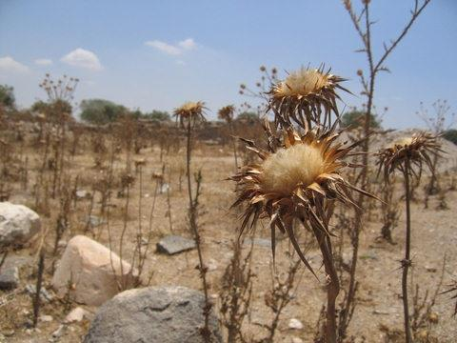
The Conflict of the Ages
The Consequences of Rebellion
Cursed is the ground for your sake; In toil you shall eat of it All the days of your life. Both thorns and thistles it shall bring forth for you. –Gen. 3:17-18
Notes:
As caretakers of God’s earthly dominion, man’s rebellion brought disaster to their domain. The earth’s fertility was greatly reduced (Gen. 3:17), and thorns and thistles emerged for the first time (Gen. 3:18). God’s earthly creation suffered from vanity and corruption due to human rebellion, leading to ongoing suffering and distress (Rom. 8:19-22). Through their sin, humans forfeited their once perfect environment.

Slide 15
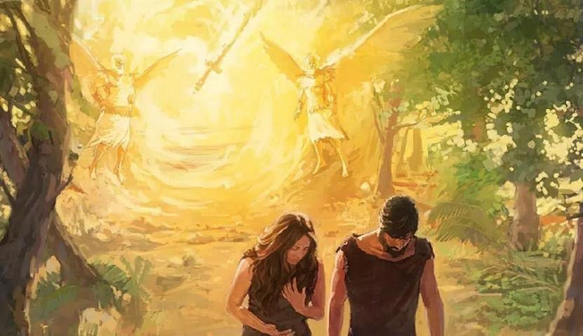
The Conflict of the Ages
The Consequences of Rebellion
Adam & Eve were banished to Satan’s domain
Notes:
Mankind was transferred from members of God’s kingdom to members of Satan’s dominion. This had ramifications for the entire human race as Adam’s sin nature was passed down to succeeding generations.

Slide 16
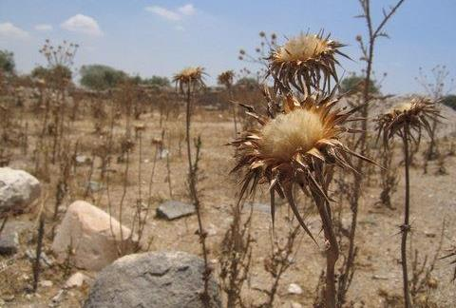
The Conflict of the Ages
The Consequences of Rebellion
Before the fall earth was a theocracy—governed by God.
After the fall earth became a “satanocracy”—rule by Satan.
Notes:
Originally Adam was the theocratic administrator of God’s earthly territory. However, when he rebelled against God, the theocracy ceased. Satan took control of the world system. The Earth’s governance shifted from a theocracy (rule by God) to a “satanocracy” (rule by Satan). For this reason, Christ referred to Satan as “the prince of this world” (Jn. 12:31; 14:30; 16:11), as Satan had the authority to offer all the kingdoms of the world to Christ (Lk. 4:5-6).

Slide 17
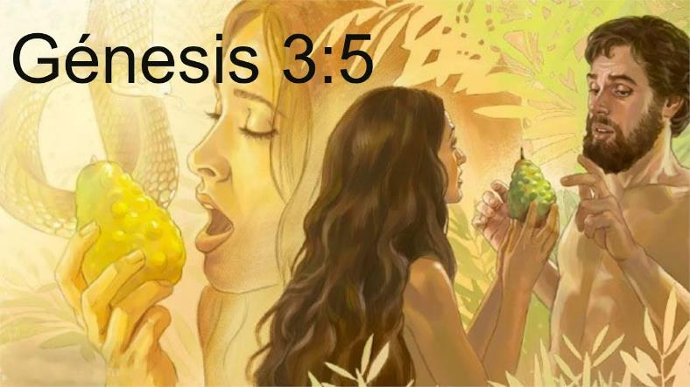
The Conflict of the Ages
The Consequences of Rebellion
Satan said to Eve, “You will be like God.”
Notes:
Our first parents were deceived by Satan into believing a lie (Jn. 8:44). Instead of becoming sovereign over their own lives, humans found themselves under the dominion of a new ruler. Their original King offered them life, peace, happiness, and fulfillment in exchange for willing obedience. Their new king became a harsh, self-serving taskmaster who inflicted upon them death, illness, conflict, sorrow, and frustration while demanding their service.

Slide 18
The Conflict of the Ages
The Consequences of Rebellion
Satan appeared to be victorious over God, however …
Notes:
With the fall of humanity, Satan succeeded in usurping God’s theocratic kingdom. He had succeeded in persuading numerous angels to join his realm and by deceit brought all of humanity into it also. He assumed control over the world system. In this challenge to God’s sovereignty, Satan appeared to be victorious over God.

Slide 19
The Promise of a Redeemer
God delivered a prophecy about Satan’s defeat:
So the LORD God said to the serpent: “Because you have done this, You are cursed more than all cattle, And more than every beast of the field; On your belly you shall go, And you shall eat dust All the days of your life. And I will put enmity Between you and the woman, And between your seed and her Seed; He shall bruise your head, And you shall bruise His heel.” –Gen. 3:14-15
Notes:
The Promise of a Redeemer
Almost immediately after Satan took control of the world system for his kingdom, God delivered a prophecy about Satan’s ultimate defeat.
Gen. 3:14-15 So the LORD God said to the serpent: “Because you have done this, You are cursed more than all cattle, And more than every beast of the field; On your belly you shall go, And you shall eat dust All the days of your life. And I will put enmity Between you and the woman, And between your seed and her Seed; He shall bruise your head, And you shall bruise His heel.”

Slide 20
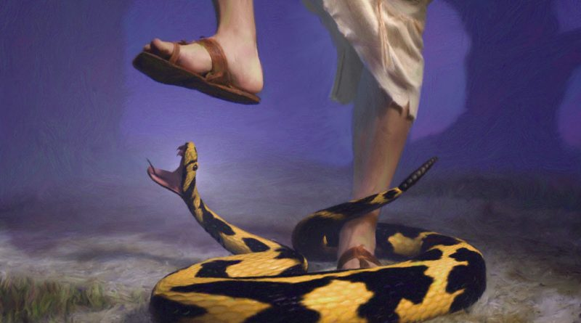
The Promise of a Redeemer
He shall bruise your head, And you shall bruise His heel. –Gen. 3:15b
Notes:
In this prophecy, God addressed Satan in the deceptive form of a serpent which he had assumed to tempt humanity. God warned Satan that, in the future, a man born of a woman would deliver a powerful blow to him. Later scriptures revealed that this prophecy marked God’s initial promise that a Redeemer would be born into the world. This Redeemer would undertake the necessary work to defeat Satan’s kingdom and plans. In other words, the Redeemer would be God’s Counterrevolutionary, enabling the overthrow of the great revolutionary, Satan. Therefore, the Redeemer was to play a pivotal role in fulfilling God’s purpose for history.

Slide 21
The Promise of a Redeemer
Notes:
To reverse the consequences of human sin, it was crucial to address the root cause, which was human sin itself. This meant dealing with human sinfulness. Later scriptures clarified that only the payment of an appropriate penalty to satisfy divine justice could eradicate human sin. It also revealed that death was the sole adequate penalty (Rom. 5:12; 6:23). In the Genesis 3:15 prophecy, God predicted that the Redeemer would ultimately defeat Satan, even though Satan would inflict harm upon Him. This was God’s way of conveying that, as a result of Satan’s actions, the promised Redeemer would experience death as a means to conquer Satan. Later scriptures further revealed that through His sacrificial death, the Redeemer would pay for humanity’s sin, leading to the removal of sin (Is. 53:4-6, 10-12; Jn. 1:29; 1 Pet. 2:24). This, in turn, made it possible for God to reverse the consequences of human rebellion.

Slide 22
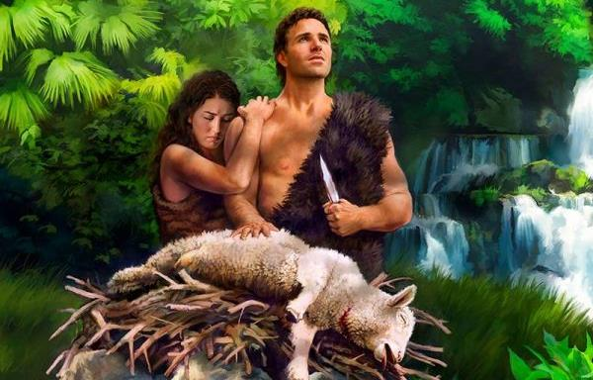
Some Portraits of this Redeemer
Garments of Skin
The LORD God made garments of skin for Adam and his wife, and clothed them. –Gen. 3:21
Notes:
Some Portraits of this Redeemer
Garments of Skin
In the Old Testament God gave us some pictures of this Redeemer.
Garments of Skin
Gen. 3:21 The LORD God made garments of skin for Adam and his wife, and clothed them.
God provided them with “garments of skin” that were adequate for their needs. Their own provision of fig leaves was not adequate. God did for them what they could not do for themselves.

Slide 23
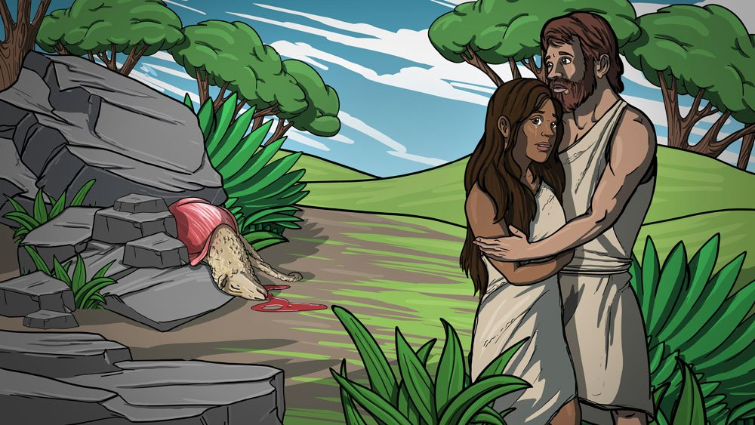
Some Portraits of this Redeemer
Garments of Skin
Notes:
Sin could not be covered up by a bunch of leaves taken from a bush. Sin required the death penalty. An animal had to be killed as a substitute. This does not seem fair. What did the animal do to deserve being killed? Nothing. But God used this as a picture of the sacrifice that Jesus would make on behalf of the sins of mankind.
It reasonable to assume that when God provided animal skins for Adam and Eve to wear that He also instructed them about the significance of the substitutionary sacrifice of the animal. No doubt they passed this understanding on to Cain and Abel.

Slide 24
Some Portraits of this Redeemer
Cain and Abel
Now Abel was a keeper of sheep, but Cain was a tiller of the ground. And in the process of time it came to pass that Cain brought an offering of the fruit of the ground to the LORD. Abel also brought of the firstborn of his flock and of their fat. And the LORD respected Abel and his offering, but He did not respect Cain and his offering. And Cain was very angry, and his countenance fell. So the LORD said to Cain, “Why are you angry? And why has your countenance fallen? If you do well, will you not be accepted? And if you do not do well, sin lies at the door. And its desire is for you, but you should rule over it.” –Gen. 4:2b-7
Notes:
Some Portraits of this Redeemer
Cain and Abel
Gen. 4:2b-7 Now Adam knew Eve his wife, and she conceived and bore Cain, and said, “I have acquired a man from the LORD.” Then she bore again, this time his brother Abel. Now Abel was a keeper of sheep, but Cain was a tiller of the ground. And in the process of time it came to pass that Cain brought an offering of the fruit of the ground to the LORD. Abel also brought of the firstborn of his flock and of their fat. And the LORD respected Abel and his offering, but He did not respect Cain and his offering. And Cain was very angry, and his countenance fell. So the LORD said to Cain, “Why are you angry? And why has your countenance fallen? If you do well, will you not be accepted? And if you do not do well, sin lies at the door. And its desire is for you, but you should rule over it.”

Slide 25
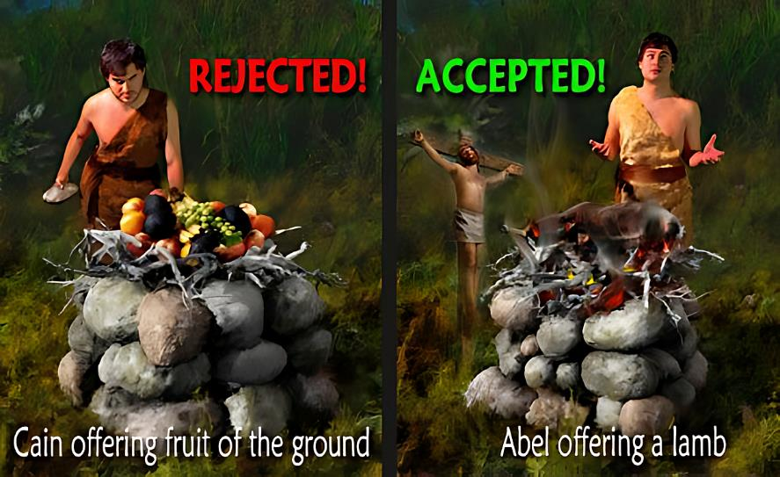
Some Portraits of this Redeemer
Cain and Abel
Notes:
Why did God accept Abel’s offering and not Cain’s offering? Scripture does not say. But they must have known about the substitutionary sacrifice of animal, or this passage would make no sense.

Slide 26
Some Portraits of this Redeemer
Cain and Abel
Dr. Andy Woods:
Abel’s sacrifice is accepted; Cain’s sacrifice is rejected. Why in the world would that happen? I think the answer is very simple. Cain came through the route of religion. He came to God through the route of good works. In fact, what Cain is doing here is no different than what Adam and Eve originally did after the fall.
Notes:
Dr. Andy Woods:
Abel’s sacrifice is accepted; Cain’s sacrifice is rejected. Why in the world would that happen? I think the answer is very simple. Cain came through the route of religion. He came to God through the route of good works. In fact, what Cain is doing here is no different than what Adam and Eve originally did after the fall.

Slide 27
Some Portraits of this Redeemer
Cain and Abel
Dr. Andy Woods:
Remember what they did in Genesis 3:7? It’s the first act of religion found anywhere in the Bible. It says, “Then the eyes of both of them were opened, and they knew they were naked; and they sewed fig leaves together and made themselves loin coverings.” They knew they had a problem and they tried to fix it through their own power. And that’s what religion is. It’s a system of works by which man tries to earn his way into God’s presence through his own “righteous,” deeds.
Notes:
Dr. Andy Woods:
Remember what they did in Genesis 3:7? It’s the first act of religion found anywhere in the Bible. It says, “Then the eyes of both of them were opened, and they knew they were naked; and they sewed fig leaves together and made themselves loin coverings.” They knew they had a problem and they tried to fix it through their own power. And that’s what religion is. It’s a system of works by which man tries to earn his way into God’s presence through his own “righteous,” deeds.

Slide 28
Some Portraits of this Redeemer
Cain and Abel
Dr. Andy Woods:
And that, in essence, is what Cain is doing when it talks here about how he brought to the LORD from the ground. Probably what Cain brought unto the LORD looked attractive. I would also think that Cain put a lot of effort into that, whatever it was from the ground. And despite the attractiveness of what he brought to the LORD, despite the energy that he put into this religious project, God simply did not look on it with favor, but with Abel’s sacrifice or worship, God looked on it with favor.
Notes:
Dr. Andy Woods:
And that, in essence, is what Cain is doing when it talks here about how he brought to the LORD from the ground. Probably what Cain brought unto the LORD looked attractive. I would also think that Cain put a lot of effort into that, whatever it was from the ground. And despite the attractiveness of what he brought to the LORD, despite the energy that he put into this religious project, God simply did not look on it with favor, but with Abel’s sacrifice or worship, God looked on it with favor.

Slide 29
Some Portraits of this Redeemer
Cain and Abel
Dr. Andy Woods:
Why is that? Because Cain brought to the LORD what was of the ground. Abel brought to the LORD from the flocks. See the difference? What comes from the ground does not constitute a blood sacrifice. What comes from the flocks does constitute a blood sacrifice.
The book of Hebrews 9:22 could not be clearer, it says, “…without the shedding of blood there is no forgiveness.”
Notes:
Dr. Andy Woods:
Why is that? Because Cain brought to the LORD what was of the ground. Abel brought to the LORD from the flocks. See the difference? What comes from the ground does not constitute a blood sacrifice. What comes from the flocks does constitute a blood sacrifice.
The book of Hebrews 9:22 could not be clearer, it says, “…without the shedding of blood there is no forgiveness.”

Slide 30
Some Portraits of this Redeemer
Cain and Abel
Dr. Andy Woods:
Abel’s sacrifice involved the shedding of innocent blood. Cain’s sacrifice did not. Cain did not come to God the way God had ordained. Abel did. Abel’s sacrifice is accepted. Cain’s sacrifice is rejected. Cain did not come the way God said. Abel did. Cain came through religion. Abel came through the … blood-sacrifice.
Notes:
Dr. Andy Woods:
Abel’s sacrifice involved the shedding of innocent blood. Cain’s sacrifice did not. Cain did not come to God the way God had ordained. Abel did. Abel’s sacrifice is accepted. Cain’s sacrifice is rejected. Cain did not come the way God said. Abel did. Cain came through religion. Abel came through the … blood-sacrifice.

Slide 31
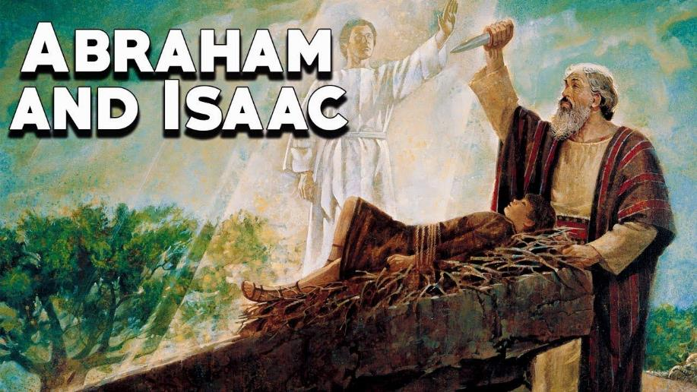
Some Portraits of this Redeemer
Abraham and Isaac
Notes:
Some Portraits of this Redeemer
Abraham and Isaac
Genesis 22:1-14 describes the account of Abraham’s faith when he was asked to sacrifice his son, Isaac, as a burnt offering on a mountain in the land of Moriah. Abraham and Isaac journey for 3 days until they reach the designated mountain. Isaac questions his father about the absence of a lamb for the offering. Abraham reassures Isaac that God will provide the lamb.
After reaching the mountain, Abraham builds an altar and binds Isaac, preparing to sacrifice him. However, just as Abraham is about to slay his son, an angel of the Lord intervenes, instructing him not to harm Isaac.
Looking up, Abraham sees a ram caught in a nearby thicket and offers it as a sacrifice instead of Isaac.

Slide 32
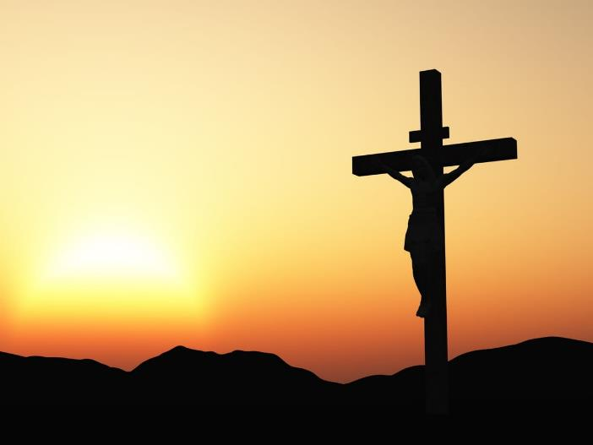
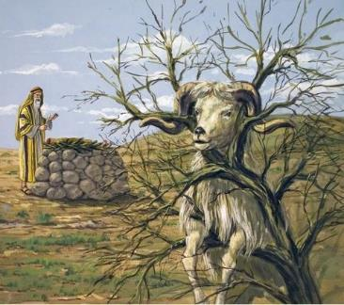
Some Portraits of this Redeemer
Abraham and Isaac
The ultimate substitutionary sacrifice was Jesus’ death on the cross. Just as the ram took Isaac’s place on the altar, Jesus took our place on the cross, bearing the punishment for sin that we deserved.
Notes:
This account is a powerful demonstration to Abraham’s unwavering faith and obedience to God, even when faced with an unimaginable task. It also shows the need for a substitutionary sacrifice. The ultimate substitutionary sacrifice was Jesus’ death on the cross. Just as the ram took Isaac’s place on the altar, Jesus took our place on the cross, bearing the punishment for sin that we deserved. This underscores the idea that a loving and merciful God would provide a substitute to bear the consequences of our sins. It’s a powerful illustration of the concept of grace and redemption through a substitutionary sacrifice.

Slide 33
Some Portraits of this Redeemer
Abraham and Isaac
“… go to the land of Moriah, and offer him there as a burnt offering on one of the mountains of which I shall tell you.”
–Gen. 22:2
MORIAH—Mount Moriah was the name of the hill on which Solomon built the temple.
Notes:
Genesis 22:2 “… go to the land of Moriah, and offer him there as a burnt offering on one of the mountains of which I shall tell you.”
MORIAH—Mount Moriah was the name of the hill just north of the City of David on which Solomon built the temple. And the temple was where animals were sacrificed for the sins of the people of Israel.

Slide 34
Some Portraits of this Redeemer
The Passover
… Christ, our Passover, was sacrificed for us. –1 Cor. 5:7b
Notes:
Some Portraits of this Redeemer
The Passover
Paul wrote: 1 Corinthians 5:7b … Christ, our Passover, was sacrificed for us.
The account of the Passover lamb is found in Exodus 12.
In Exodus 12, we find the account of Passover when God delivered the Children of Israel out of Egyptian bondage. Bible scholars have noted a beautiful progression in this passage of Scripture regarding the Passover lamb.

Slide 35
Some Portraits of this Redeemer
The Passover
First: “a lamb”
Speak to all the congregation of Israel, saying: “On the tenth of this month every man shall take for himself a lamb, according to the house of his father, a lamb for a household.”
–Ex. 12:3
Notes:
First the lamb is described with the indefinite article “a”.
Ex. 12:3 Speak to all the congregation of Israel, saying: “On the tenth of this month every man shall take for himself a lamb, according to the house of his father, a lamb for a household.”
An indefinite article does not specify the identity of the word it modifies.
In verse 3, the Passover lamb was referred to as simply “a lamb.” It was one of many lambs that could be chosen for the purpose at hand.

Slide 36
Some Portraits of this Redeemer
The Passover
John: Behold the Lamb of God… (Jn. 1:29, 36)
Jesus: I am the way, the truth, the life… (Jn. 14:6)
Peter: There is salvation in no one else, for there is no other name under heaven given to people by which we must be saved. (Acts 4:12)
Notes:
Many claim that Christianity is just one of many roads the lead to heaven. In other words, Jesus is just “a” path to God. But that is not what the Word of God says.
• John: Behold the Lamb of God… (Jn. 1:29, 36)
• Jesus: I am the way, the truth, the life… (Jn. 14:6)
• Peter: There is salvation in no one else, for there is no other name under heaven given to people by which we must be saved. (Acts 4:12)

Slide 37
Some Portraits of this Redeemer
The Passover
Second: “the lamb”
And if the household is too small for the lamb, let him and his neighbor next to his house take it according to the number of the persons; according to each man's need you shall make your count for the lamb. –Ex. 12:4
Notes:
Second the lamb is designated with the definite article “the”.
Ex. 12:4 And if the household is too small for the lamb, let him and his neighbor next to his house take it according to the number of the persons; according to each man's need you shall make your count for the lamb.
The lamb was not simply one of many lambs. It is now singled out as the specific lamb which was selected for the purpose at hand. That purpose was to be the Passover sacrifice.

Slide 38
Some Portraits of this Redeemer
The Passover
Third: “your lamb”
Your lamb shall be without blemish, a male of the first year. You may take it from the sheep or from the goats. –Ex. 12:5
But as many as received Him, to them He gave the right to become children of God, to those who believe in His name.
–Jn. 1:12
Notes:
Third the lamb is personalized with the possessive pronoun “your”.
Ex. 12:5 Your lamb shall be without blemish, a male of the first year. You may take it from the sheep or from the goats.
God’s free gift of salvation is personal.
Jn. 1:12 But as many as received Him, to them He gave the right to become children of God, to those who believe in His name.
The moment we believe in His name, we receive Christ as our personal Savior. What does it mean to “believe in His name?” It simply means to trust in who He is and what He accomplished on the cross by dying in our place as a substitutionary sacrifice for our sins.
The Bible says that whoever believes in Jesus has everlasting life. That means you can be sure of your salvation and never lose it. Jesus did everything for you when He died and rose again. He paid the full price for your sins and offers you forgiveness and eternal life as a free gift. You don’t have to do anything to earn it or keep it. You just have to accept it by faith. You don’t have to join a church, give money, or sign a card. It’s a matter of privacy between you and the Lord. When you place your trust Christ and what He did for you by dying in your place, then you receive His gift of eternal life.

Slide 39
The Table of Our Redeemer
When the hour had come, He sat down, and the twelve apostles with Him. Then He said to them, “With fervent desire I have desired to eat this Passover with you before I suffer; for I say to you, I will no longer eat of it until it is fulfilled in the kingdom of God.” Then He took the cup, and gave thanks, and said, “Take this and divide it among yourselves; for I say to you, I will not drink of the fruit of the vine until the kingdom of God comes.” And He took bread, gave thanks and broke it, and gave it to them, saying, “This is My body which is given for you; do this in remembrance of Me.” Likewise He also took the cup after supper, saying, “This cup is the new covenant in My blood, which is shed for you. –Lk. 22:14-20
Notes:
The Table of Our Redeemer
Luke 22:14–20 When the hour had come, He sat down, and the twelve apostles with Him. Then He said to them, “With fervent desire I have desired to eat this Passover with you before I suffer; for I say to you, I will no longer eat of it until it is fulfilled in the kingdom of God.” Then He took the cup, and gave thanks, and said, “Take this and divide it among yourselves; for I say to you, I will not drink of the fruit of the vine until the kingdom of God comes.” And He took bread, gave thanks and broke it, and gave it to them, saying, “This is My body which is given for you; do this in remembrance of Me.” Likewise He also took the cup after supper, saying, “This cup is the new covenant in My blood, which is shed for you.

Slide 40
The Table of Our Redeemer
When the hour had come, He sat down, and the twelve apostles with Him. Then He said to them, “With fervent desire I have desired to eat this Passover with you before I suffer; for I say to you, I will no longer eat of it until it is fulfilled in the kingdom of God.” Then He took the cup, and gave thanks, and said, “Take this and divide it among yourselves; for I say to you, I will not drink of the fruit of the vine until the kingdom of God comes.” And He took bread, gave thanks and broke it, and gave it to them, saying, “This is My body which is given for you; do this in remembrance of Me.” Likewise He also took the cup after supper, saying, “This cup is the new covenant in My blood, which is shed for you. –Lk. 22:14-20
"I have looked forward to this hour with deep longing, anxious to eat this Passover meal with you before my suffering begins.”
Notes:
In verse 15, Jesus said: “With fervent desire I have desired to eat this Passover with you before I suffer…”
A literal translation of the Greek phrase is “with desire I have desired.” It expresses intense desire.
<click>
(NLT) Jesus said, "I have looked forward to this hour with deep longing, anxious to eat this Passover meal with you before my suffering begins.”
Who were these men that Jesus desired to have one last meal with? What kind of characteristics were evident in their lives that caused Jesus to desire to have one last meal with them?

Slide 41
The Table of Our Redeemer
Now there was also a dispute among them, as to which of them should be considered the greatest. –Lk. 22:24
Notes:
Luke gives us a glimpse into the hearts of these men. immediately after the meal we read:
Luke 22:24 Now there was also a dispute among them, as to which of them should be considered the greatest.
The apostle John was at that Passover feast. He knew exactly what was in the hearts of his fellow disciples. And he added this nugget of truth which gives us a glimpse into the heart of Jesus.

Slide 42
The Table of Our Redeemer
Now before the Feast of the Passover, when Jesus knew that His hour had come that He should depart from this world to the Father, having loved His own who were in the world, He loved them to the end. –Jn. 13:1
Jesus knew that:
His disciples would argue about being the greatest.
Peter would deny Him.
His disciples would all forsake Him.
Yet, He loved them to the end!
Notes:
John 13:1 Now before the Feast of the Passover, when Jesus knew that His hour had come that He should depart from this world to the Father, having loved His own who were in the world, He loved them to the end.
Jesus knew that:
• After the meal His disciples would argue about which one of them would be the greatest.
• Peter would deny Him.
• His disciples would all forsake Him.
In spite of all that, He loved them to the end. And knowing all that would take place, He still desired to have this last meal with them.

Slide 43
A time of morbid introspection!
Make a list of all your sins!
Confess all your sins!
Repent of all your sins!
Notes:
For a long time, I viewed communion as a time of morbid introspection. It seemed as if the preacher was asking us to make a list of every unconfessed sin that we had ever committed. You needed to confess everything and promise to make things right before you could take communion.

Slide 44
But let a man examine himself, and if he has any unconfessed sin he better not eat of the bread and drink of the cup. –1 Cor. 11:28
Notes:
You better not take communion if there is unconfessed in your life or God will strike you dead. After all, Paul wrote:
1 Cor. 11:28 But let a man examine himself, and if he has any unconfessed sin he better not eat of the bread and drink of the cup.
No, that’s not what he said.

Slide 45
But let a man examine himself, and so let him eat of the bread and drink of the cup. –1 Cor. 11:28
Notes:
He actually said:
1 Cor. 11:28 But let a man examine himself, and so let him eat of the bread and drink of the cup.

Slide 46
Rob Ketcham:
“Many of us grew up in environments that were very performance based. You perform and you get the attention. You perform and you get the honors. Many of us grew up in MK schools (missionary kid schools), which were a performance-based environment.”
Notes:
Rob Ketcham: Many of us grew up in environments that were very performance based. You perform and you get the attention. You perform and you get the honors. Many of us grew up in MK schools (missionary kid schools), which were a performance-based environment.
Here’s the problem: NTM, is a mission that is known for clearly teaching the gospel of grace. But somehow that grace did not seem to translate to our MK schools.

Slide 47
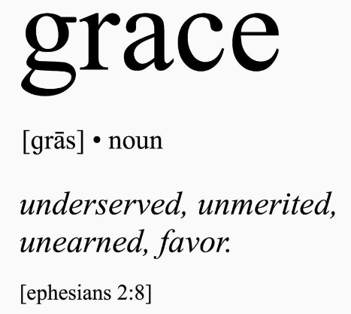
NTM Missionary:
“We should only give grace where grace is due.”
Notes:
A comment at worker’s conference: “We should only give grace where grace is due.”
<click>
By definition, grace is unmerited favor. You can never earn grace. It is undeserved. If you say that you only give grace when someone deserves grace, then you have effectively destroyed grace.

Slide 48
An Ethnos360 Missionary Kid wrote:
I remember when I was growing up … it was really pounded into us that we had to have all sin confessed before taking communion or we might be struck dead like Ananias and Sapphira. I made a mental list of everyone I thought I may have offended and made sure to talk to each one and ask them to forgive me. Then, I would take communion with fear and trembling, hoping I hadn’t forgotten to confess anything, and wondering if God was going to strike me dead because I’d forgotten something. I surreptitiously peeked at others that I was sure were going to die because I felt like they should have apologized to me, but they didn’t. If we weren’t sure we’d apologized to everyone and didn’t take communion, then someone would come and talk to us. Even sometimes when we thought we’d apologized to everyone and took communion, someone would talk to us afterwards and ask us if we’d apologized to so-and-so for such-and-such.
Notes:
Email from an MK: I remember when I was growing up … it was really pounded into us that we had to have all sin confessed before taking communion or we might be struck dead like Ananias and Sapphira. I made a mental list of everyone I thought I may have offended and made sure to talk to each one and ask them to forgive me. Then, I would take communion with fear and trembling, hoping I hadn’t forgotten to confess anything, and wondering if God was going to strike me dead because I’d forgotten something. I surreptitiously peeked at others that I was sure were going to die because I felt like they should have apologized to me, but they didn’t. If we weren’t sure we’d apologized to everyone and didn’t take communion, then someone would come and talk to us. Even sometimes when we thought we’d apologized to everyone and took communion, someone would talk to us afterwards and ask us if we’d apologized to so-and-so for such-and-such.

Slide 49
But let a man examine himself, and if he has any unconfessed sin he better not eat of the bread and drink of the cup. –1 Cor. 11:28
Notes:
I have been in a number of churches that viewed communion just like that. You better not take communion if there is unconfessed in your life or God will strike you dead. After all, Paul wrote:
1 Cor. 11:28 But let a man examine himself, and if he has any unconfessed sin he better not eat of the bread and drink of the cup.
Again, that’s not what he said.

Slide 50
But let a man examine himself, and so let him eat of the bread and drink of the cup. –1 Cor. 11:28
Notes:
Paul actually said:
1 Cor. 11:28 But let a man examine himself, and so let him eat of the bread and drink of the cup.

Slide 51
None of us are “worthy.”
If our “worthiness” were the requirement, then we should all go home.
Notes:
The fact is that none of us are “worthy” to partake of the Lord’s table. We are all miserable sinners. If our “worthiness” were the requirement, then we should all go home.

Slide 52
For he who eats and drinks in an unworthy manner eats and drinks judgment to himself, not discerning the Lord's body. –1 Cor. 11:29
Notes:
Paul wrote:
1 Cor. 11:29 For he who eats and drinks in an unworthy manner eats and drinks judgment to himself, not discerning the Lord's body.
Some of the Corinthians were drunk and others were snubbing their brothers and sisters. The Lord’s table had turned into a frivolous social gathering.

Slide 53
Paul was not addressing their unworthy character.
Paul was addressing their unworthy manner.
Notes:
Paul was not addressing the unworthy character of the Corinthian believers. The Corinthian church was one of the most dysfunctional churches in the first century. What Paul was addressing was the unworthy manner in which they conducted themselves at the Lord’s table.

Slide 54
If you are unworthy, then this table is for you!
Notes:
The fact the you are unworthy means that this table is for you. When we recognize that fact, then we come before the Lord in all humility. The fact is that we are ALL unworthy.

Slide 55
The Table of Our Redeemer
When the hour had come, He sat down, and the twelve apostles with Him. Then He said to them, “With fervent desire I have desired to eat this Passover with you before I suffer; for I say to you, I will no longer eat of it until it is fulfilled in the kingdom of God.” Then He took the cup, and gave thanks, and said, “Take this and divide it among yourselves; for I say to you, I will not drink of the fruit of the vine until the kingdom of God comes.” And He took bread, gave thanks and broke it, and gave it to them, saying, “This is My body which is given for you; do this in remembrance of Me.” Likewise He also took the cup after supper, saying, “This cup is the new covenant in My blood, which is shed for you. –Lk. 22:14-20
"I have looked forward to this hour with deep longing, anxious to eat this Passover meal with you before my suffering begins.”
Notes:
Jesus looked forward with deep longing, anxious to eat one last meal with His disciples. He poured out His heart to them in this manner in spite of the fact that they would shortly forsake and deny Him! Were they worthy of receiving communion in light of what they were about to do to our Lord? Hardly!

Slide 56
Grace extends its invitation regardless of our unworthiness!
Jesus says, “come and let us eat together.”
Notes:
But grace extends its invitation to partake regardless of the believer’s unworthiness!
With the same compassion, the Lord Jesus implored our Scottish brethren, “come and let us eat together”, yet sadly they turn their backs on our broken-hearted Savior!
This morning our Lord extends the same invitation to you and me. He says, “come and let us eat together.”
Are you unworthy? If so, then this table is for you.
Explain that we practice “open communion.” If you have trusted in Jesus Christ and His death on the cross for you, then we invite you to join us in eating and drinking of these elements. The elements are simply symbols of Jesus broken body and His shed blood. Some teach that the elements actually become the body and blood of Jesus. We do not believe that. Some teach that Jesus is present in these elements. We do not believe that either. They are merely symbols that help us remember what Jesus did for us at the cross.
Ask the men to come forward to pass out the elements.
Ask one of them to give thanks for the bread.
As they pass out the bread explain that we hold our portions and eat together.

Slide 57
The Table of Our Redeemer
For I received from the Lord that which I also delivered to you: that the Lord Jesus on the same night in which He was betrayed took bread; and when He had given thanks, He broke it and said, "Take, eat; this is My body which is broken for you; do this in remembrance of Me." –1 Cor. 11:23-24
Notes:
1 Cor. 11:23-24 For I received from the Lord that which I also delivered to you: that the Lord Jesus on the same night in which He was betrayed took bread; and when He had given thanks, He broke it and said, "Take, eat; this is My body which is broken for you; do this in remembrance of Me."
Let’s partake.

Slide 58
The Table of Our Redeemer
In the same manner He also took the cup after supper, saying, "This cup is the new covenant in My blood. This do, as often as you drink it, in remembrance of Me." For as often as you eat this bread and drink this cup, you proclaim the Lord's death till He comes. –1 Cor. 11:25-26
Notes:
1 Cor. 11:25-26 In the same manner He also took the cup after supper, saying, "This cup is the new covenant in My blood. This do, as often as you drink it, in remembrance of Me." For as often as you eat this bread and drink this cup, you proclaim the Lord's death till He comes.
Give thanks for the cup.
Hold your cup until everyone is served and we will drink together.
Before we drink, I want to share one more thought with you.

Slide 59
The Table of Our Redeemer
“But I say to you, I will not drink of this fruit of the vine from now on until that day when I drink it new with you in My Father's kingdom.”
–Mat. 26:29
Notes:
Mat. 26:29 But I say to you, I will not drink of this fruit of the vine from now on until that day when I drink it new with you in My Father's kingdom.“
The next time that Jesus drinks this cup, it will be with us in His Father’s Kingdom.

Slide 60
Notes:
A small country church in Wisconsin has a special tradition that they have used at the close of their communion services for a number of years. It is adapted from an ancient Jewish closing of the Passover meal.

Slide 61
The Table of Our Redeemer—The Toast
The Jewish custom is to end the Passover meal with a toast. Passover participants raise the cup and say, “Next year, in Jerusalem!”
Notes:
The Jewish custom is to end the Passover meal with a toast. Passover participants raise the cup and say, “Next year, in Jerusalem!”
Orthodox Jews express this messianic hope at the end of the Passover meal. Jerusalem refers to the future city and its rebuilt Temple when the Messiah comes.

Slide 62
The Table of Our Redeemer—The Toast
The Jewish custom is to end the Passover meal with a toast. Passover participants raise the cup and say, “Next year, in Jerusalem!”
“Next time with Christ!”
Notes:
At the close of communion, the members of this church raise their cups in anticipation and say, “Next time, with Christ!”

Slide 63
The Table of Our Redeemer—The Toast
“Next time with Christ!”
Notes:
Please stand and join me in a toast to our coming Messiah.
Please raise your cups and join me for a toast of blessing: “Next time, with Christ!”

Slide 64
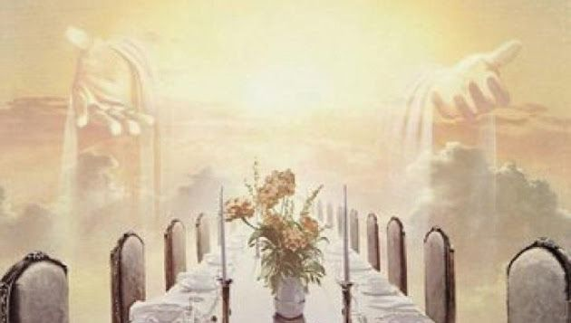
Maranatha!
Even so, Lord Jesus, come!
Notes:
Maranatha!
Even so, Lord Jesus, come!

