Slide 1
Now the Spirit expressly says that in latter times some will depart from the faith, giving heed to deceiving spirits and doctrines of demons. –1 Tim. 4:1
But know this, that in the last days perilous times will come. –2 Tim. 3:1
Notes:
1 Tim. 4:1 Now the Spirit expressly says that in latter times some will depart from the faith, giving heed to deceiving spirits and doctrines of demons.
2 Tim. 3:1 But know this, that in the last days perilous times will come.

Slide 2
David Jeremiah says apostasy among pastors a
sign of ‘great falling away’ ahead of End Times
Influential Pastor David Jeremiah has voiced his concerns about the seemingly increasing number of pastors and churches straying from biblical truth, warning that this trend indicates the “falling away” Scripture prophesies ahead of the End Times.
Notes:
The Christian Post: David Jeremiah says apostasy among pastors a sign of ‘great falling away’ ahead of End Times.
Influential Pastor David Jeremiah has voiced his concerns about the seemingly increasing number of pastors and churches straying from biblical truth, warning that this trend indicates the “falling away” Scripture prophesies ahead of the End Times.

Slide 3
“One of the things the Bible says is that during the time when we’re anticipating the rapture, there will be what they call the falling away, the apostasy, is what theologians call it.”
“There will be a time when people who once embraced the truth will fall away from the truth, and it will be an epidemic of this.”
Notes:
He said, “one of the things the Bible says is that during the time when we’re anticipating the rapture, there will be what they call the falling away, the apostasy, is what theologians call it. And if you study that, what it teaches is that there will be a time when people who once embraced the truth will fall away from the truth, and it will be an epidemic of this. Hardly a month goes by where you don’t hear somebody that you thought was straight and going in the right way and doing the right things and teaching the right truth, and now they don’t believe this anymore, or they’ve gotten in trouble, and they’re no longer in the ministry anymore.”

Slide 4
“The enemy is at work. The Bible says Satan goes about like a roaring lion seeking whom he may devour. And he doesn’t devour our bodies. Obviously, he devours our influence.”
“A lot of young guys who I know are saying, ‘I don’t believe there’s anything wrong with abortion,’ or ‘I don’t believe there’s anything wrong with homosexuality’.”
“That’s the falling away. That’s what the Bible says is going to happen, and it’s happening.”
Notes:
“The enemy is at work. The Bible says Satan goes about like a roaring lion seeking whom he may devour. And he doesn’t devour our bodies. Obviously, he devours our influence. … A lot of young guys who I know are saying, ‘I don’t believe there’s anything wrong with abortion,’ or ‘I don’t believe there’s anything wrong with homosexuality’ or all of these other issues. They once did, but now they don’t. That’s the falling away. That’s what the Bible says is going to happen, and it’s happening.”

Slide 5

The Last Days
of the Church
Notes:
This morning, I would like us to consider the “Last Days Apostasy of the Church.”
First, we will define apostasy. Then we will list its characteristics.

Slide 6
Definition of Apostasy
ἀποστασία (apostasia)
  apo = away from
  stasia = to stand
  Apostasy = Lit. to stand away from
  Apostasy = a departure
Notes:
Definition:
ἀποστασία (apostasia)
ἀπο “away from”
στασία “to stand”
Lit: “to stand away from”
It means” “a departure”

Slide 7
Definition of Apostasy
ἀποστασία (apostasia)
  Usually a departure from known
  (or previously embraced) truth.
  It is not about conditions in the world.
  It is about conditions in Christendom.
Notes:
It means “to depart from.” Typically to depart from known truth or from doctrine that was once acknowledged as truth.
Apostasy is not about conditions in the world. The world has no truth to depart from. It is about conditions in the church or within the ranks of Christendom or Christianity.

Slide 8
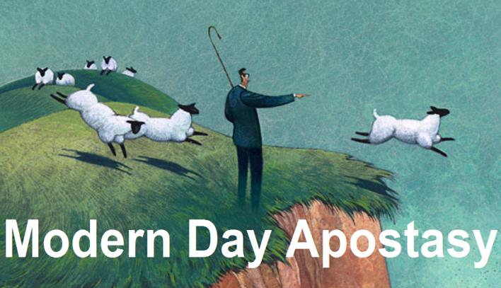
Ten Characteristics of Apostasy
Notes:
Now that we have defined “apostasy” we will next look at 10 characteristics of apostasy.

Slide 9
Apostasy is a Sign of the Last Days
Many signs in Scripture relate to the tribulation.
Events today could be setting the stage for the events of the tribulation.
Apostasy is related to the church itself.
Notes:
Characteristic #1: Apostasy is a sign of the last days or a sign of the end times.
Many signs of the last days are in relation to the world during the tribulation after the church is removed.
Events today could be setting the stage for events that take place during the tribulation.
While there are many signs in the world that could be setting the stage for the tribulation, we should remember that the sign of apostasy is related to the church itself.

Slide 10
Apostasy is a Sign of the Last Days
The enemy has used apostasy throughout history to deceive God’s people.
Evil men and impostors will grow worse and worse, deceiving and being deceived.
(2 Tim. 3:13).
Notes:
Apostasy is nothing new. It has been a tool the enemy has used throughout history to deceive God’s people.
However, Paul tells us that apostasy will grow worse and worse as God gets ready to wrap up His program with the church.
2 Tim. 3:13, “evil men and impostors will grow worse and worse, deceiving and being deceived.”
The rapid growth of apostasy is a sign of the last days.

Slide 11



Apostasy is a Sign of the Last Days
Notes:
Postmillennialism claims that the world will get better and better until it is “Christianized.” But this is in direct contradiction to what Paul wrote. He did not say that evil men will become less and less. The harsh fact is that two world wars dashed the hopes of Postmillennialism.

Slide 12
Apostasy is a Sign of the Last Days
Dominion Theology
Theonomy
Kingdom Now Theology
Christian Reconstructionism
Notes:
Yet Postmillennialism is making a come-back today in various forms. For example, Dominion Theology; Theonomy or Christian Reconstructionism; and Kingdom Now Theology.

Slide 13
Apostasy is a Sign of the Last Days
The Church will NOT:
  Go out on a note of optimism.
  Go out on a blaze of glory.
  Succeed in establishing the kingdom.
Notes:
As the church age is getting ready to wrap up.
Don’t look for the church to going out on a note of optimism.
Don’t look for the church going out on a blaze of glory.
Don’t look for the church succeeding in establishing the kingdom of God on the earth.

Slide 14
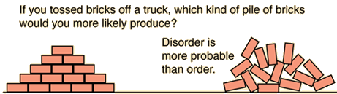
Apostasy is a Sign of the Last Days
The 2nd Law of Thermodynamics
Notes:
If you toss a load of bricks off the back of a truck, would you expect to find a pile of bricks stacked neatly or a bunch of bricks scattered all over the road?
The second law of thermal dynamics: things proceed from order to chaos. This is one reason that evolution cannot be true. This is true in the spiritual realm. The church will be marked by a progressive deterioration at the end of the church age.

Slide 15

Notes:
Matthew 13 contains a number of parables which characterize this church age that we are currently living in. These parables can be outlined like this:

Slide 16
Matthew 13 Parables
Sower
Wheat and tares
Mustard seed
Leaven
Earthen treasure
Pearl of great price
Dragnet
(1) There will be a sowing of the Word throughout the church age.
Notes:
(1) The Sower: There will be a sowing of the Word throughout the church age.

Slide 17
Matthew 13 Parables
Sower
Wheat and tares
Mustard seed
Leaven
Earthen treasure
Pearl of great price
Dragnet
(2) The sowing of the Word will be faked by a false counter sowing.
Notes:
(2) The Wheat and Tares: The sowing of the Word will be faked by a false counter sowing.

Slide 18
Matthew 13 Parables
Sower
Wheat and tares
Mustard seed
Leaven
Earthen treasure
Pearl of great price
Dragnet
(3) Christendom will experience massive outward growth.
Notes:
(3) The Mustard Seed: Christendom will experience massive outward growth.

Slide 19
Matthew 13 Parables
Sower
Wheat and tares
Mustard seed
Leaven
Earthen treasure
Pearl of great price
Dragnet
(4) But it will experience doctrinal corruption.
Notes:
(4) The Leaven: But it will experience doctrinal corruption.

Slide 20
Matthew 13 Parables
Sower
Wheat and tares
Mustard seed
Leaven
Earthen treasure
Pearl of great price
Dragnet
(5) The Lord will gain for Himself a peculiar treasure from among Israel.
Notes:
(5) The Earthen Treasure: The Lord will gain for Himself a peculiar treasure from among Israel.

Slide 21
Matthew 13 Parables
Sower
Wheat and tares
Mustard seed
Leaven
Earthen treasure
Pearl of great price
Dragnet
(6) He will also gain for Himself a unique treasure from the church.
Notes:
(6) The Pearl of Great Price: He will also gain for Himself a unique treasure from the church.

Slide 22
Matthew 13 Parables
Sower
Wheat and tares
Mustard seed
Leaven
Earthen treasure
Pearl of great price
Dragnet
(7) The age will end in judgment with the unbelievers being excluded from entering the Millennial kingdom. In contrast, believers will enter into the blessings of Messiah’s reign.
Notes:
(7) The Dragnet: The age will end in judgment with the unbelievers being excluded from entering the Millennial kingdom. In contrast, believers will enter into the blessings of Messiah’s reign.

Slide 23
The Parable of the Leaven
Sower (13:1-9, 18-23)
Wheat and tares (13:24-30, 36-43)
Mustard seed (13:31-32)
Leaven (13:33)
Earthen treasure (13:44)
Pearl of great price (13:45-46)
Dragnet (13:47-50)
Notes:
The parable of the leaven (aka yeast) is an apt description of the close of the church age in which we are living today.

Slide 24
The Parable of the Leaven
Mt. 13.33 He told them still another parable: "The kingdom of heaven is like yeast that a woman took and mixed into a large amount of flour until it worked all through the dough."
Mt. 16:6 And Jesus said to them, “Watch out and beware of the leaven of the Pharisees and Sadducees.”
Notes:
Mt. 13.33 He told them still another parable: "The kingdom of heaven is like yeast that a woman took and mixed into a large amount of flour until it worked all through the dough." (NIV)
Mt. 16:6, And Jesus said to them, “Watch out and beware of the leaven of the Pharisees and Sadducees.”

Slide 25


The Parable of the Leaven
2 Tim. 3:13, “But evil men and impostors will grow worse and worse, deceiving and being deceived.”
Notes:
The yeast spreads through the dough. Christendom will experience internal corruption to greater and greater degrees as the church age comes to a conclusion.
2 Tim. 3:13, “But evil men and impostors will grow worse and worse, deceiving and being deceived.”

Slide 26








































Notes:
Apostasy is a characteristic of the church in the last days. Each dispensation ends in failure.
<click>
Sadly, the church age is no different. It ends in failure.

Slide 27

Apostasy is A Massive NT Subject
Gospels (Matt 13)
Notes:
Characteristic #2: Apostasy is a massive New Testament subject.
Jesus predicted it in the Matthew 13 parables.

Slide 28
Apostasy is A Massive NT Subject
Gospels (Matt 13)
Early church (Acts 20:29-31)
  Acts 20:29-31 For I know this, that after my departure savage wolves will come in among you, not sparing the flock. Also from among yourselves men will rise up, speaking perverse things, to draw away the disciples after themselves. Therefore watch, and remember that for three years I did not cease to warn everyone night and day with tears.
Notes:
Characteristic #2: Apostasy is a massive New Testament subject.
Paul predicted it in Acts 20.
Acts 20:29-31 For I know this, that after my departure savage wolves will come in among you, not sparing the flock. Also from among yourselves men will rise up, speaking perverse things, to draw away the disciples after themselves. Therefore watch, and remember that for three years I did not cease to warn everyone night and day with tears.

Slide 29
Apostasy is A Massive NT Subject
Gospels (Matt 13)
Early church (Acts 20:29-31)
Pauline letters (Rom 16:17-18; Gal 1:6-9; 2 Cor 11:1-15; Phil 3:2, 18-19; Col 2:8; 1 Tim 4; 2 Tim 3–4; Titus 1:10)
Notes:
Characteristic #2: Apostasy is a massive New Testament subject.
Paul’s letters deals with warnings about apostasy. It is the second most frequently dealt with subject in the letters of Paul.

Slide 30
Apostasy is A Massive NT Subject
Gospels (Matt 13)
Early church (Acts 20:29-31)
Pauline letters (Rom 16:17-18; Gal 1:6-9; 2 Cor 11:1-15; Phil 3:2, 18-19; Col 2:8; 1 Tim 4; 2 Tim 3–4; Titus 1:10)
Revelation (2–3)
Notes:
Characteristic #2: Apostasy is a massive New Testament subject.
John warns about apostasy in Revelation. Five of the seven churches are in an apostate state.

Slide 31
Apostasy is A Massive NT Subject
Gospels (Matt 13)
Early church (Acts 20:29-31)
Pauline letters (Rom 16:17-18; Gal 1:6-9; 2 Cor 11:1-15; Phil 3:2, 18-19; Col 2:8; 1 Tim 4; 2 Tim 3–4; Titus 1:10)
Revelation (2–3)
General letters (Heb 2:1-4; 2 Pet 2–3; Jude; 1 John 4:1-6)
Notes:
Characteristic #2: Apostasy is a massive New Testament subject.
The General Letters: Hebrews, 2 Peter, Jude and 1 John dealt with false teaching, doctrinal errors and apostasy.

Slide 32
Apostasy Impacts Every Major Doctrine
  The faith
    Now the Spirit expressly says that in latter times some will depart from the faith, giving heed to deceiving spirits and doctrines of demons.
    1 Tim. 4:1
Notes:
Characteristic #3: Apostasy impacts every major doctrine.
The Faith: 1 Tim. 4:1 Now the Spirit expressly says that in latter times some will depart from the faith, giving heed to deceiving spirits and doctrines of demons.

Slide 33
Apostasy Impacts Every Major Doctrine
  God:
    For certain men have crept in unnoticed, who long ago were marked out for this condemnation, ungodly men, who … deny the only Lord God and our Lord Jesus Christ.
    Jude 1:4
Notes:
God: Jude 1:4 For certain men have crept in unnoticed, who long ago were marked out for this condemnation, ungodly men, who … deny the only Lord God and our Lord Jesus Christ.

Slide 34
Apostasy Impacts Every Major Doctrine
  Christ and His Death:
    But there were also false prophets among the people, even as there will be false teachers among you, who will secretly bring in destructive heresies, even denying the Lord who bought them, and bring on themselves swift destruction.
    2 Pet. 2:1
Notes:
Christ and His Death: 2 Pet. 2:1 But there were also false prophets among the people, even as there will be false teachers among you, who will secretly bring in destructive heresies, even denying the Lord who bought them, and bring on themselves swift destruction.

Slide 35
Apostasy Impacts Every Major Doctrine
  Christ’s Return:
    Knowing this first: that scoffers will come in the last days, walking according to their own lusts, and saying, "Where is the promise of His coming? For since the fathers fell asleep, all things continue as they were from the beginning of creation.“
    2 Pet. 3:3-4
Notes:
Christ’s Return: 2 Pet. 3:3-4 knowing this first: that scoffers will come in the last days, walking according to their own lusts, and saying, "Where is the promise of His coming? For since the fathers fell asleep, all things continue as they were from the beginning of creation."

Slide 36
Apostasy Impacts Every Major Doctrine
  Sound Doctrine:
    For the time will come when they will not endure sound doctrine, but according to their own desires, because they have itching ears, they will heap up for themselves teachers; and they will turn their ears away from the truth, and be turned aside to fables.
    2 Tim. 4:3-4
Notes:
Sound Doctrine: 2 Tim. 4:3-4 For the time will come when they will not endure sound doctrine, but according to their own desires, because they have itching ears, they will heap up for themselves teachers; and they will turn their ears away from the truth, and be turned aside to fables.

Slide 37
Apostasy Impacts Every Major Doctrine
  The Resurrection:
    But shun profane and idle babblings, for they will increase to more ungodliness. And their message will spread like cancer. Hymenaeus and Philetus are of this sort, who have strayed concerning the truth, saying that the resurrection is already past; and they overthrow the faith of some.
    2 Tim. 2:16-18
Notes:
The Resurrection: 2 Tim. 2:16-18 But shun profane and idle babblings, for they will increase to more ungodliness. And their message will spread like cancer. Hymenaeus and Philetus are of this sort, who have strayed concerning the truth, saying that the resurrection is already past; and they overthrow the faith of some.

Slide 38
Apostasy Impacts Every Major Doctrine
  God as Creator:
    For this they willfully forget: that by the word of God the heavens were of old, and the earth standing out of water and in the water.
    2 Pet. 3:5
Notes:
God as Creator: 2 Pet. 3:5 For this they willfully forget: that by the word of God the heavens were of old, and the earth standing out of water and in the water.

Slide 39
Apostasy happens inside the church
For I know this, that after my departure savage wolves will come in among you, not sparing the flock. Also from among yourselves men will rise up, speaking perverse things, to draw away the disciples after themselves. Therefore watch, and remember that for three years I did not cease to warn everyone night and day with tears.
Acts 20:29-31
Notes:
Characteristic #4: Apostasy happens inside the church.
Act 20:29-31 For I know this, that after my departure savage wolves will come in among you, not sparing the flock. Also from among yourselves men will rise up, speaking perverse things, to draw away the disciples after themselves. Therefore watch, and remember that for three years I did not cease to warn everyone night and day with tears.

Slide 40
Apostasy happens inside the church
For certain men have crept in unnoticed, who long ago were marked out for this condemnation, ungodly men, who turn the grace of our God into lewdness and deny the only Lord God and our Lord Jesus Christ.
Jude 4
Notes:
Jude 4 For certain men have crept in unnoticed, who long ago were marked out for this condemnation, ungodly men, who turn the grace of our God into lewdness and deny the only Lord God and our Lord Jesus Christ.

Slide 41

Apostasy happens inside the church
Twenty-six million Americans stopped reading the Bible in 2022.
A Bible reader is described as one who reads his or her Bible three times per year.
Notes:
The American Bible Society released the results of a startling survey. Roughly fifty percent of American adults reported reading Scripture at least three times a year from 2011 to 2021. In 2022, that number declined to thirty-nine percent. That means twenty-six million Americans stopped reading the Bible in 2022. Even more alarming than this drop in Bible reading is the idea that a Bible reader is described as one who reads his or her Bible three times per year.

Slide 42

Apostasy happens inside the church
Do you agree with the following statement?
“The Bible contains helpful accounts
of ancient myths but is not literally true.”
26% of evangelicals said “yes.”
Notes:
In 2022, LifeWay Research conducted a survey. They wanted to know how many evangelicals agreed with the following statement: “The Bible contains helpful accounts of ancient myths but is not literally true.”
In 2020, 15% of evangelicals agreed with that statement.
In 2022, 26% of evangelicals agreed with that statement.
The Evangelical church in America is in theological freefall.

Slide 43
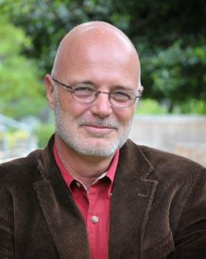
Apostasy happens inside the church
“I don’t think we’ve got the gospel right yet. What does it mean to be saved? None of us have arrived at orthodoxy.”
Brian McLaren
Notes:
Brian McLaren: Raised in the Brethren Assembly.
“I don’t think we’ve got the gospel right yet. What does it mean to be saved? None of us have arrived at orthodoxy.”

Slide 44
Apostasy happens inside the church
“Is getting individual souls into heaven the focal point of the Gospel? I’d have to say no, for any number of reasons. Don’t you think God is concerned about saving the whole world? It is the redemption of the world, the stars, the animals, the planets, the whole show.”
Brian McLaren
Notes:
“Is getting individual souls into heaven the focal point of the Gospel? I’d have to say no, for any number of reasons. Don’t you think God is concerned about saving the whole world? It is the redemption of the world, the stars, the animals, the planets, the whole show.”

Slide 45
Apostasy happens inside the church
“The church latched on to that old doctrine of original sin like a dog to a stick, and before you knew it, the whole gospel got twisted around it. Instead of being God’s big message of saving love for the whole world, the gospel became a little bit of secret information on how to solve the pesky legal problem of original sin.”
Brian McLaren
Notes:
“The church latched on to that old doctrine of original sin like a dog to a stick, and before you knew it, the whole gospel got twisted around it. Instead of being God’s big message of saving love for the whole world, the gospel became a little bit of secret information on how to solve the pesky legal problem of original sin.”

Slide 46

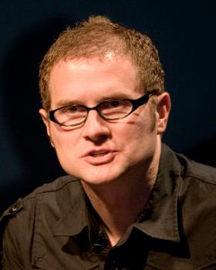
Apostasy happens inside the church
Given enough time everybody will turn to God.
Even the most “depraved sinners” will eventually give up their resistance and turn to God.
Hell is not forever, and love, in the end, wins and all will be reconciled to God.
Rob Bell
Notes:
Rob Bell: Pastored a Bible Church in Grandville, MI. Sherry Karum used to babysit his kids.
Love Wins: At the heart of this perspective is the belief that, given enough time, everybody will turn to God and find themselves in the joy and peace of God’s presence. The love of God will melt every hard heart, and even the most “depraved sinners” will eventually give up their resistance and turn to God…At the center of Christian tradition since the first church have been a number who insist that history is not tragic, hell is not forever, and love, in the end, wins and all will be reconciled to God.

Slide 47
Apostasy happens inside the church
Andy Woods:
  Don’t look for apostasy in the world. Look for it in books written by Christians. Look for it from pulpits occupied by so-called “men of God.” Look for it in so-called Christian schools. Look for it in so-called Christian seminaries.
Notes:
Andy Woods:
Don’t look for apostasy in the world. Look for it in books written by Christians. Look for it from pulpits occupied by so-called “men of God.” Look for it in so-called Christian schools. Look for it in so-called Christian seminaries.

Slide 48
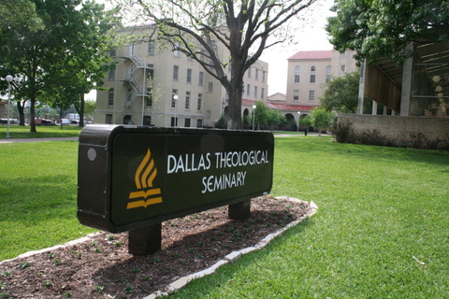
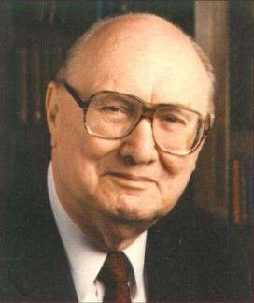
Apostasy happens inside the church
Dr. John Walvoord
President of DTS
1952 to 1986
Notes:
Dr. John Walvoord was President of DTS 1952 to 1986

Slide 49
Apostasy happens inside the church
Dr. John Walvoord:
  In all of my study of church history, here’s how it always works. Somebody gets into a position of teaching and they start to say things that aren’t quite right, a little off, and typically what happens is Satan puts that person in that position at a time when the school has very weak leadership and a non-aggressive president.
Notes:
Dr. John Walvoord:
In all of my study of church history, here’s how it always works. Somebody gets into a position of teaching and they start to say things that aren’t quite right, a little off, and typically what happens is Satan puts that person in that position at a time when the school has very weak leadership and a non-aggressive president.

Slide 50
Apostasy happens inside the church
Dr. John Walvoord:
  And nobody really challenges what this faculty member is saying because after all, they have the PhD from Europe so they know everything, right? And as that unchallenged person begins to promote their ideas another faculty member gets contaminated and another one, and another one.
Notes:
Dr. John Walvoord:
And nobody really challenges what this faculty member is saying because after all, they have the PhD from Europe so they know everything, right? And as that unchallenged person begins to promote their ideas another faculty member gets contaminated and another one, and another one.

Slide 51
Apostasy happens inside the church
Dr. John Walvoord:
  And eventually what you have is a whole school, if you’re not careful, has moved away from its theological position.
Notes:
Dr. John Walvoord:
And eventually what you have is a whole school, if you’re not careful, has moved away from its theological position.

Slide 52

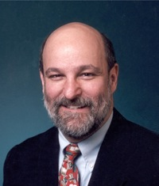
Apostasy happens inside the church
The definitive
book promoting
Progressive Dispensationalism
Darrell Bock
Professor @ DTS
PhD from Aberdeen
Published: 1992
Notes:
Darrell Bock:
Co-Author of the leading book promoting Progressive Dispensationalism.

Slide 53
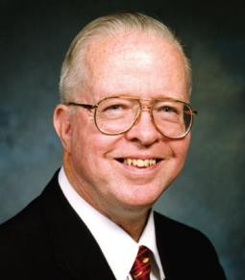
Apostasy happens inside the church
Darrell Bock
Professor @ DTS
PhD from Aberdeen
Zane Hodges
“Darrell has told me both in person and in writing that his position is "soft lordship" salvation--a view that would have been rejected by the founder and first president of Dallas Seminary, Dr. Lewis Sperry Chafer.”
Notes:
Zane Hodges: “Darrell has told me both in person and in writing that his position is "soft lordship" salvation--a view that would have been rejected by the founder and first president of Dallas Seminary, Dr. Lewis Sperry Chafer.”

Slide 54
Apostasy happens inside the church
Dr. John Walvoord:
  And nobody really challenges what this faculty member is saying because after all, they have the PhD from Europe so they know everything, right? And as that unchallenged person begins to promote their ideas another faculty member gets contaminated and another one, and another one.
Darrell Bock
Professor @ DTS
PhD from Aberdeen
Notes:
Dr. Walvoord was prophet when he made that statement.
And nobody really challenges what this faculty member is saying because after all, they have the PhD from Europe so they know everything, right? And as that unchallenged person begins to promote their ideas another faculty member gets contaminated and another one, and another one.
Where did Darrell Bock his PhD? From the University of Aberdeen in Scotland.

Slide 55


Apostasy Knows No Limits
Notes:
Characteristic #5: Apostasy knows no limits.
You say to yourself, “Professor _______ would be the last person ever to be involved in apostasy.” Yet, they are often the ones leading the charge.

Slide 56
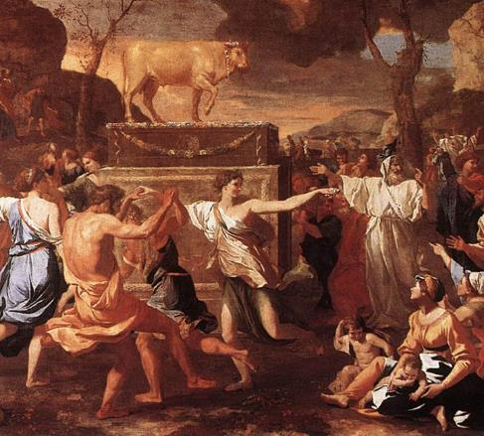
Apostasy Knows No Limits
Aaron (Exodus 32)
Now when the people saw that Moses delayed coming down from the mountain, the people gathered together to Aaron, and said to him, "Come, make us gods that shall go before us; for as for this Moses, the man who brought us up out of the land of Egypt, we do not know what has become of him."
Ex 32:1
Notes:
Aaron was responsible for the apostasy among the children of Israel.
Ex 32:1 Now when the people saw that Moses delayed coming down from the mountain, the people gathered together to Aaron, and said to him, "Come, make us gods that shall go before us; for as for this Moses, the man who brought us up out of the land of Egypt, we do not know what has become of him."

Slide 57
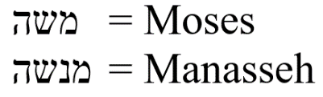
Apostasy Knows No Limits
Jonathan, the son of Gershom (Judges 18:30)
Then the children of Dan set up for themselves the carved image; and Jonathan the son of Gershom, the son of Manasseh¹, and his sons were priests to the tribe of Dan until the day of the captivity of the land. (NKJV)
¹ Manasseh = Moses
Notes:
Judges 18:30 Then the children of Dan set up for themselves the carved image; and Jonathan the son of Gershom, the son of Manasseh, and his sons were priests to the tribe of Dan until the day of the captivity of the land. (NKJV)
Jonathan was the son of Gershom. Gershom was the son of Manasseh (KJV, NKJV, NASB).
Click: See footnote to the NKJV & NASB.
The ESV, HCSB, NET, NIV, & NLT: Moses. Why? To safeguard Moses’ reputation of by not associating him with his idolatrous grandson.
Click: The Massoretic Text inserts a suspended nun.
Who brought idolatry into the land? It was none other than Moses’ grandson.

Slide 58

Apostasy Knows No Limits
Freedom is never more than one generation away from extinction. We didn't pass it to our children in the bloodstream.
Notes:
Ronald Reagan: Freedom is never more than one generation away from extinction. We didn't pass it to our children in the bloodstream.
The same could be said for the church. Sound doctrine is never more than one generation away from extinction.

Slide 59
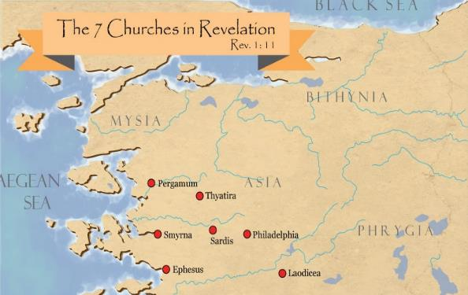
Apostasy Knows No Limits
But I have this against you, that you have left your first love (Rev 2:4).
The Church at Ephesus:
  Planted by Paul
  Priscilla & Aquilla
  Timothy was pastor
  John was bishop
  Books of Act: a key church
Notes:
To the church at Ephesus Jesus said: But I have this against you, that you have left your first love (Rev 2:4).
The church at Ephesus was planted by Paul. Priscilla and Aquila ministered there. Timothy became the pastor of the church at Ephesus. John became bishop over Ephesus. Ephesus is the key church that’s vibrant and on fire in the book of Acts. But in 96AD, Jesus told that church that it had left its first love.

Slide 60
Apostasy Knows No Limits
“Let every student be plainly instructed and earnestly pressed to consider well the main end of his life and studies is to know God and Jesus Christ which is eternal life (John 17:3) and therefore to lay Christ in the bottom as the only foundation of all sound knowledge and learning. And seeing the Lord only giveth wisdom, let everyone seriously set himself by prayer in secret to seek it of Him (Prov. 2, 3). Everyone shall exercise himself in reading the Scriptures twice a day that he shall be ready to give such an account of his proficiency therein.”
Rules of Harvard in 1636; quoted in David Barton, Original Intent, 81
Notes:
The following is from a major university in colonial America:
“Let every student be plainly instructed and earnestly pressed to consider well the main end of his life and studies is to know God and Jesus Christ which is eternal life (John 17:3) and therefore to lay Christ in the bottom as the only foundation of all sound knowledge and learning. And seeing the Lord only giveth wisdom, let everyone seriously set himself by prayer in secret to seek it of Him (Prov. 2, 3). Everyone shall exercise himself in reading the Scriptures twice a day that he shall be ready to give such an account of his proficiency therein.”
Any guesses as to which university required their students to follow those instructions?
<click>
Harvard was a top-notch theological school in colonial America. Harvard was where ministers were trained to be preachers and teachers of the gospel. Many of our Founding Fathers who believed that the Bible was the Word of God were educated at Harvard. Today there is not a hint or trace of Biblicism or evangelicalism at Harvard, other than a few things engraved in the wall by a prior generation.

Slide 61
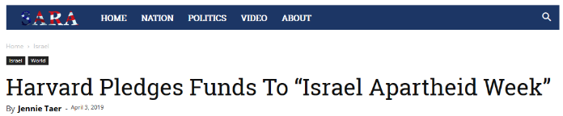
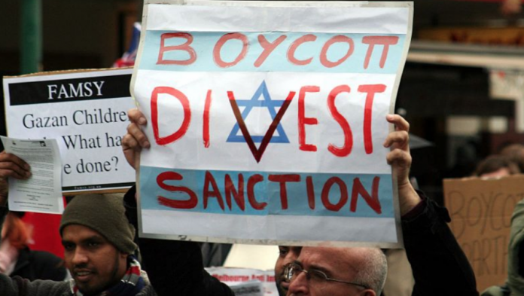
Apostasy Knows No Limits
Hosted at Harvard by the Palestine Solidarity Committee, Israel Apartheid Week aims to bolster the Palestinian-led boycott, divestment, and sanctions (BDS) campaign against Israel.
Notes:
Today Harvard has departed from the Christian faith. Yet had you predicted this in 1636, you would have been a laughing-stock. Surely, not Harvard!
Today Harvard supports the Boycott, Divestment, Sanctions (BDS) movement which works to end international support for Israel’s alleged oppression of Palestinians.

Slide 62
Apostasy Knows No Limits
Notes:
But the BDS movement is not just limited to Harvard. Today, 10 major denominations support the Boycott, Divestment and Sanctions (BDS) movement.

Slide 63
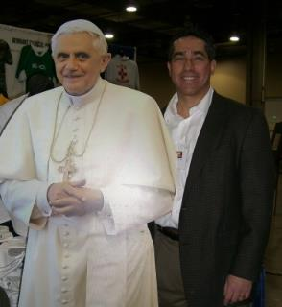

Francis Beckwith was president of The Evangelical Theological Society
Apostasy Knows No Limits
Notes:
The Evangelical Theological Society is the leading think-tank among conservative Bible scholars in the world. Frances Beckwith was president of ETS in 2007.
Beckwith was probably considered the top conservative Bible scholar in the world at that time. Beckwith grew up as a Roman Catholic. Later in his life he converted to a Protestant. In the middle of his tenure as president of ETS, he went back to Catholicism.

Slide 64
Apostasy Can Happen Quickly
I marvel that you are turning away so soon from Him who called you in the grace of Christ, to a different gospel, which is not another; but there are some who trouble you and want to pervert the gospel of Christ.
Gal 1:6-7
ταχέως (tacheōs): quickly, shortly
NASB: so quickly
Notes:
Characteristic #6: Apostasy can happen very quickly.
Gal 1:6-7 I marvel that you are turning away so soon from Him who called you in the grace of Christ, to a different gospel, which is not another; but there are some who trouble you and want to pervert the gospel of Christ.
ταχέως (tacheōs): quickly, shortly
NASB: so quickly
It only took between 6-12 months for the Galatians to turn away from the gospel.

Slide 65
Apostasy Can Happen Quickly
And the LORD said to Moses, "Go, get down! For your people whom you brought out of the land of Egypt have corrupted themselves. They have turned aside quickly out of the way which I commanded them. They have made themselves a molded calf, and worshiped it and sacrificed to it, and said, "This is your god, O Israel, that brought you out of the land of Egypt!“’
Ex. 32:7-8
Notes:
Ex. 32:7-8 And the LORD said to Moses, "Go, get down! For your people whom you brought out of the land of Egypt have corrupted themselves. They have turned aside quickly out of the way which I commanded them. They have made themselves a molded calf, and worshiped it and sacrificed to it, and said, "This is your god, O Israel, that brought you out of the land of Egypt!"'
Moses was on the mountain for 40 days.

Slide 66
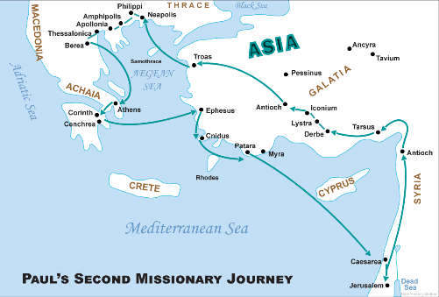
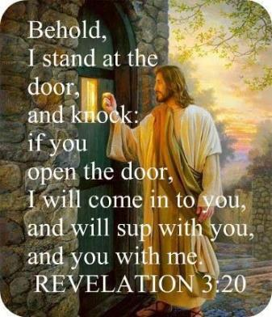
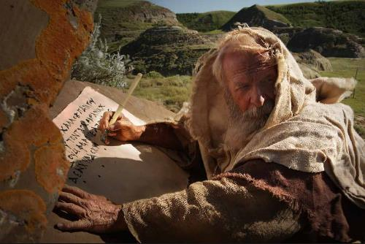
Apostasy Can Happen Quickly
But I have this against you, that you have left your first love (Rev 2:4).
A.D. 96
A.D. 52
44 years later
Notes:
Rev. 2: 4 But I have this against you, that you have left your first love.
A.D. 52—On Paul’s second mission journey, he visited Ephesus after leaving Corinth, and evidently planted the church there (Acts 18:19).
A.D. 67—Paul’s second letter to Timothy, who was pastor of the Ephesian church (less than 30 years).
A.D. 96—The Book of Revelation was written.
After 44 years Jesus was on the outside knocking at the church door.

Slide 67

Apostasy Is Satanically Orchestrated
“But I fear, lest somehow, as the serpent deceived Eve by his craftiness, so your minds may be corrupted by from the simplicity that is in Christ.”
2 Cor 11:3
Notes:
Characteristic #7: Apostasy is satanically orchestrated.
2 Cor. 11:3 But I fear, lest somehow, as the serpent deceived Eve by his craftiness, so your minds may be corrupted from the simplicity that is in Christ.

Slide 68
Apostasy Is Satanically Orchestrated
“Now the Spirit expressly says that in the latter times some will depart from the faith giving heed to deceiving spirits and doctrines of demons.”
1 Tim 4:1
Notes:
1 Tim. 4:1 Now the Spirit expressly says that in latter times some will depart from the faith, giving heed to deceiving spirits and doctrines of demons,

Slide 69
Apostasy Is Destructive
I know that after my departure savage wolves will come in among you, not sparing the flock.
Acts 20:29
Notes:
Characteristic #8: Apostasy is destructive.
Paul told the Ephesian elders…
Acts 20:29, I know that after my departure savage wolves will come in among you, not sparing the flock.

Slide 70
Apostasy Is Destructive
…having faith and a good conscience, which some have rejected concerning the faith, having suffered shipwreck.
1 Tim. 1:19
Notes:
1 Tim. 1:19 …having faith and a good conscience, which some have rejected concerning the faith, having suffered shipwreck.

Slide 71
Apostasy Is Destructive
But shun profane and idle babblings, for they will increase to more ungodliness. And their message will spread like cancer. Hymenaeus and Philetus are of this sort, who have strayed concerning the truth, saying that the resurrection is already past; and they overthrow the faith of some.
2 Tim. 2:16-18
Notes:
2 Tim. 2:16-18 But shun profane and idle babblings, for they will increase to more ungodliness. And their message will spread like cancer. Hymenaeus and Philetus are of this sort, who have strayed concerning the truth, saying that the resurrection is already past; and they overthrow the faith of some.

Slide 72
Apostasy makes life difficult for the people of God.
Yes, and all who desire to live godly in Christ Jesus will suffer persecution.
2 Tim. 3:12
Notes:
Characteristic #9: Apostasy makes life difficult for the people of God.
2 Tim. 3:12 Yes, and all who desire to live godly in Christ Jesus will suffer persecution.
Unfortunately, much of the persecution comes from within the church.

Slide 73

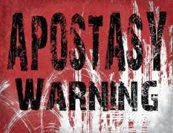
Apostasy impacts those who have not taken preventive measures.
“I didn’t see that coming.”
Notes:
Characteristic #10: Apostasy impacts those who have not taken preventive measures.
The church in America is asleep at the wheel. Her last words will probably be: “I didn’t see that coming.”

Slide 74

Apostasy impacts those who have not taken preventive measures.
Apostasy Is Inevitable
Notes:
Apostasy is inevitable. Paul does not tell us how to stop apostasy. He does warn us about apostasy.

Slide 75
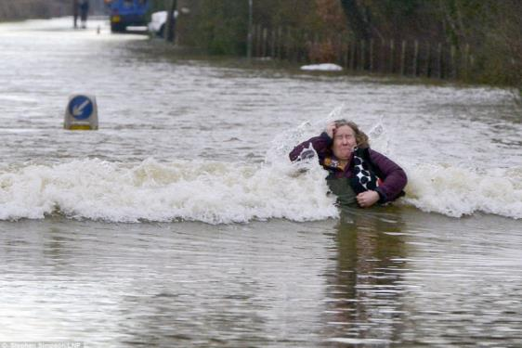
Apostasy impacts those who have not taken preventive measures.
Notes:
Paul tell us how we can avoid being swept away by the coming tide of apostasy.
The current will pull us downstream unless we take action.
There is a war on for our minds, both in the church and outside the church.
We must be in God’s Word, or we are in danger of being pulled in a direction we don’t want to go.

Slide 76
Conclusion
Remedy:
  Test all things; hold fast what is good.
  1 Thes. 5:21
Notes:
Remedy:
1 Thes. 5:21 Test all things; hold fast what is good.

Slide 77
Conclusion
Remedy:
  Do not be conformed to this world, but be transformed by the renewing of your mind.
  Rom. 12:2
Notes:
Rom. 12:2 Do not be conformed to this world, but be transformed by the renewing of your mind.

Slide 78
Conclusion
Remedy:
  Put on the full armor of God.
  Eph. 6:11
Notes:
Eph. 6:11 Put on the full armor of God.
That includes the sword of the Spirit which is the Word of God. Are you dressed for success? Have you put on the full armor of God?

Slide 79
Conclusion
Remedy:
  Contend earnestly for the faith.
  Jude 3
Notes:
Jude 3 Contend earnestly for the faith.

Slide 80
Conclusion
Latin proverb:
Praemonitus, praemunitus
“to be forewarned is to be forearmed”
Notes:
Latin proverb, Praemonitus, praemunitus
“to be forewarned is to be forearmed”

Slide 81

Notes:
Forewarned, forearmed; to be prepared is half the victory!
Miguel de Cervantes Saavedra was a Spanish writer who is widely regarded as the greatest writer in the Spanish language and one of the world's preeminent novelists. His novel Don Quixote has been translated into over 140 languages and dialects; it is, after the Bible, the most-translated book in the world.

